Slide 1
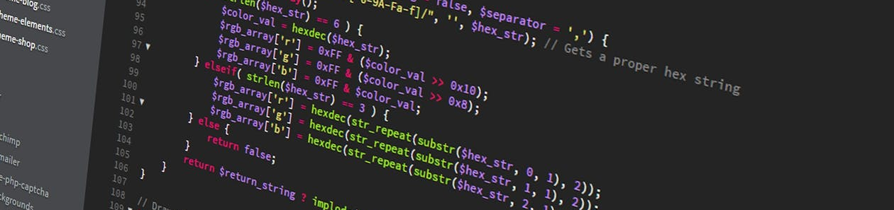

Practical Machine Learning
Supervised vs. Unsupervised Learning

Slide 2


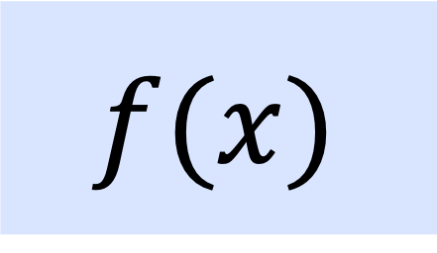
Introduction into Machine Learning
$$x$$
$$f(x)$$
$$y$$
Input
Model
Output

Slide 3
Introduction into Machine Learning
$$f(x)$$
🐩
dog
Model?
*object recognition

Slide 4
Types of ML Problems
What can we learn just by looking at the data?
🐩
🐆
🐈
🐕
🦍
🐴
🐶

Slide 5
Types of ML Problems
What can we learn just by looking at the data?
🐩
🐆
🐈
🐕
🦍
🐴
🐶

Slide 6
Types of ML Problems
What can we do with binned data?
Wild Animals
🐩
🐆
?
Domestic Animals
🐈
🐈
🐕
🦍
🐴
🐶

Slide 7
Types of ML Problems
What can we do with binned data?
Wild Animals
🐩
🐆
?
Domestic Animals
🐈
🐈
🐕
🐖
🦍
🐘
🐴
🐶

Slide 8
Learning Strategies
Supervised Learning
Unsupervised Learning

Slide 9
Learning Strategies
Supervised Learning
Unsupervised Learning
Reinforcement learning

Slide 10
Learning Strategies
 | Supervised Learning | Unsupervised Learning
Discrete | Classification or Categorization | Clustering
Continuous | Regression | Dimensionality reduction

Slide 11
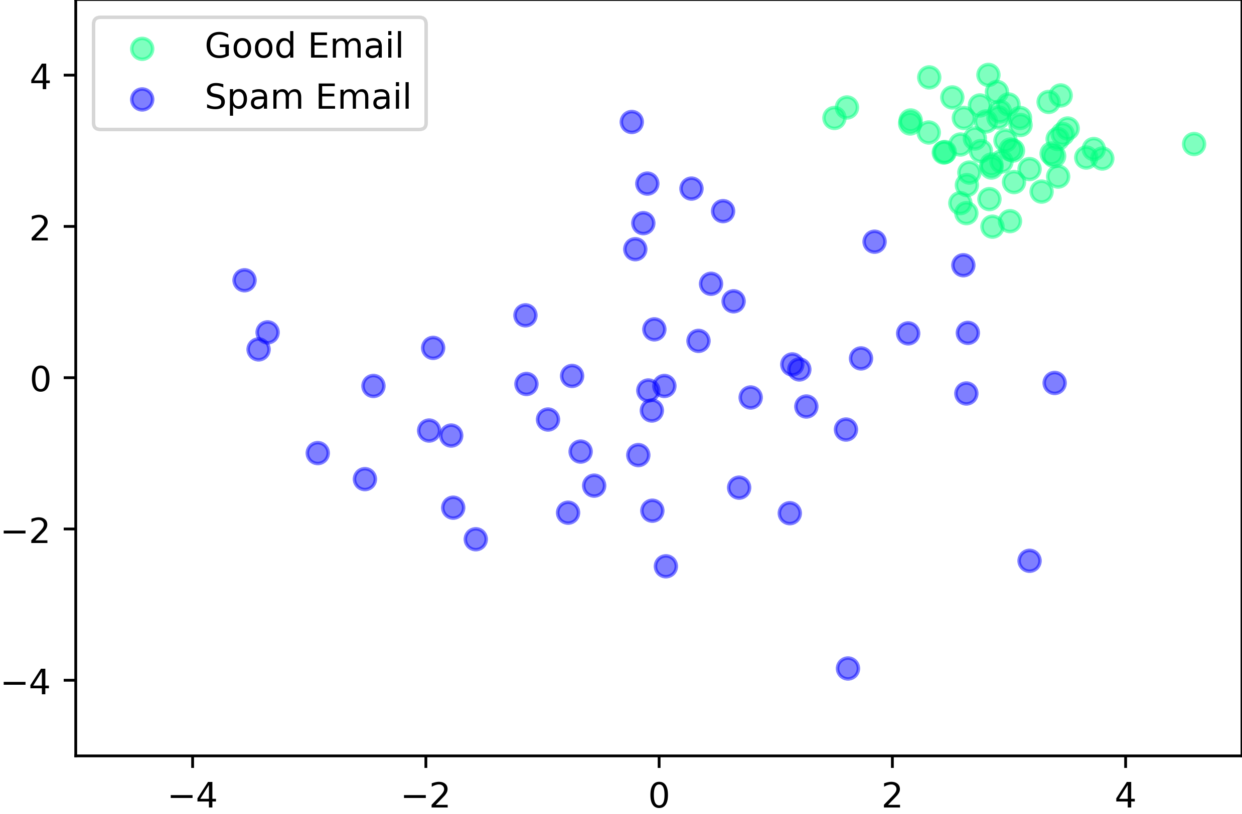
Supervised Learning
SVM Example

Slide 12
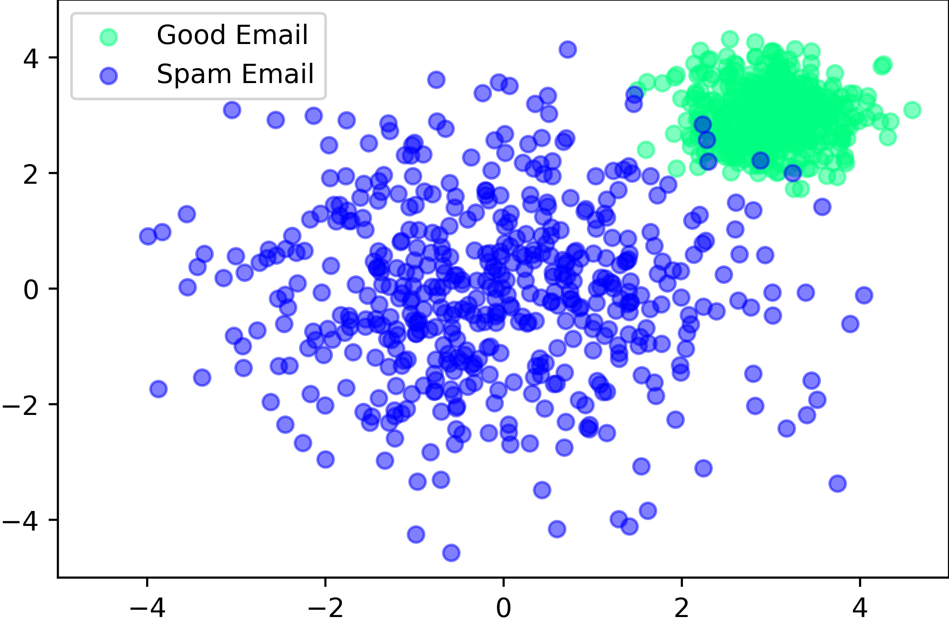
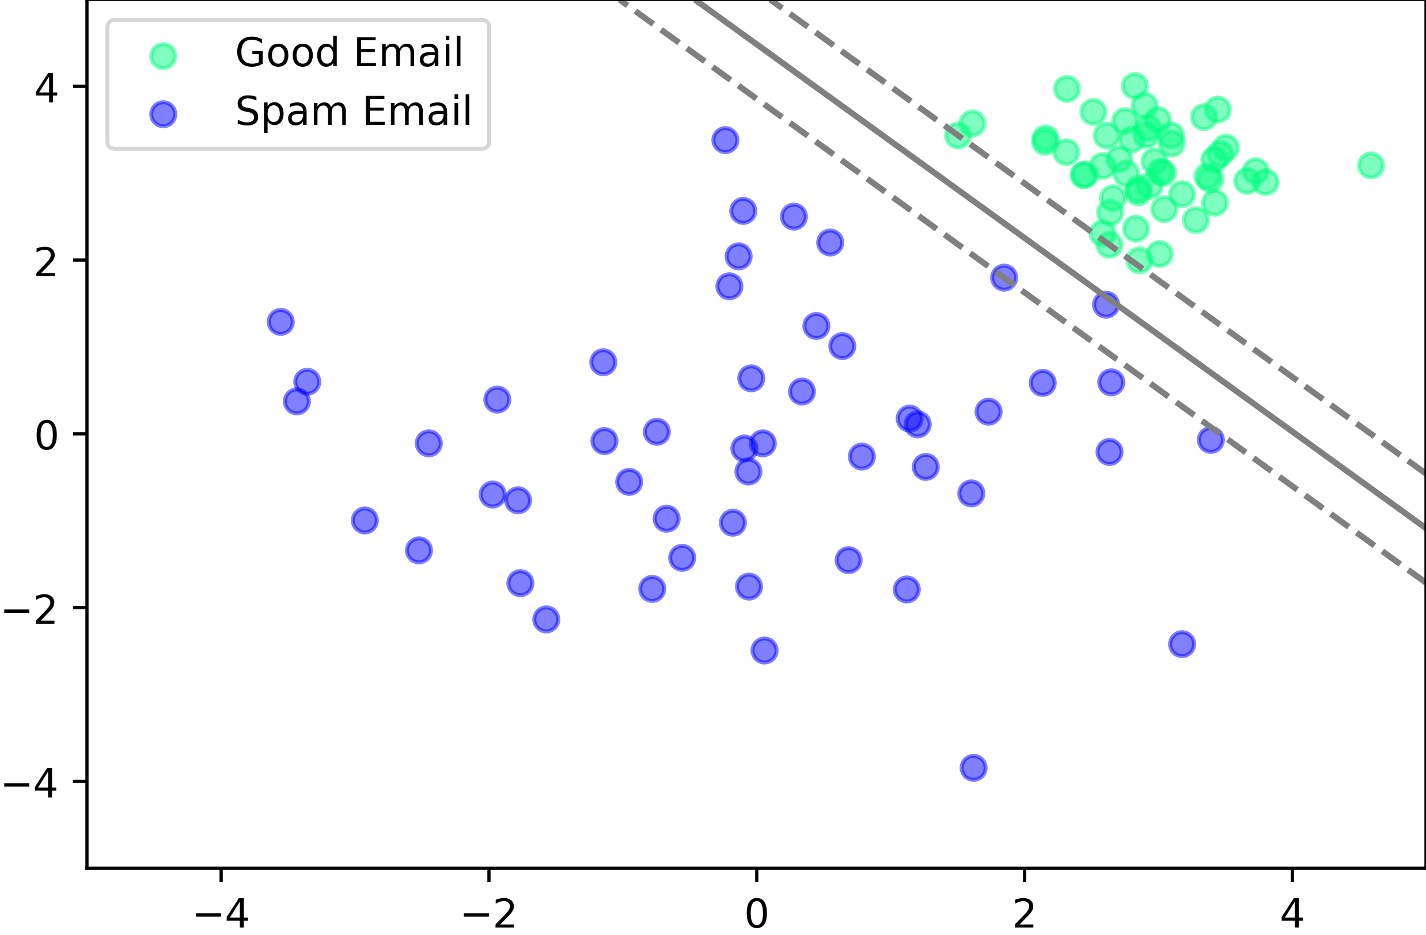
Supervised Learning
SVM Example

Slide 13
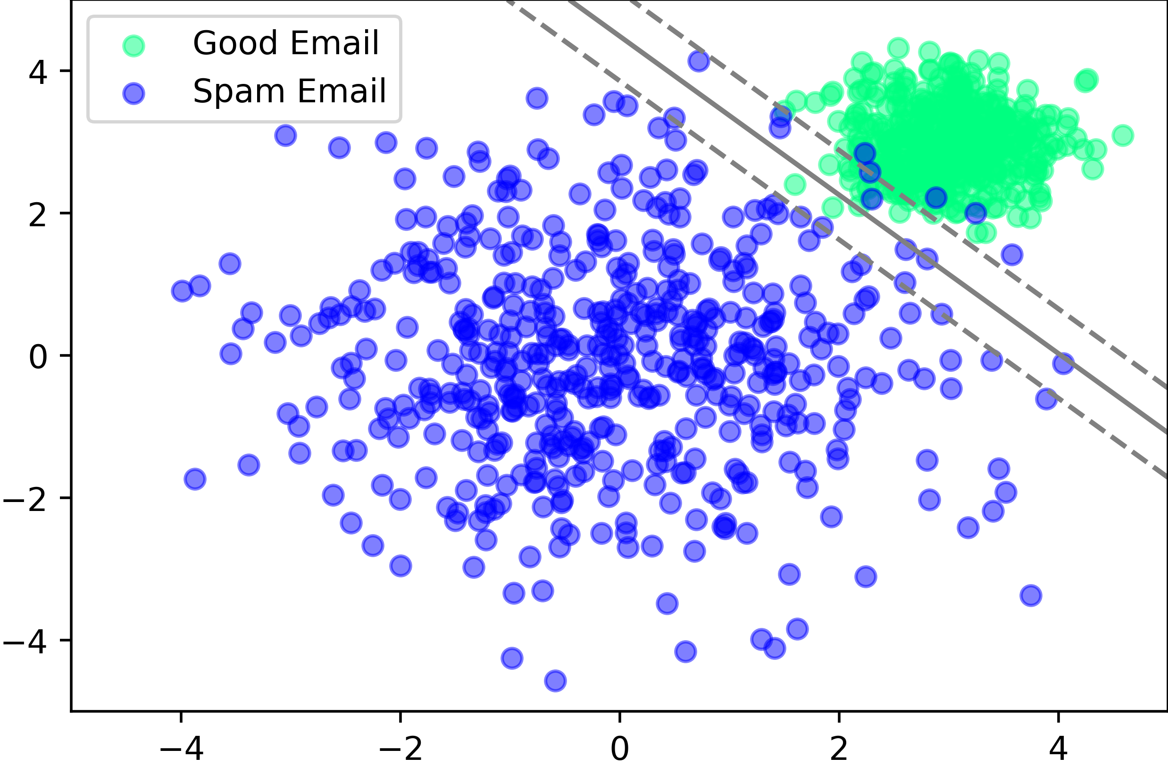
Supervised Learning
SVM Example

Slide 14
Supervised Learning
Input
“Training”
Programm (Model)
Output

Slide 15
Supervised Learning
Data
Input
“Training”
Programm (Model)
Output
Labels (Classes)
Continues values

Slide 16
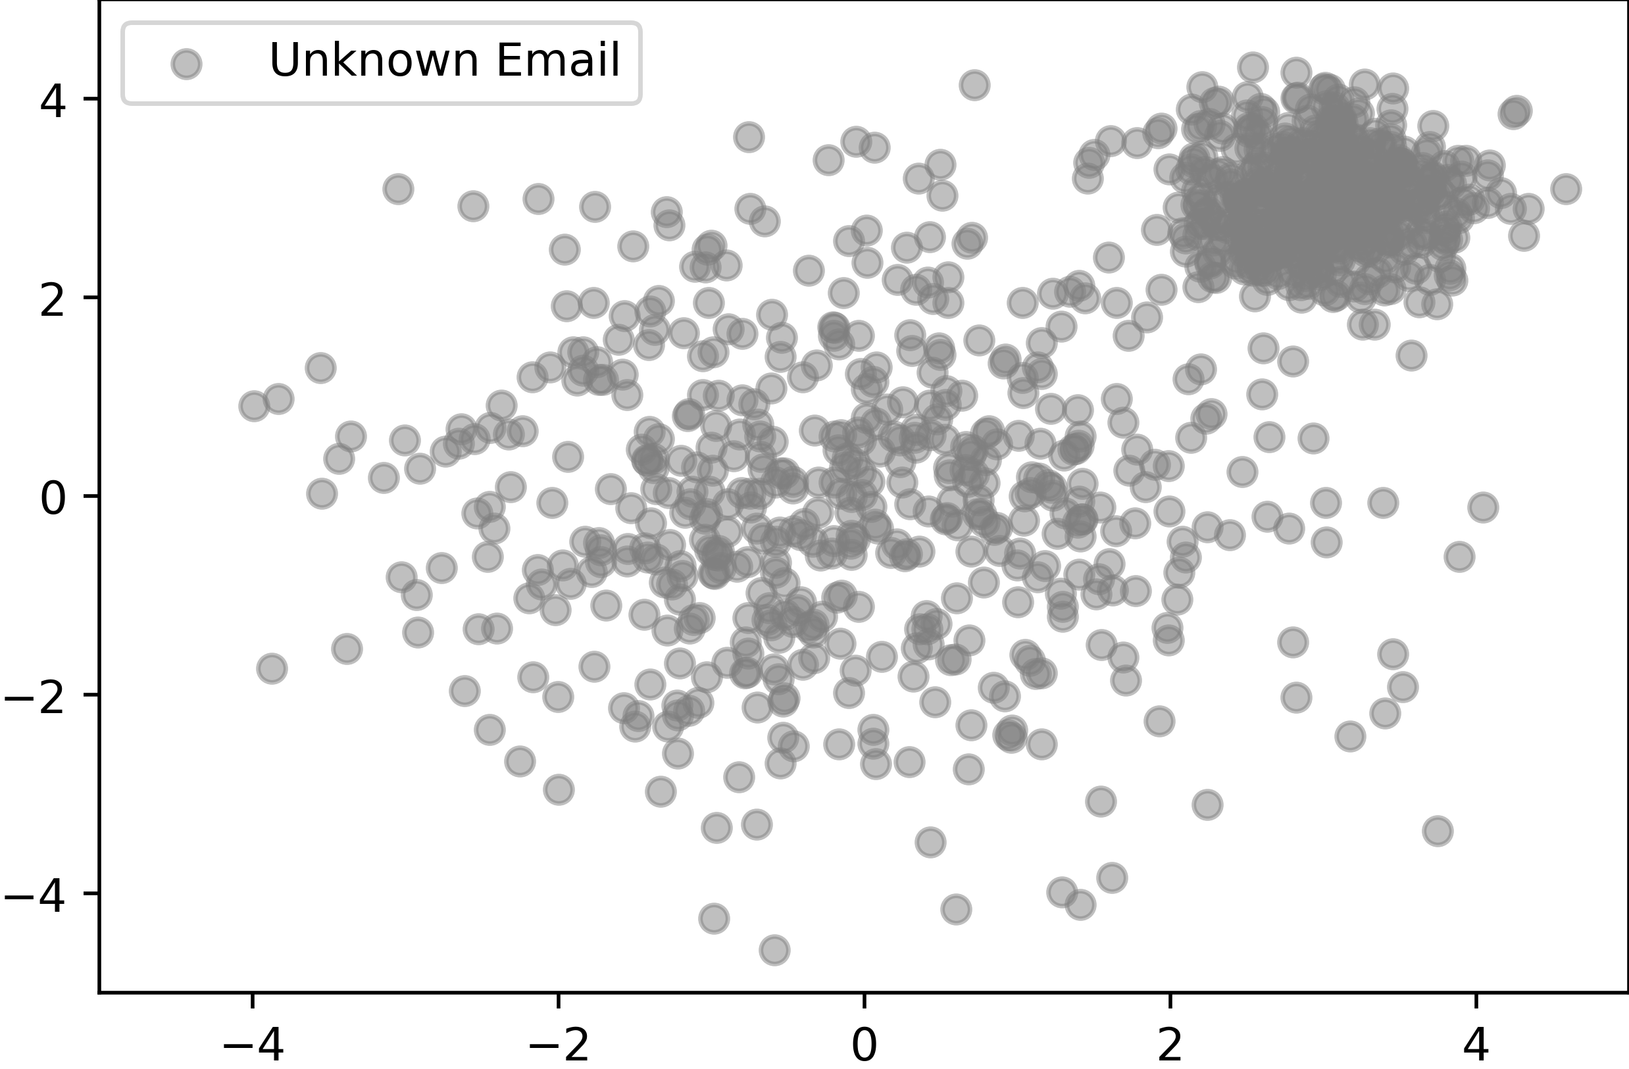
Unsupervised Learning

Slide 17
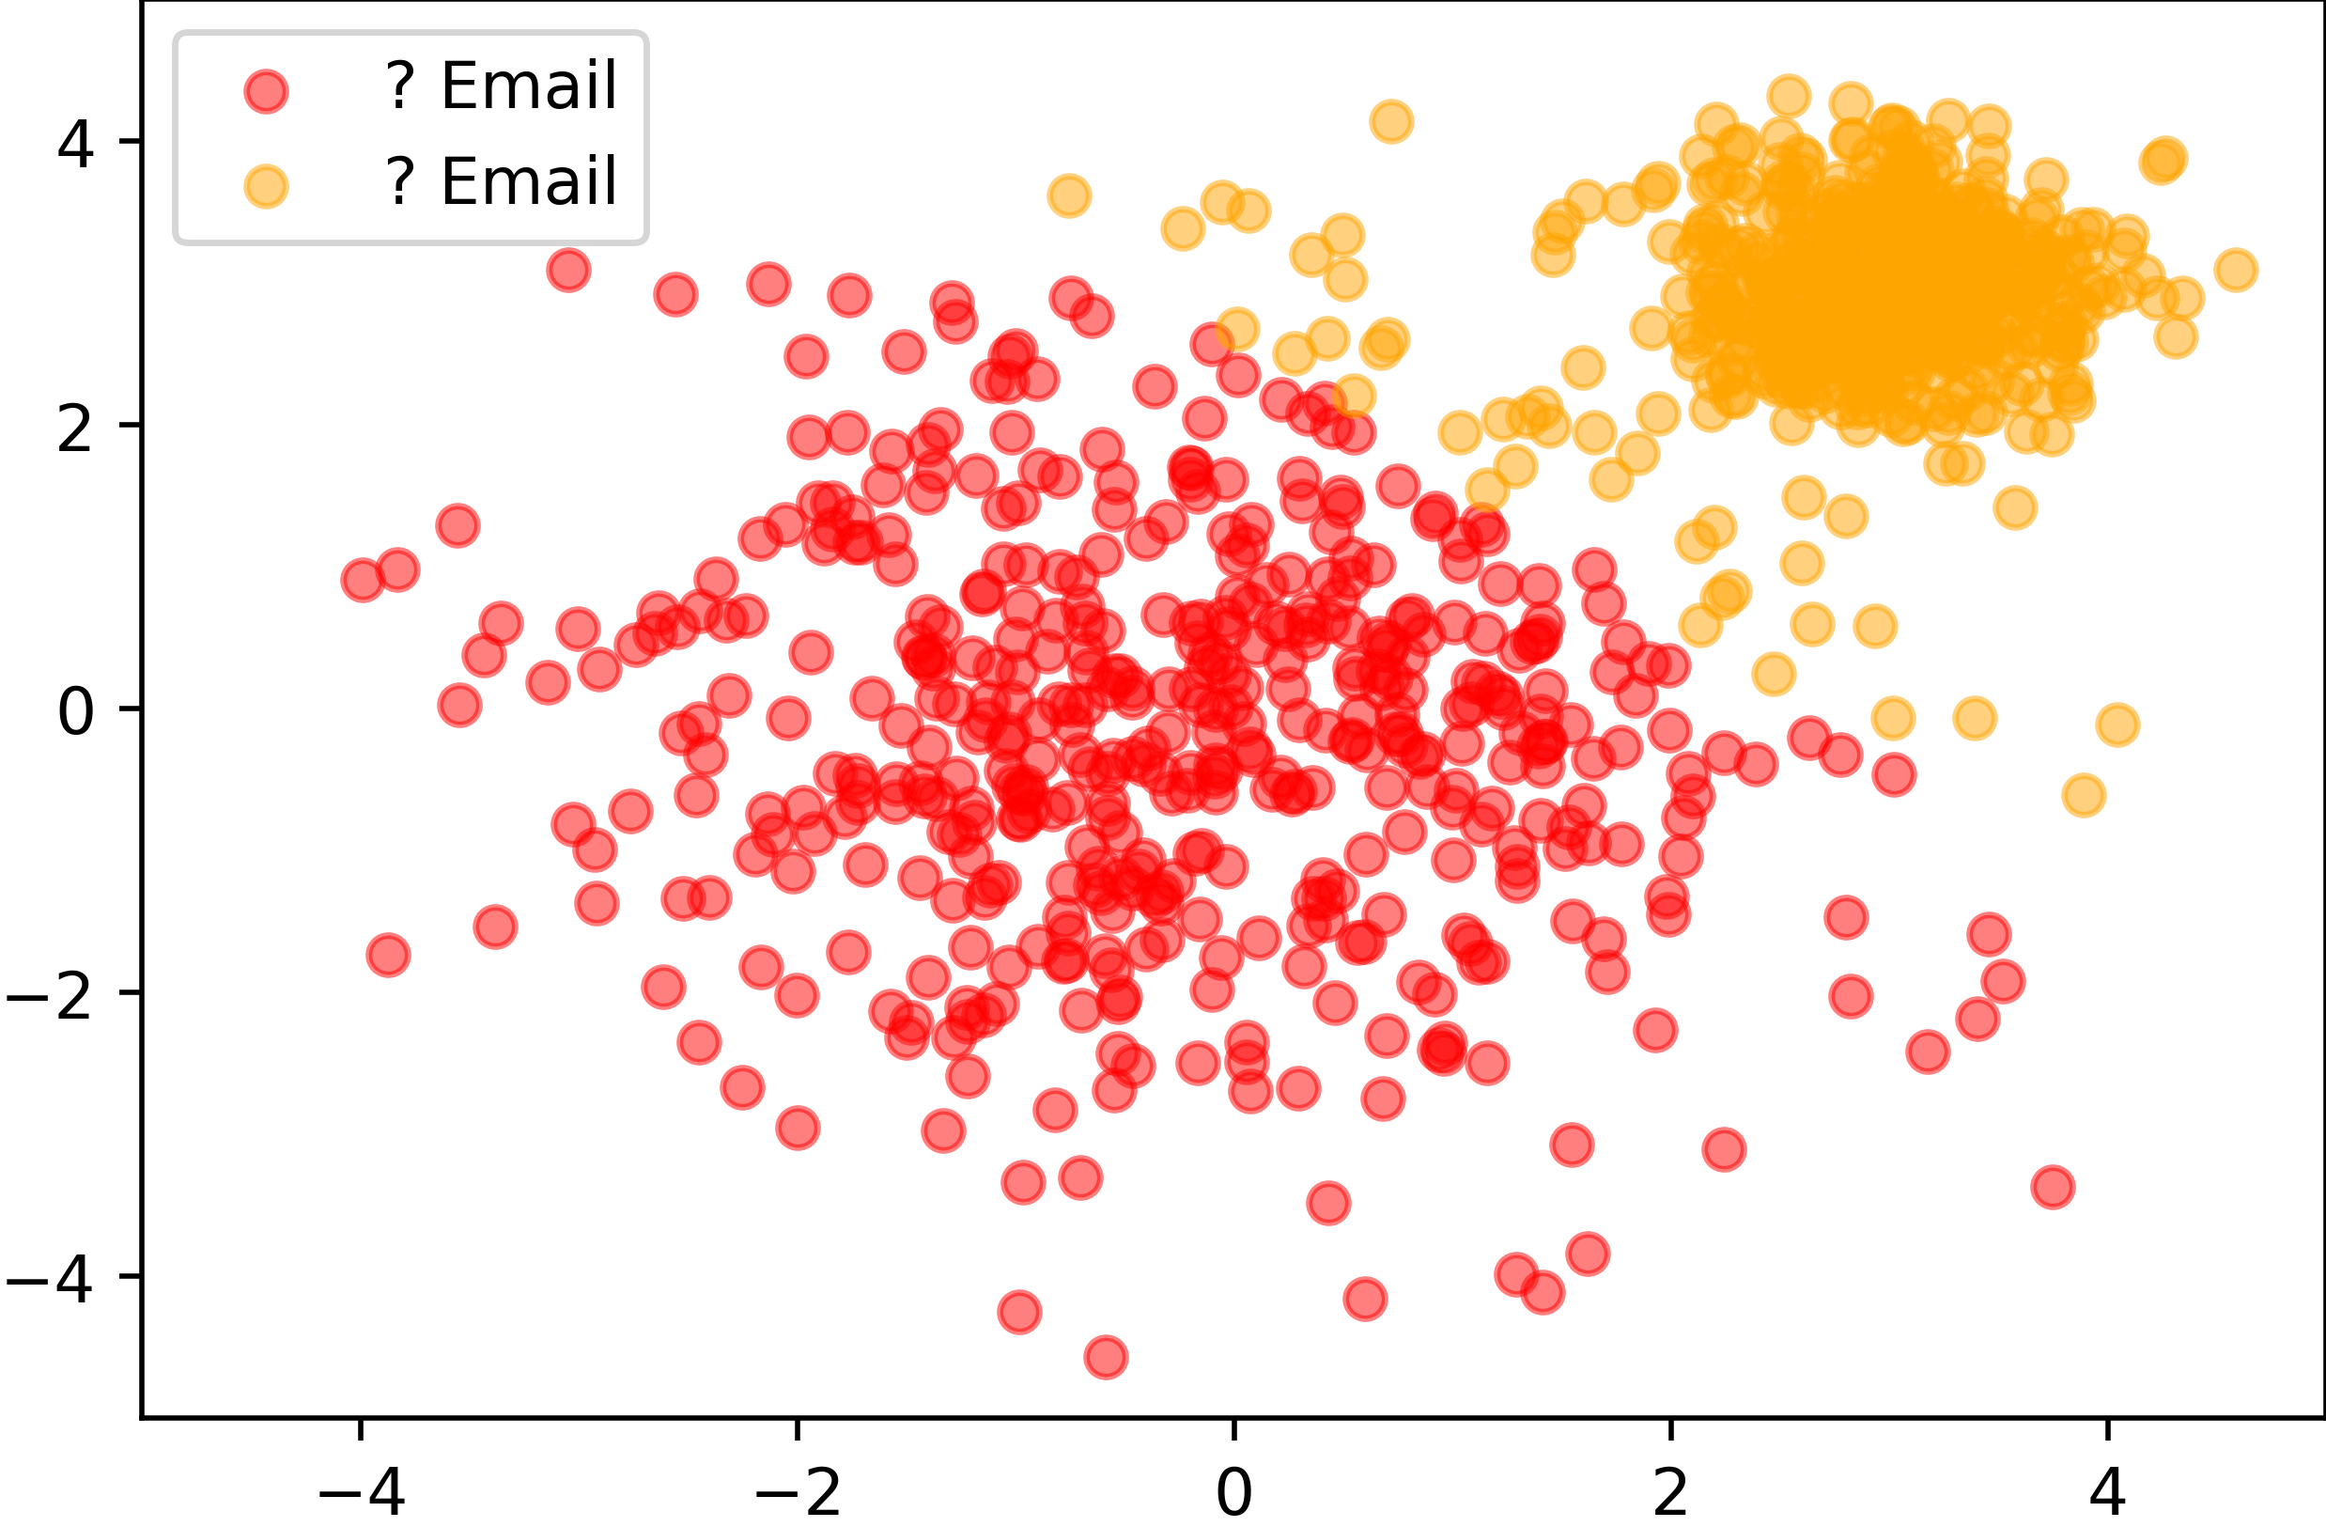
Unsupervised Learning

Slide 18
Unsupervised Learning
Data
“Training”
Programm (Model)
Input
Not needed:
Labels (Classes)
Continues values

Slide 19
Learning Strategies
 | Supervised Learning | Unsupervised Learning
Discrete | Classification or Categorization | Clustering
Continuous | Regression | Dimensionality reduction

Slide 20
Conclusion
Supervised vs. Unsupervised Learning
Unsupervised Learning
  Unlabeled data
  Use to discover patterns and information
Supervised Learning
  Labeled data
  Used to generalize known relations between input and output

Slide 21

License
This file is licensed under the Creative Commons Attribution-Share Alike 4.0 (CC BY-SA) license:
https://creativecommons.org/licenses/by-sa/4.0
Attribution: Sven Mayer

