Slide 1


Practical Machine Learning
Unsupervised Learning

Slide 2
Unsupervised Learning
Data
“Training”
Programm (Model)
Input
Not needed:
Lables (Classes)
Continues values

Slide 3
Unsupervised Learning
What can we learn just buy looking at the data?
🐩
🐆
🐈
🐕
🦍
🐴
🐶

Slide 4
Unsupervised Learning
What can we learn just buy looking at the data?
🐩
🐆
🐈
🐕
🦍
🐴
🐶

Slide 5
Learning Strategies
 | Supervised Learning | Unsupervised Learning
Discrete | Classification or Categorization | Clustering
Continuous | Regression | Dimensionality reduction

Slide 6
Unsupervised Learning Methods
Hierarchical clustering
K-means clustering
Principal Component Analysis (PCA)
Singular Value Decomposition
Independent Component Analysis
….

Slide 7
Clustering
Unsupervised Learning

Slide 8
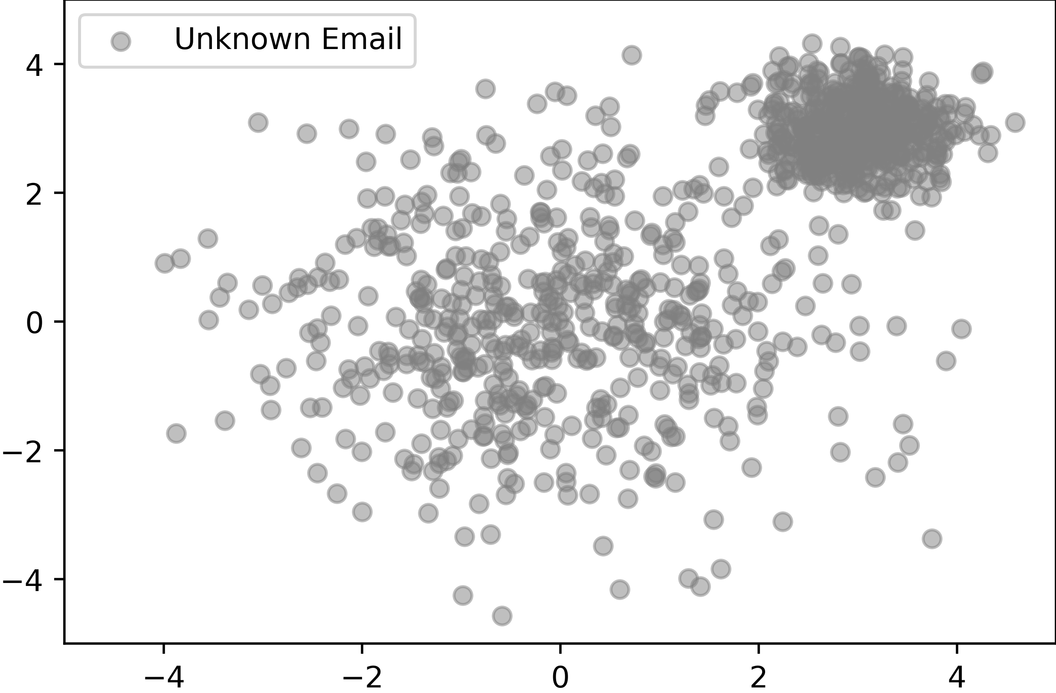
Unknown Data

Slide 9
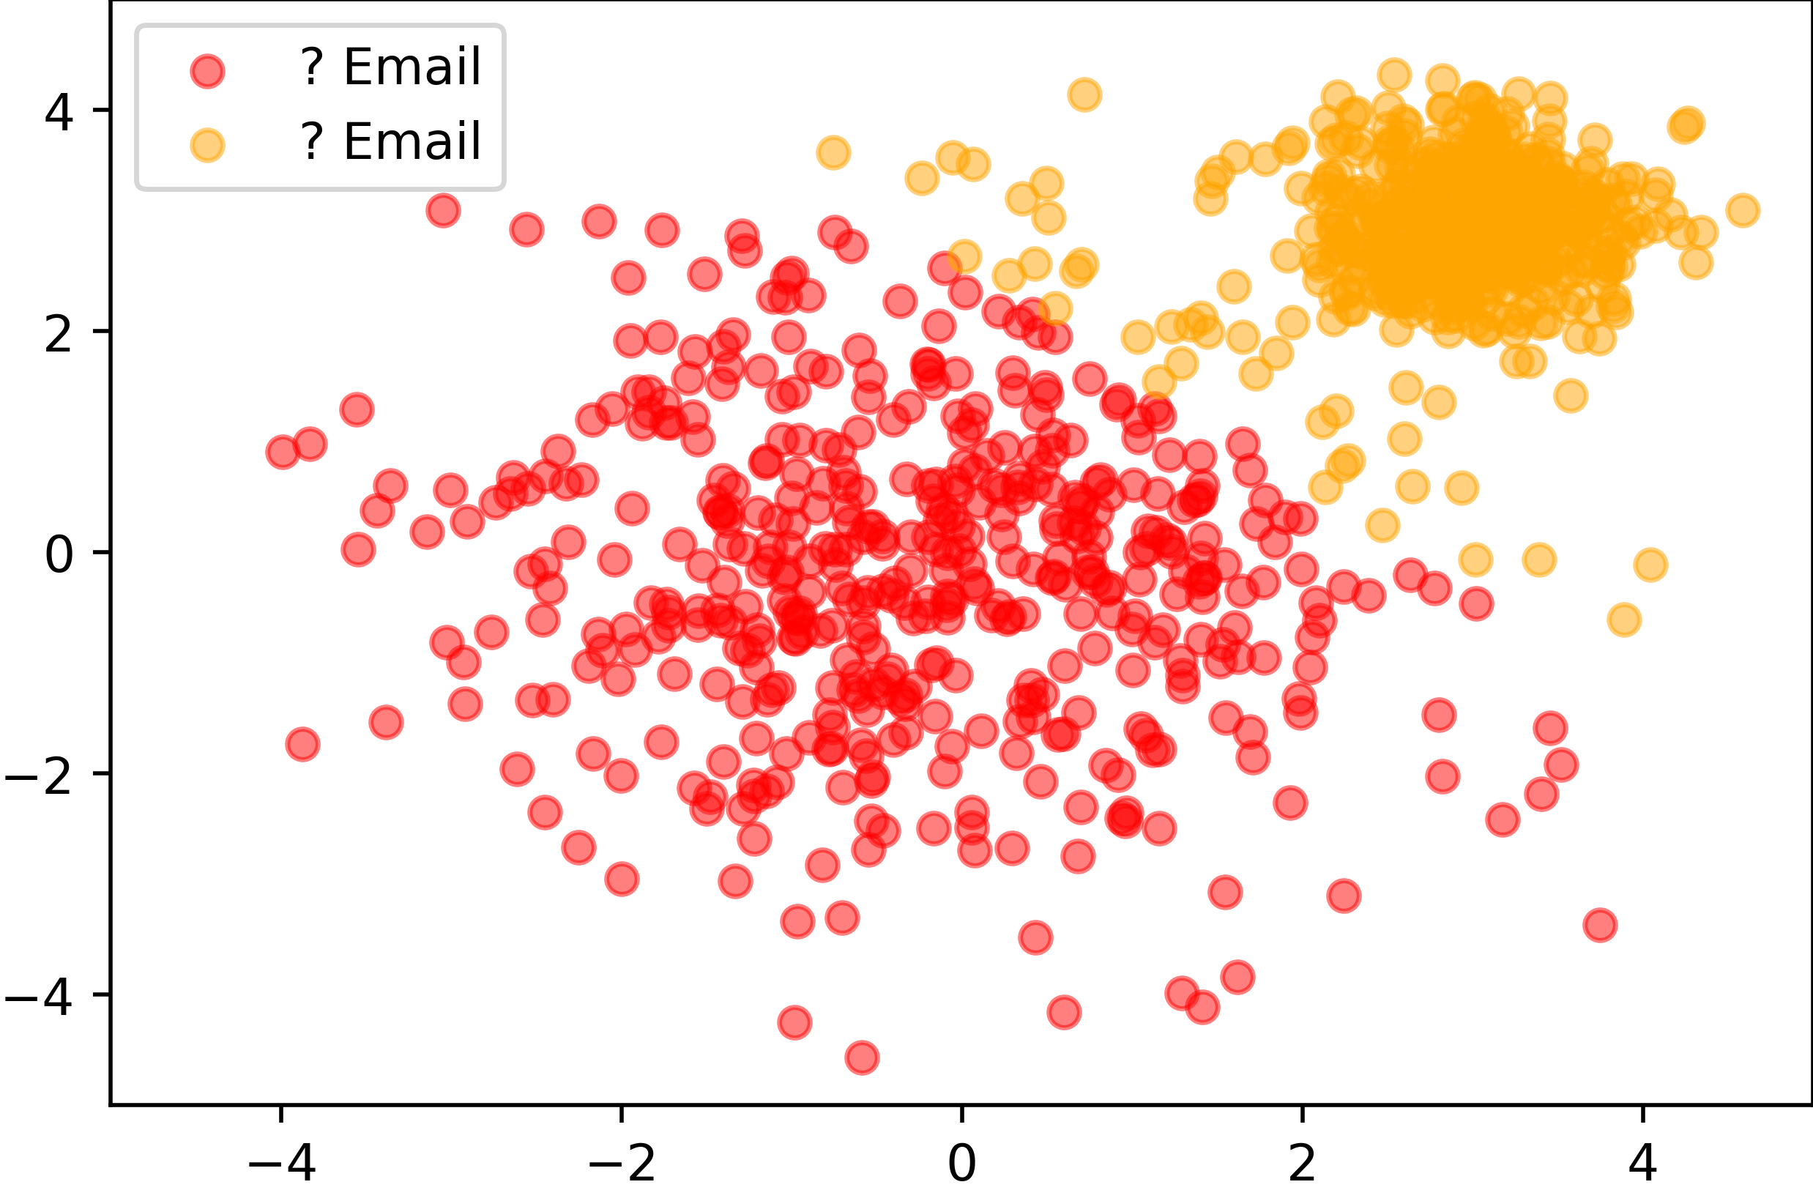
Clustering
K-means clustering
Uncovering “structure” in unlabeled data

Slide 10
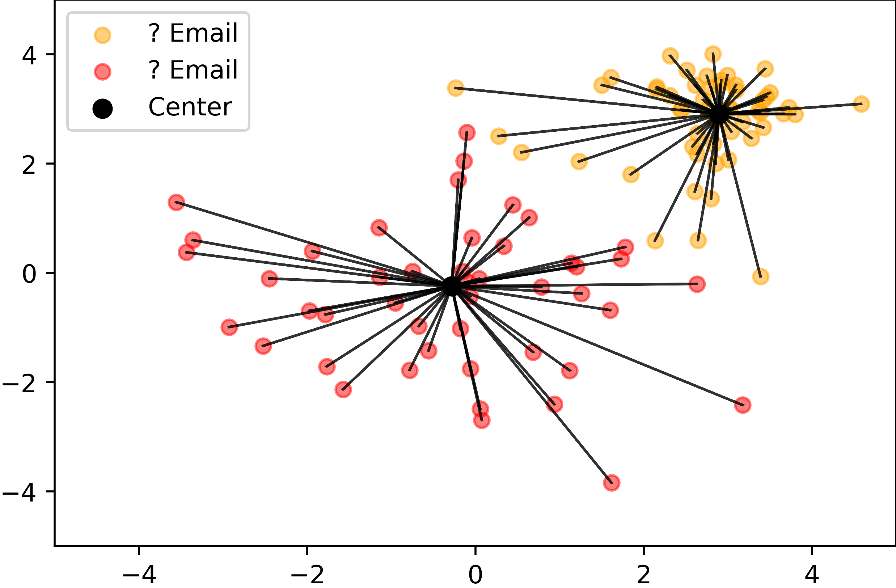
Clustering
K-means clustering

Slide 11
Clustering
K-means clustering
?

Slide 12
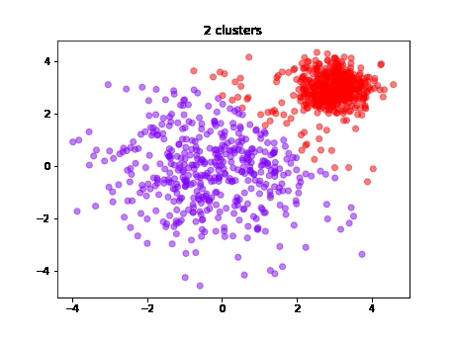
Clustering
Cluster Count?

Slide 13
Dimensionality Reduction
Unsupervised Learning

Slide 14
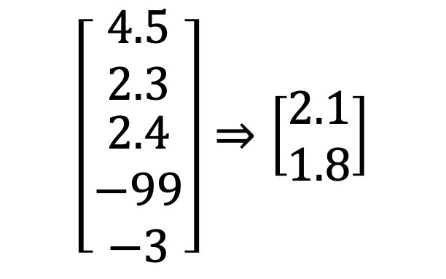
Dimensionality Reduction
Principal Component Analysis (PCA)
Transforming high-dimensional data into a low-dimensional space
$$\left[\begin{matrix}4.5 \\ 2.3 \\ \begin{matrix}2.4 \\ −99 \\ −3\end{matrix}\end{matrix}\right]⇒\left[\begin{matrix}2.1 \\ 1.8\end{matrix}\right]$$

Slide 15
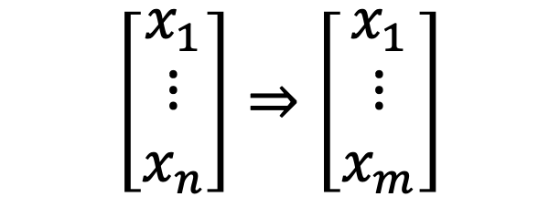

Dimensionality Reduction
Principal Component Analysis (PCA)
Transforming high-dimensional data into a low-dimensional space
$$\left[\begin{matrix}x_{1} \\ ⋮ \\ x_{n}\end{matrix}\right]⇒\left[\begin{matrix}x_{1} \\ ⋮ \\ x_{m}\end{matrix}\right]$$
$$n>m$$

Slide 16
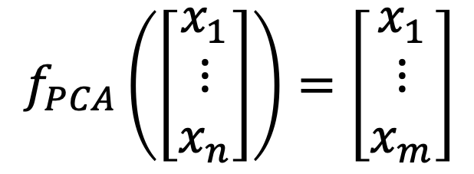
Dimensionality Reduction
Principal Component Analysis (PCA)
Transforming high-dimensional data into a low-dimensional space
$$f_{PCA}\left(\left[\begin{matrix}x_{1} \\ ⋮ \\ x_{n}\end{matrix}\right]\right)=\left[\begin{matrix}x_{1} \\ ⋮ \\ x_{m}\end{matrix}\right]$$
$$n>m$$

Slide 17
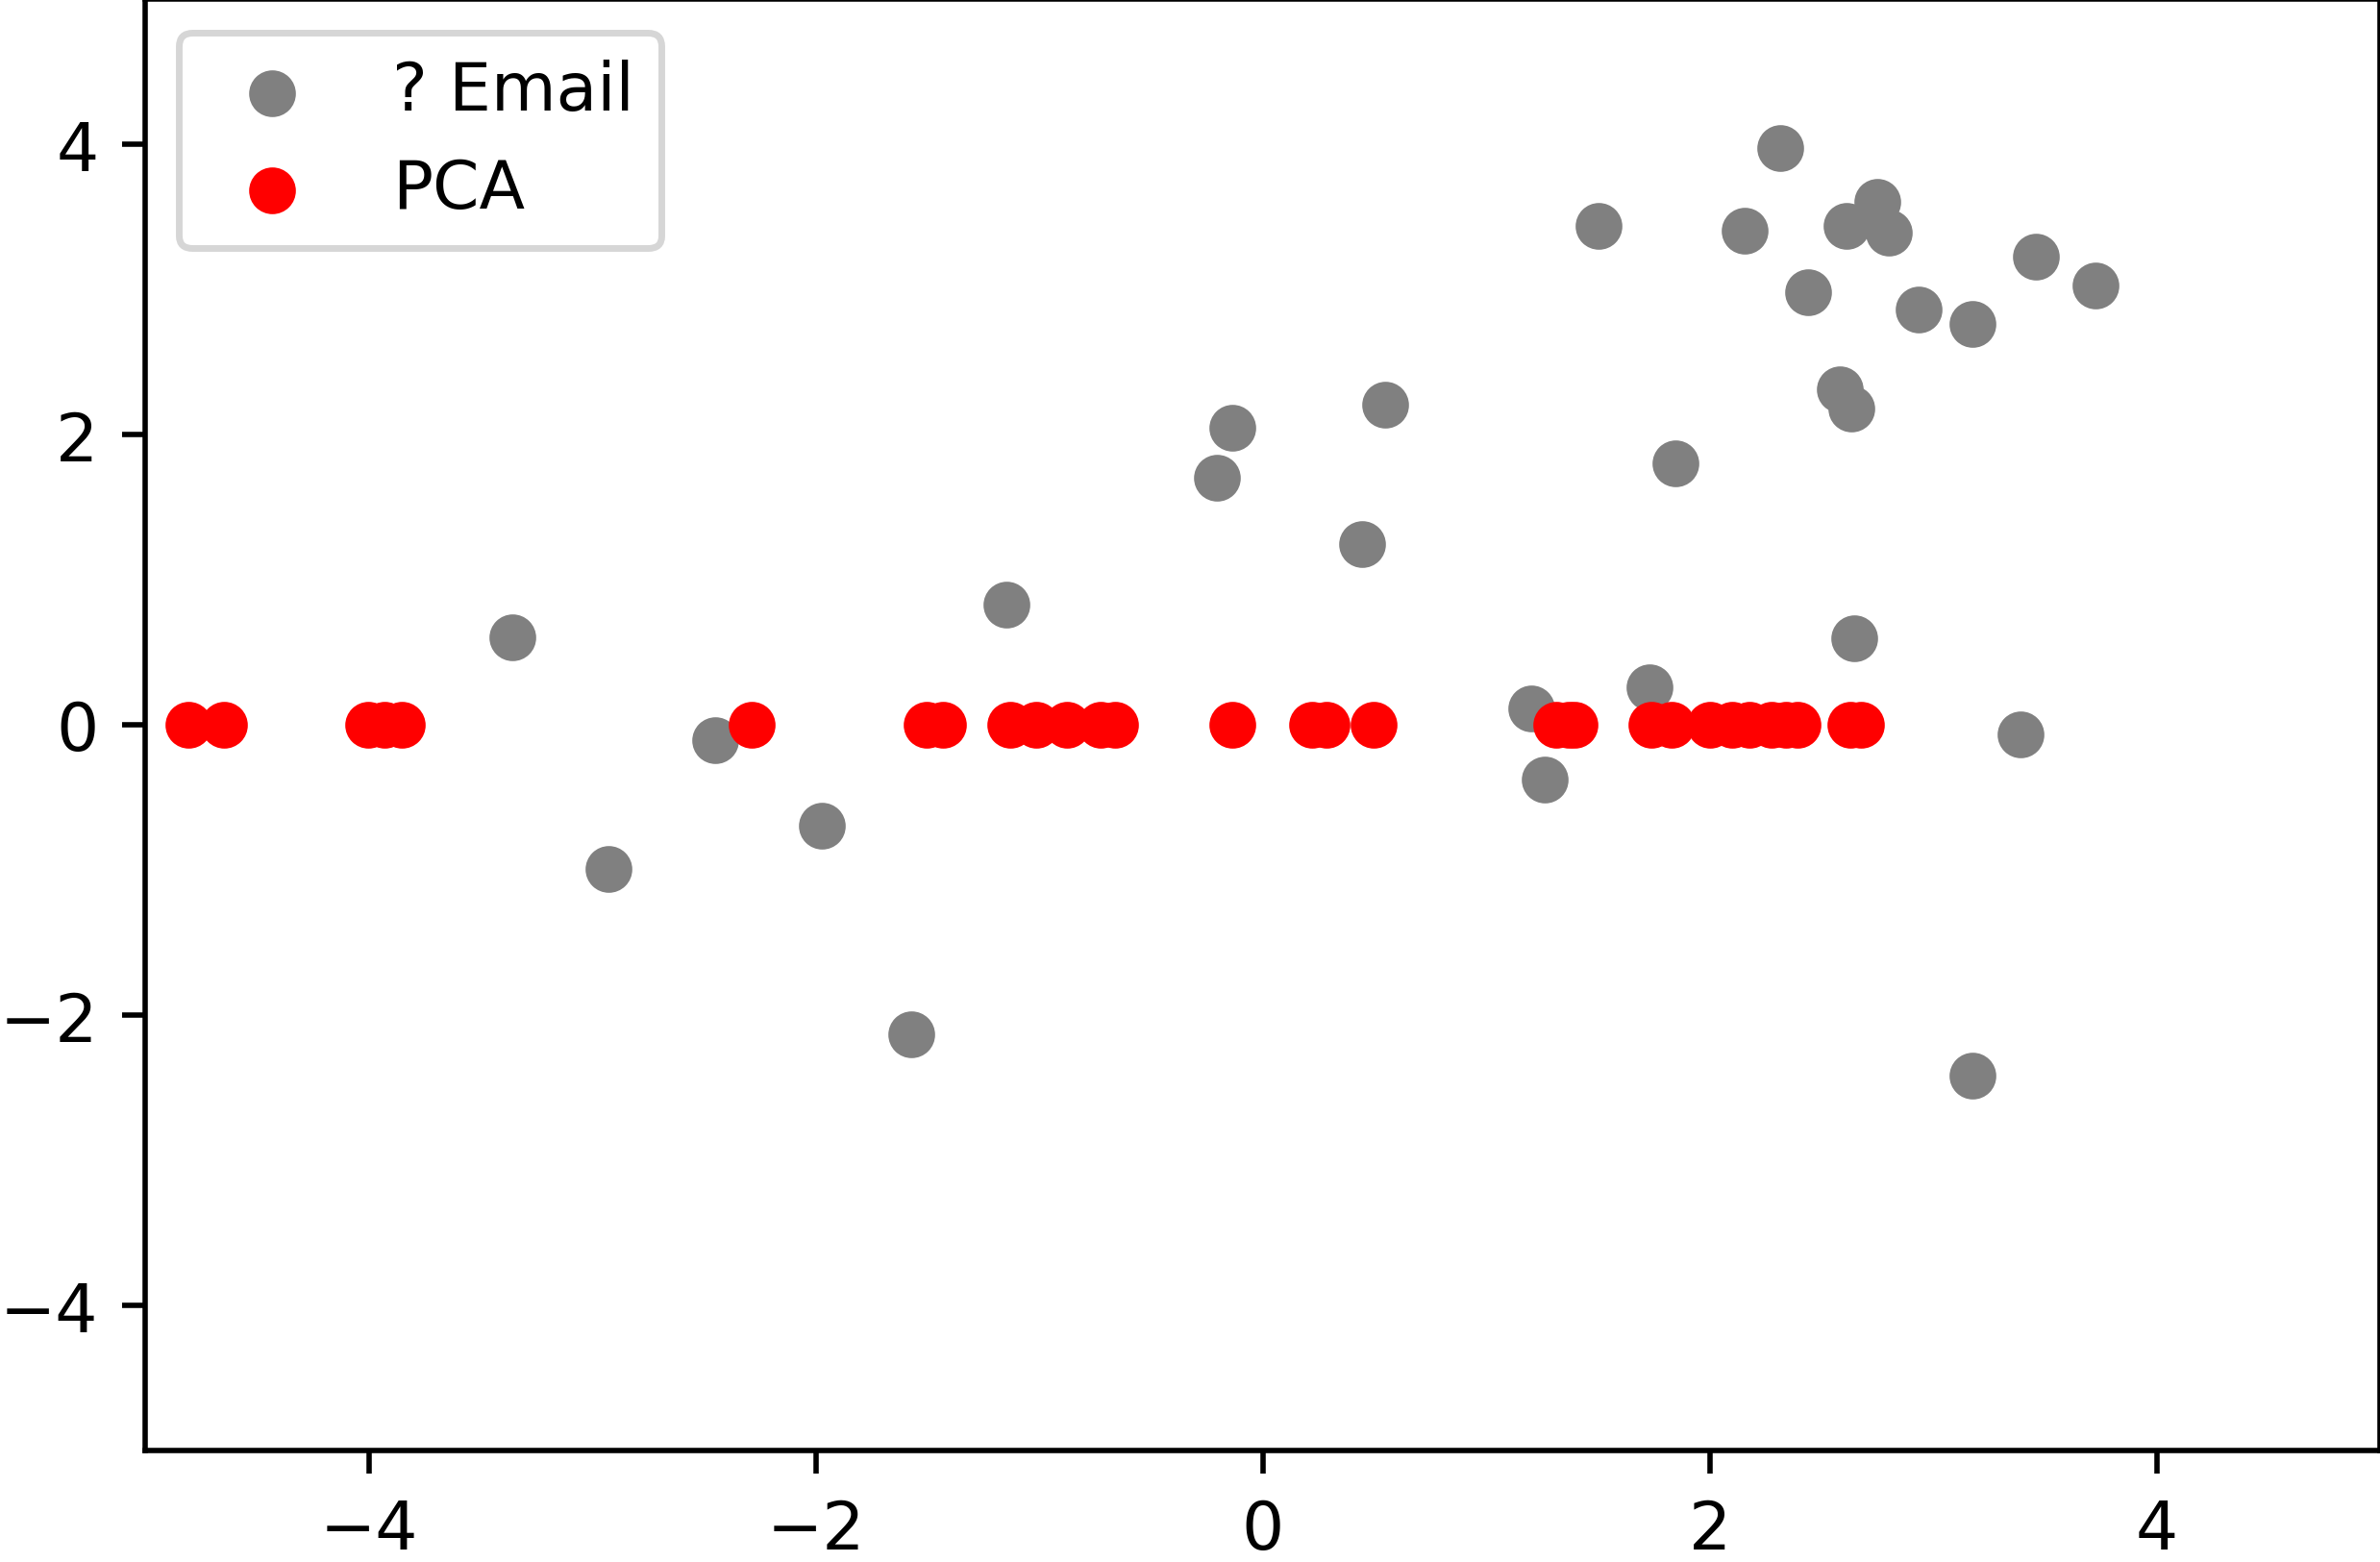
Dimensionality Reduction
Principal Component Analysis (PCA)

Slide 18
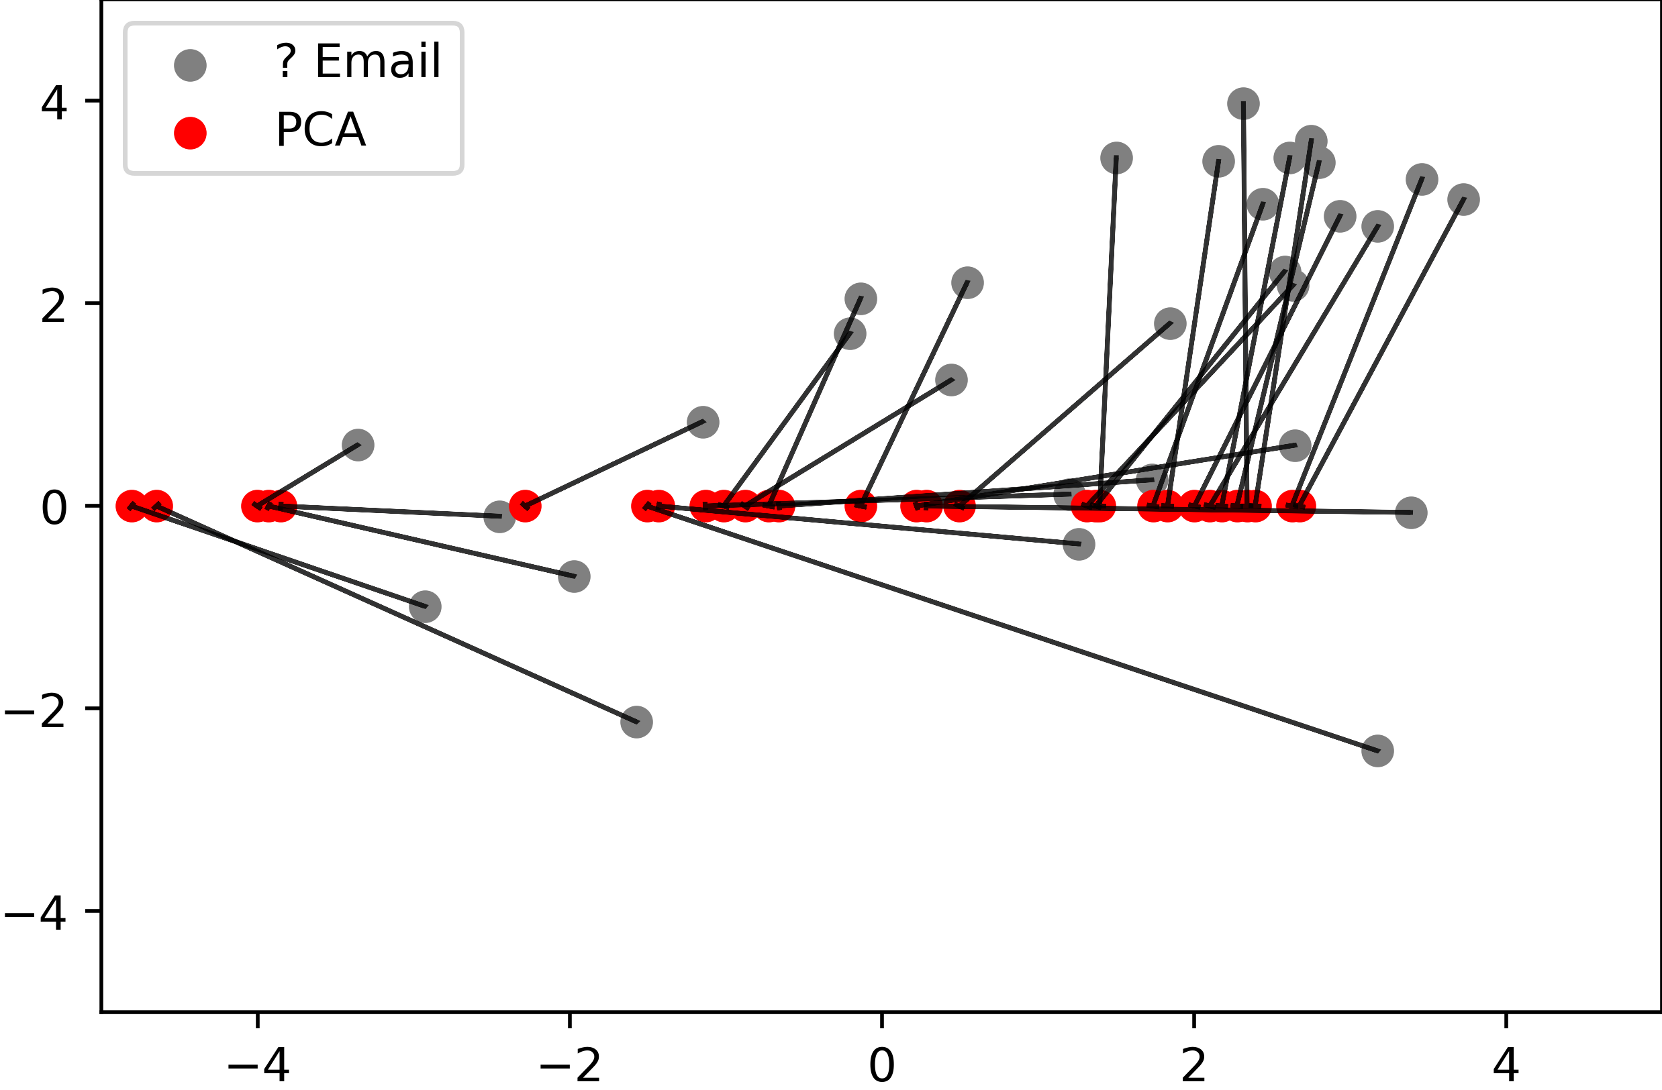
Dimensionality Reduction
Principal Component Analysis (PCA)

Slide 19
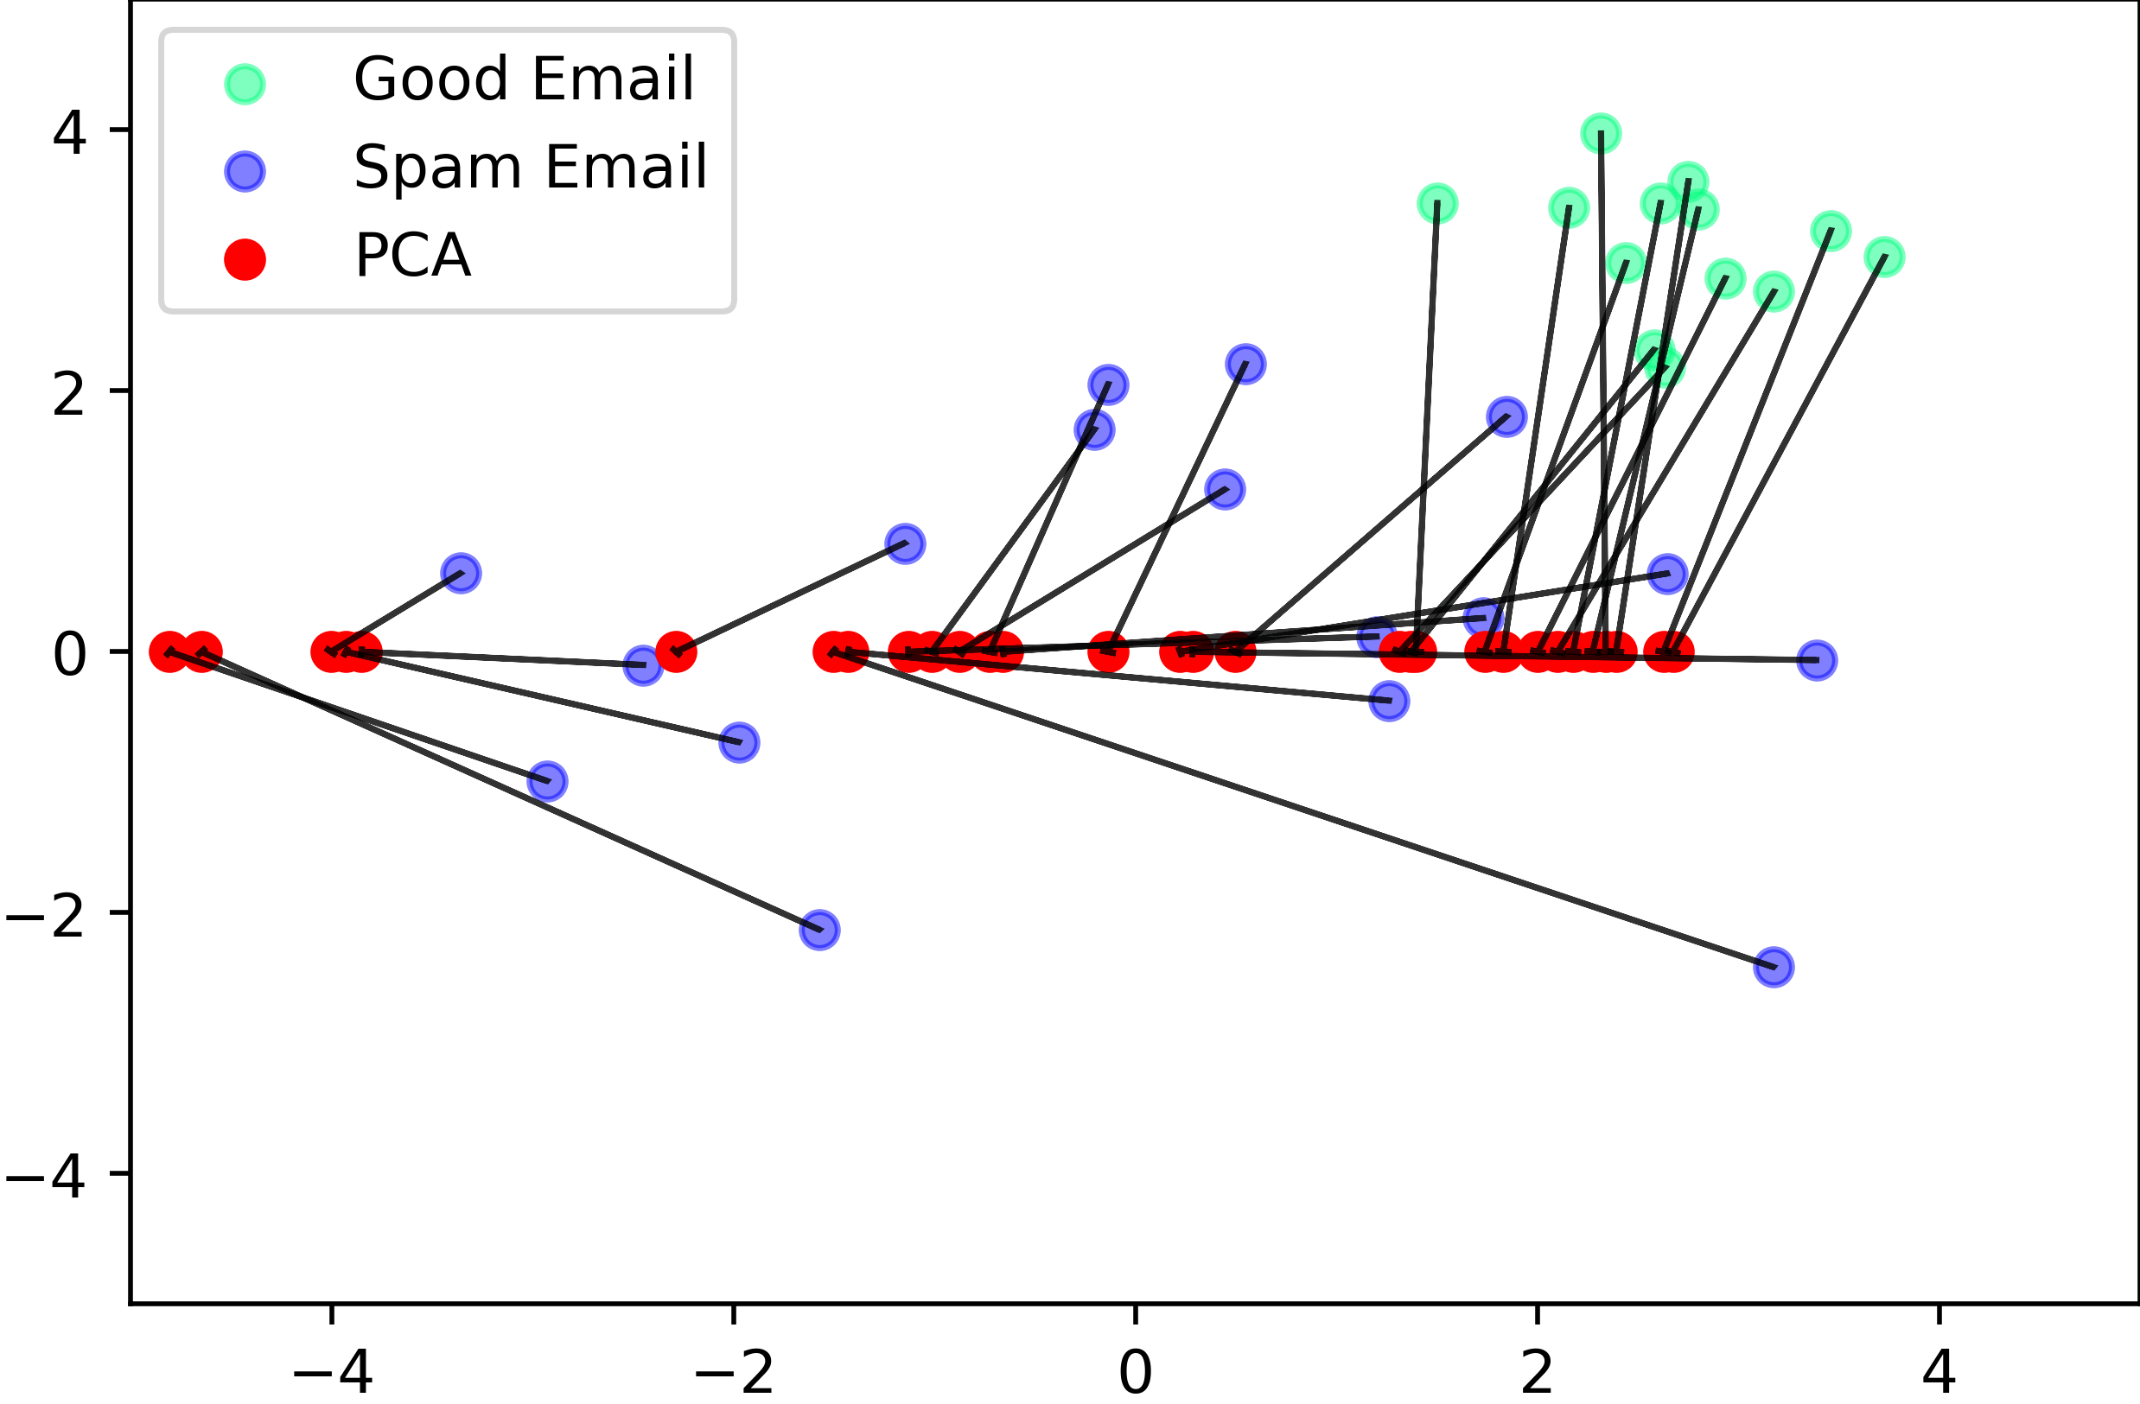
Dimensionality Reduction
Principal Component Analysis (PCA)

Slide 20
Conclusion
Unsupervised Learning
Clustering
  Finding meaning in unlabeled data
Dimensionality Reduction
  Transforming high-dimensional data into a low-dimensional space
  Reducing the data to more essential features.

Slide 21

License
This file is licensed under the Creative Commons Attribution-Share Alike 4.0 (CC BY-SA) license:
https://creativecommons.org/licenses/by-sa/4.0
Attribution: Sven Mayer

