Slide 1


Practical Machine Learning
Supervised Learning

Slide 2
Learning Strategies
 | Supervised Learning | Unsupervised Learning
Discrete | Classification or Categorization | Clustering
Continuous | Regression | Dimensionality reduction

Slide 3
Classification
Supervised Learning

Slide 4
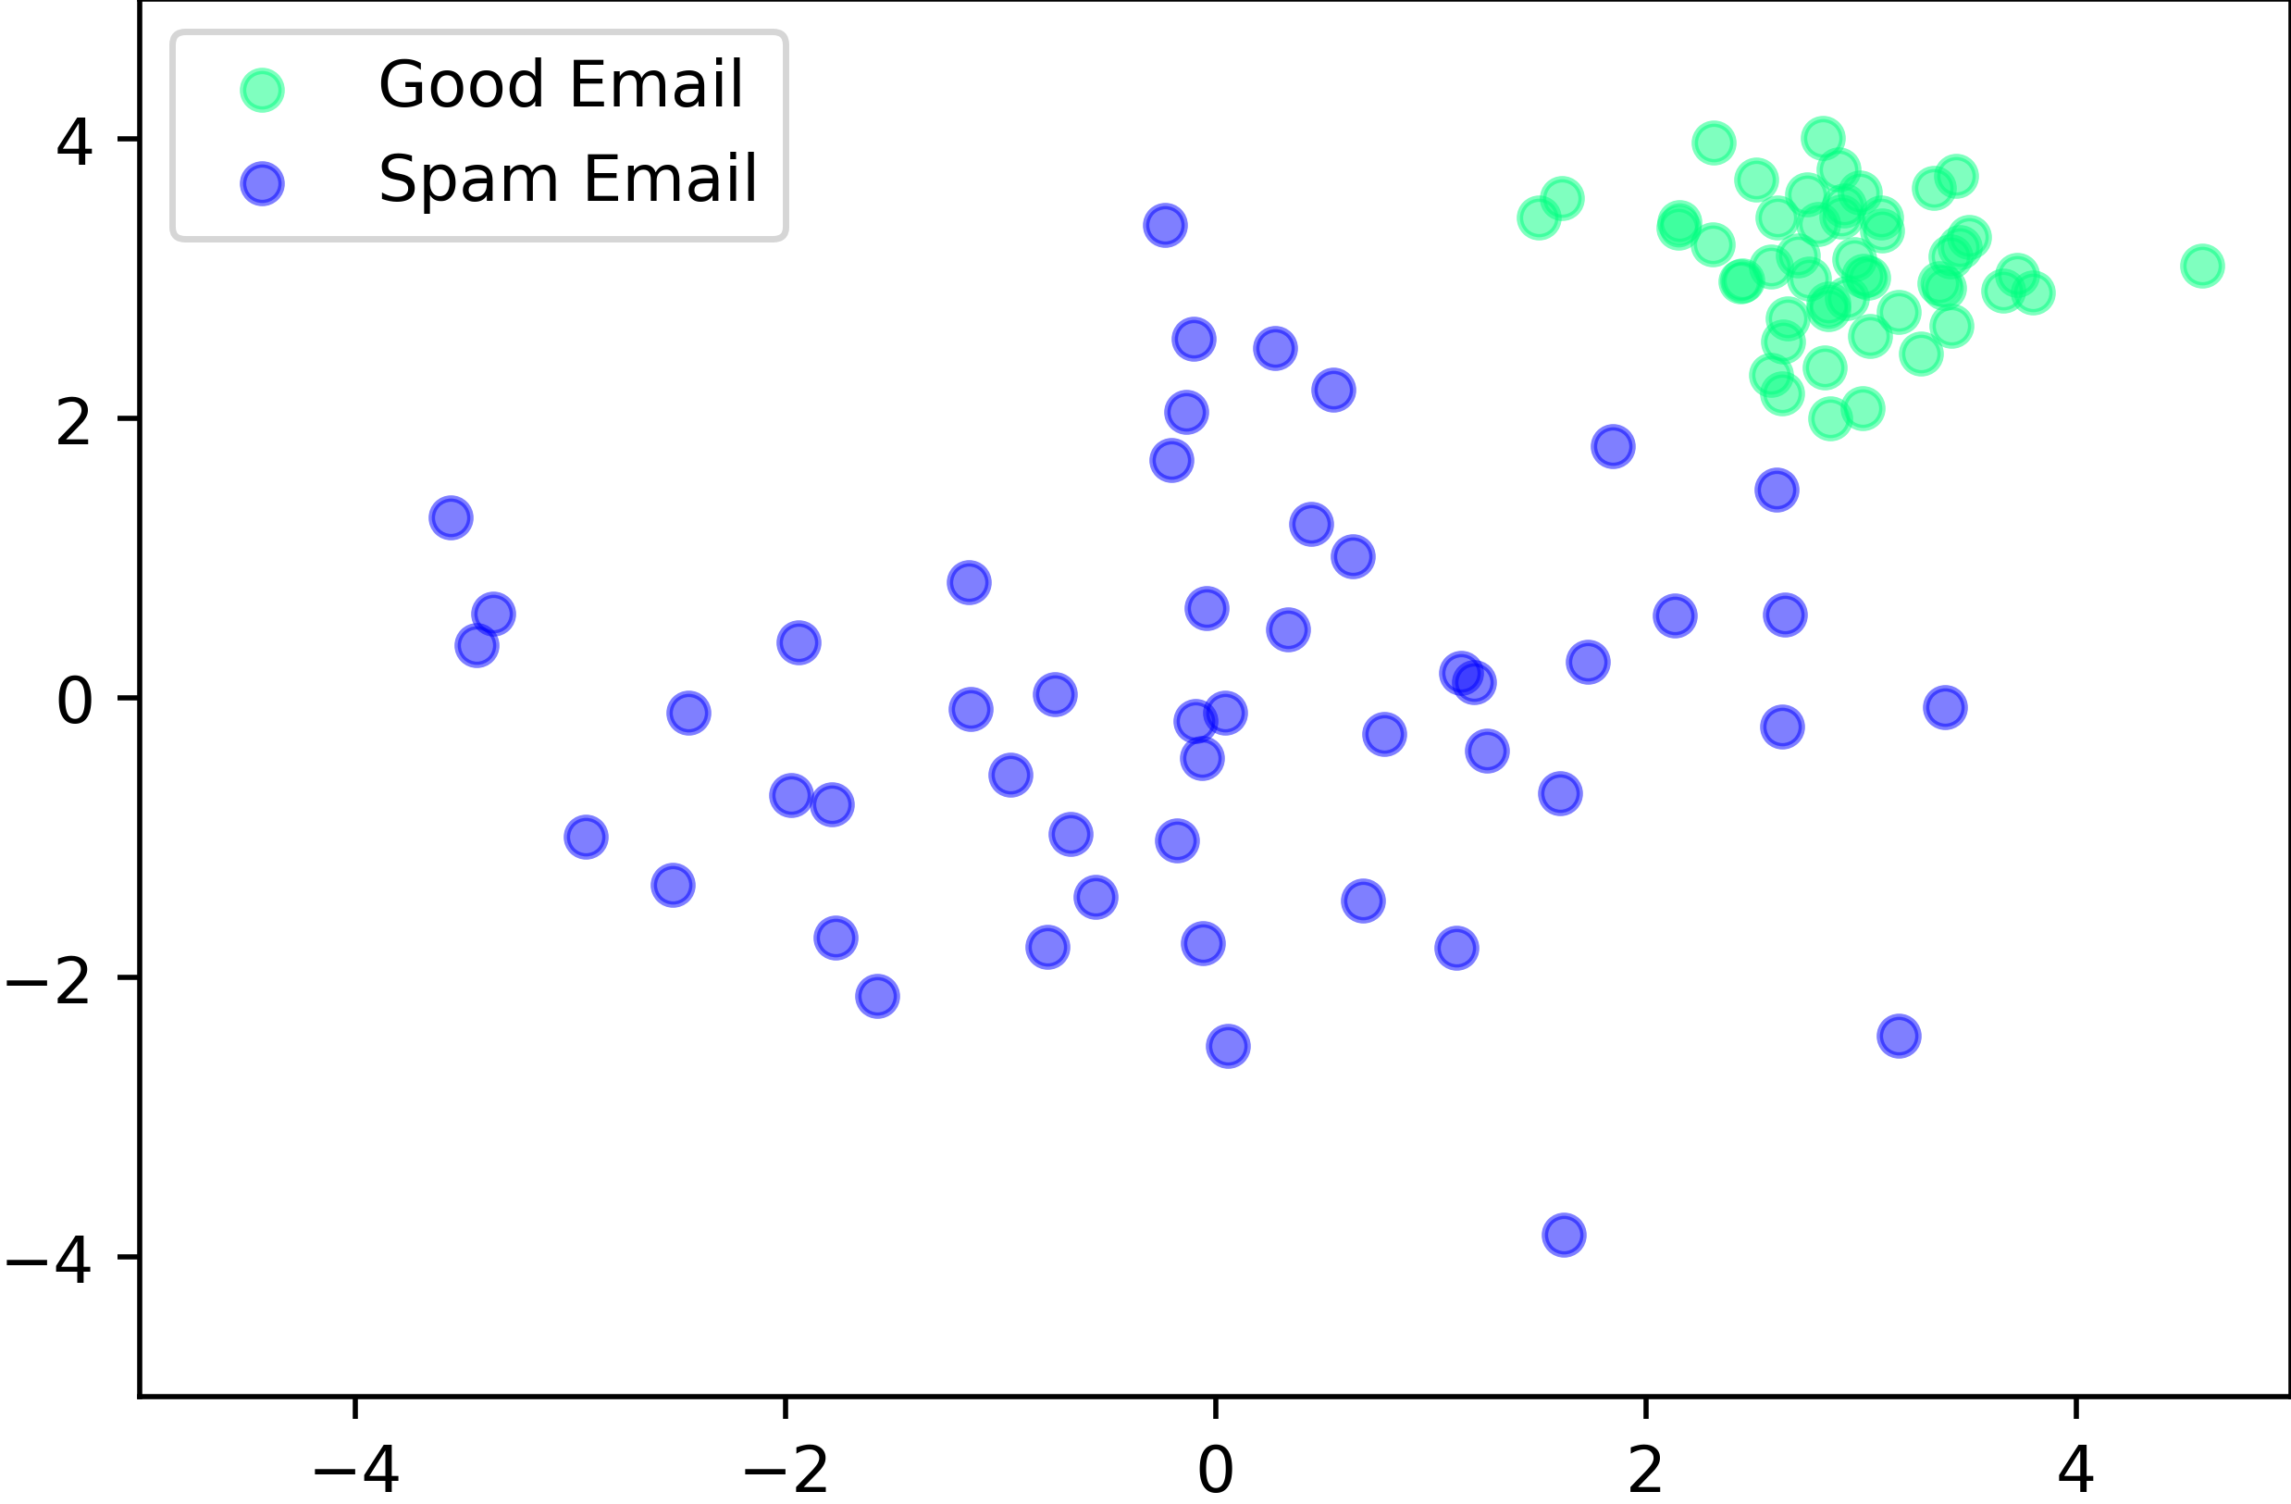
Classification
SVM Example

Slide 5
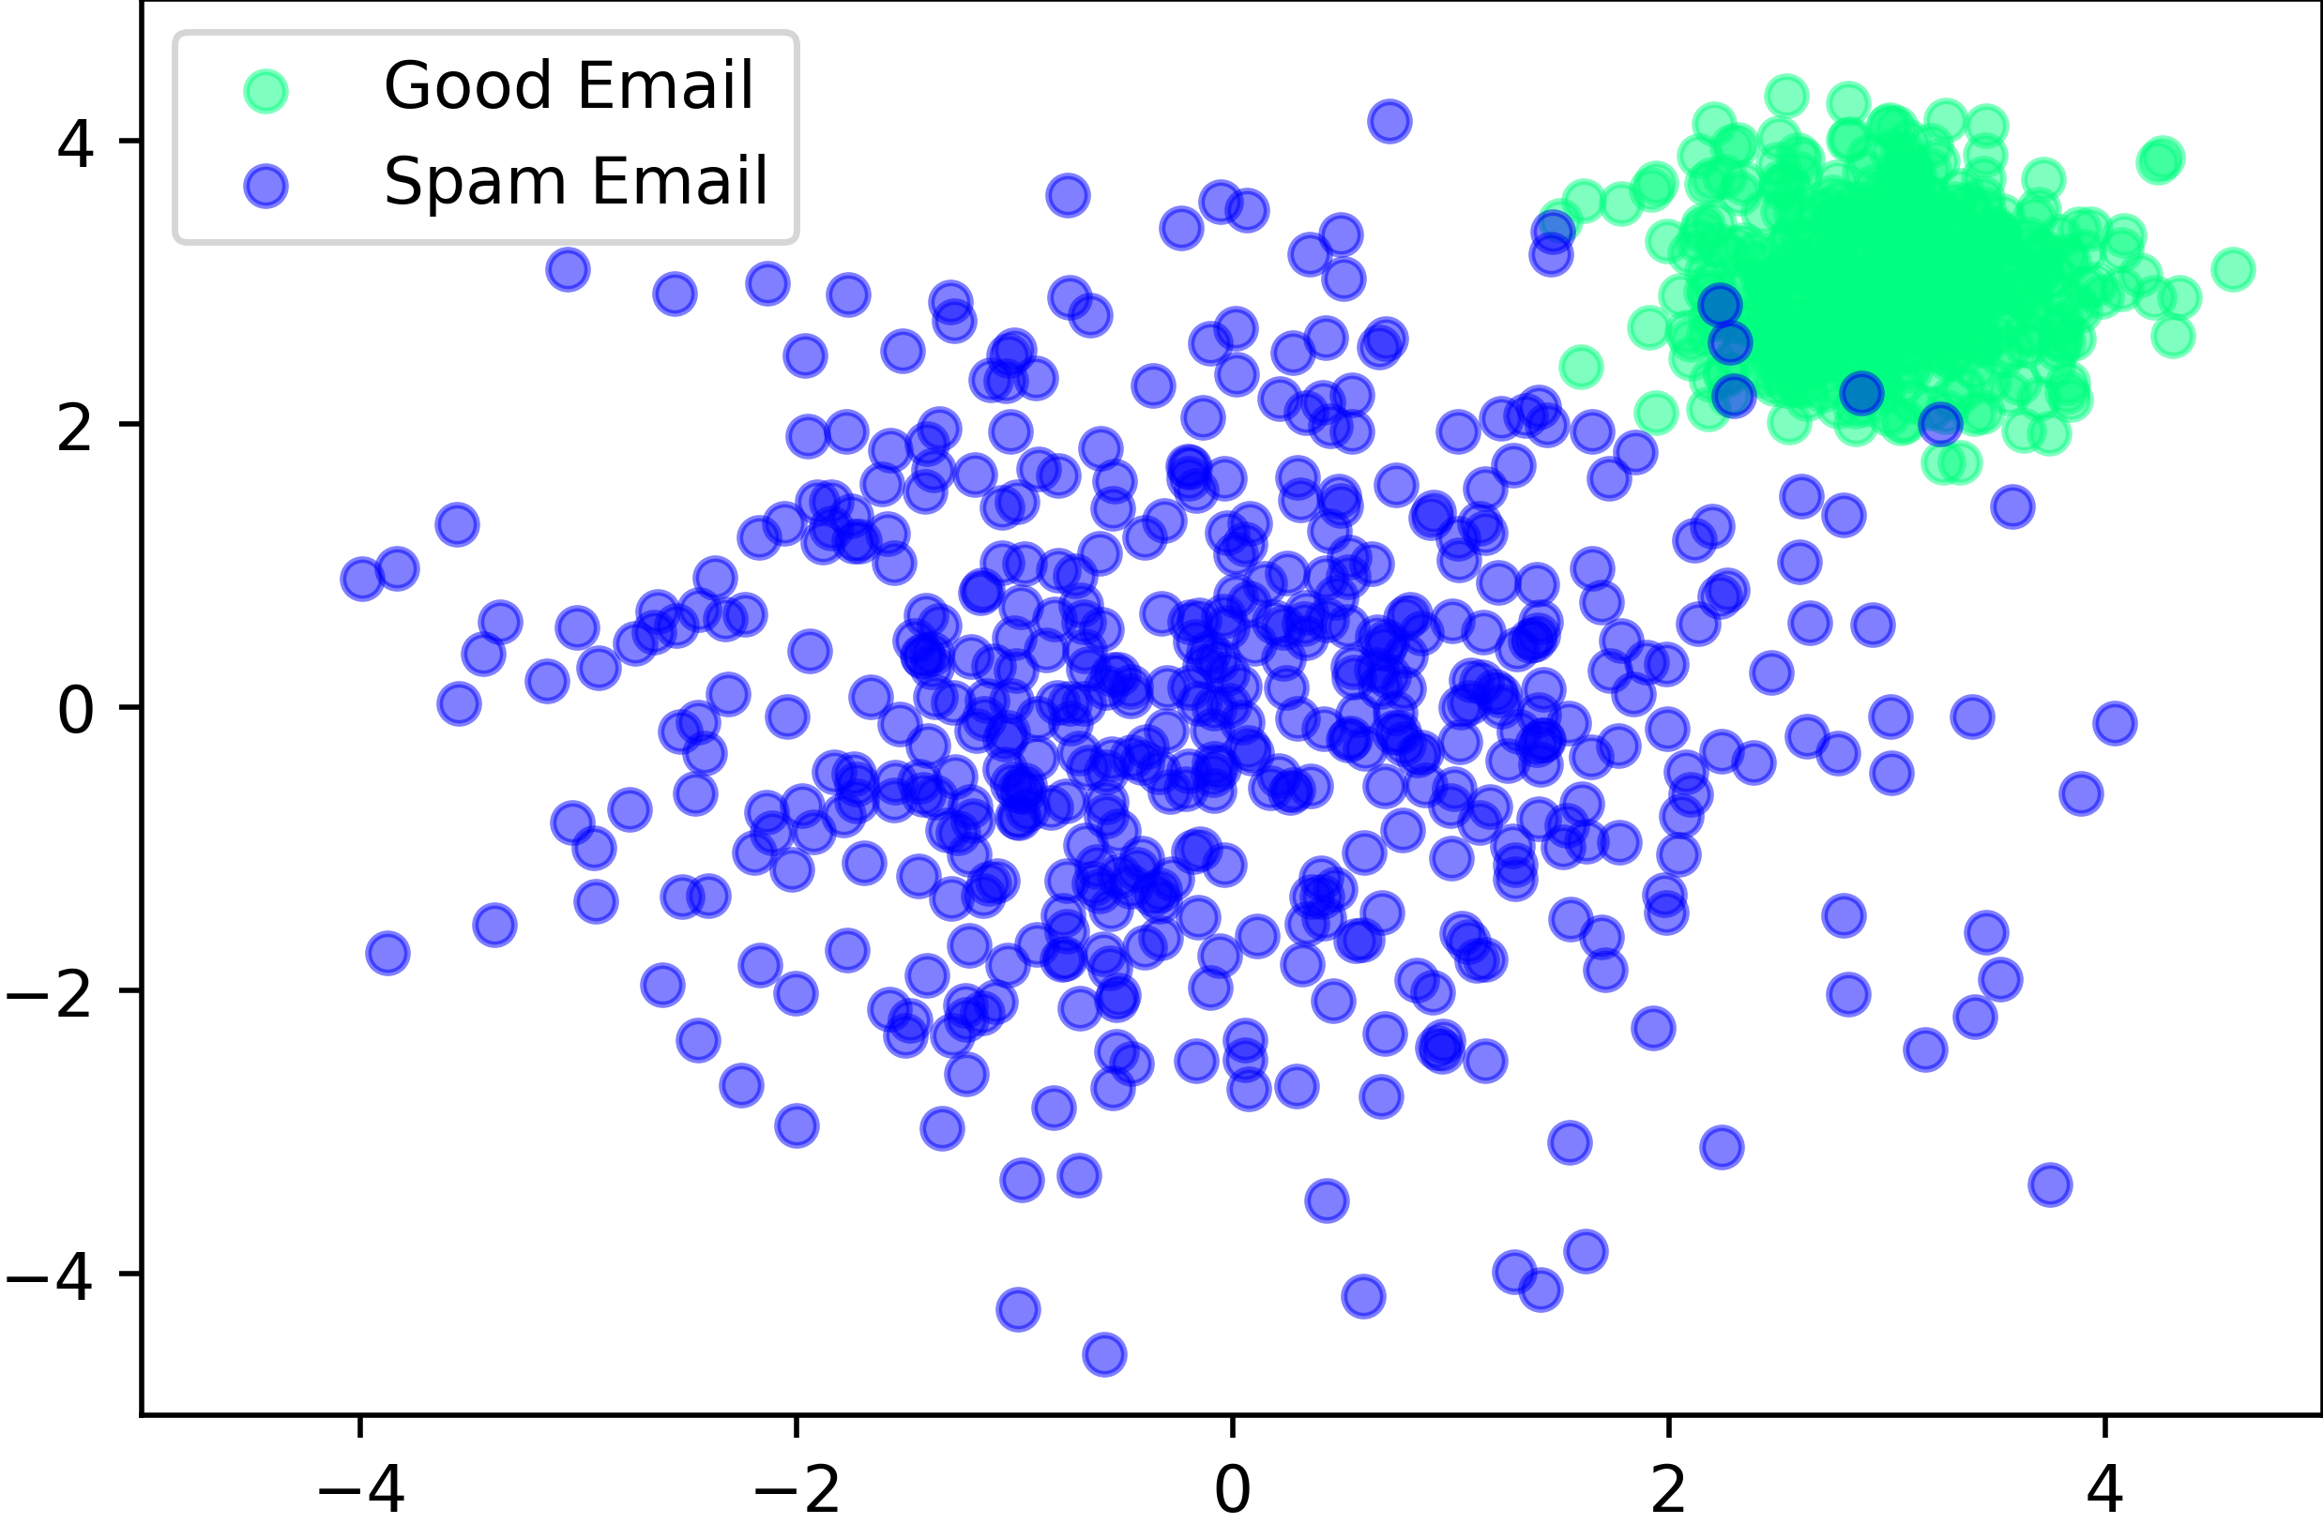
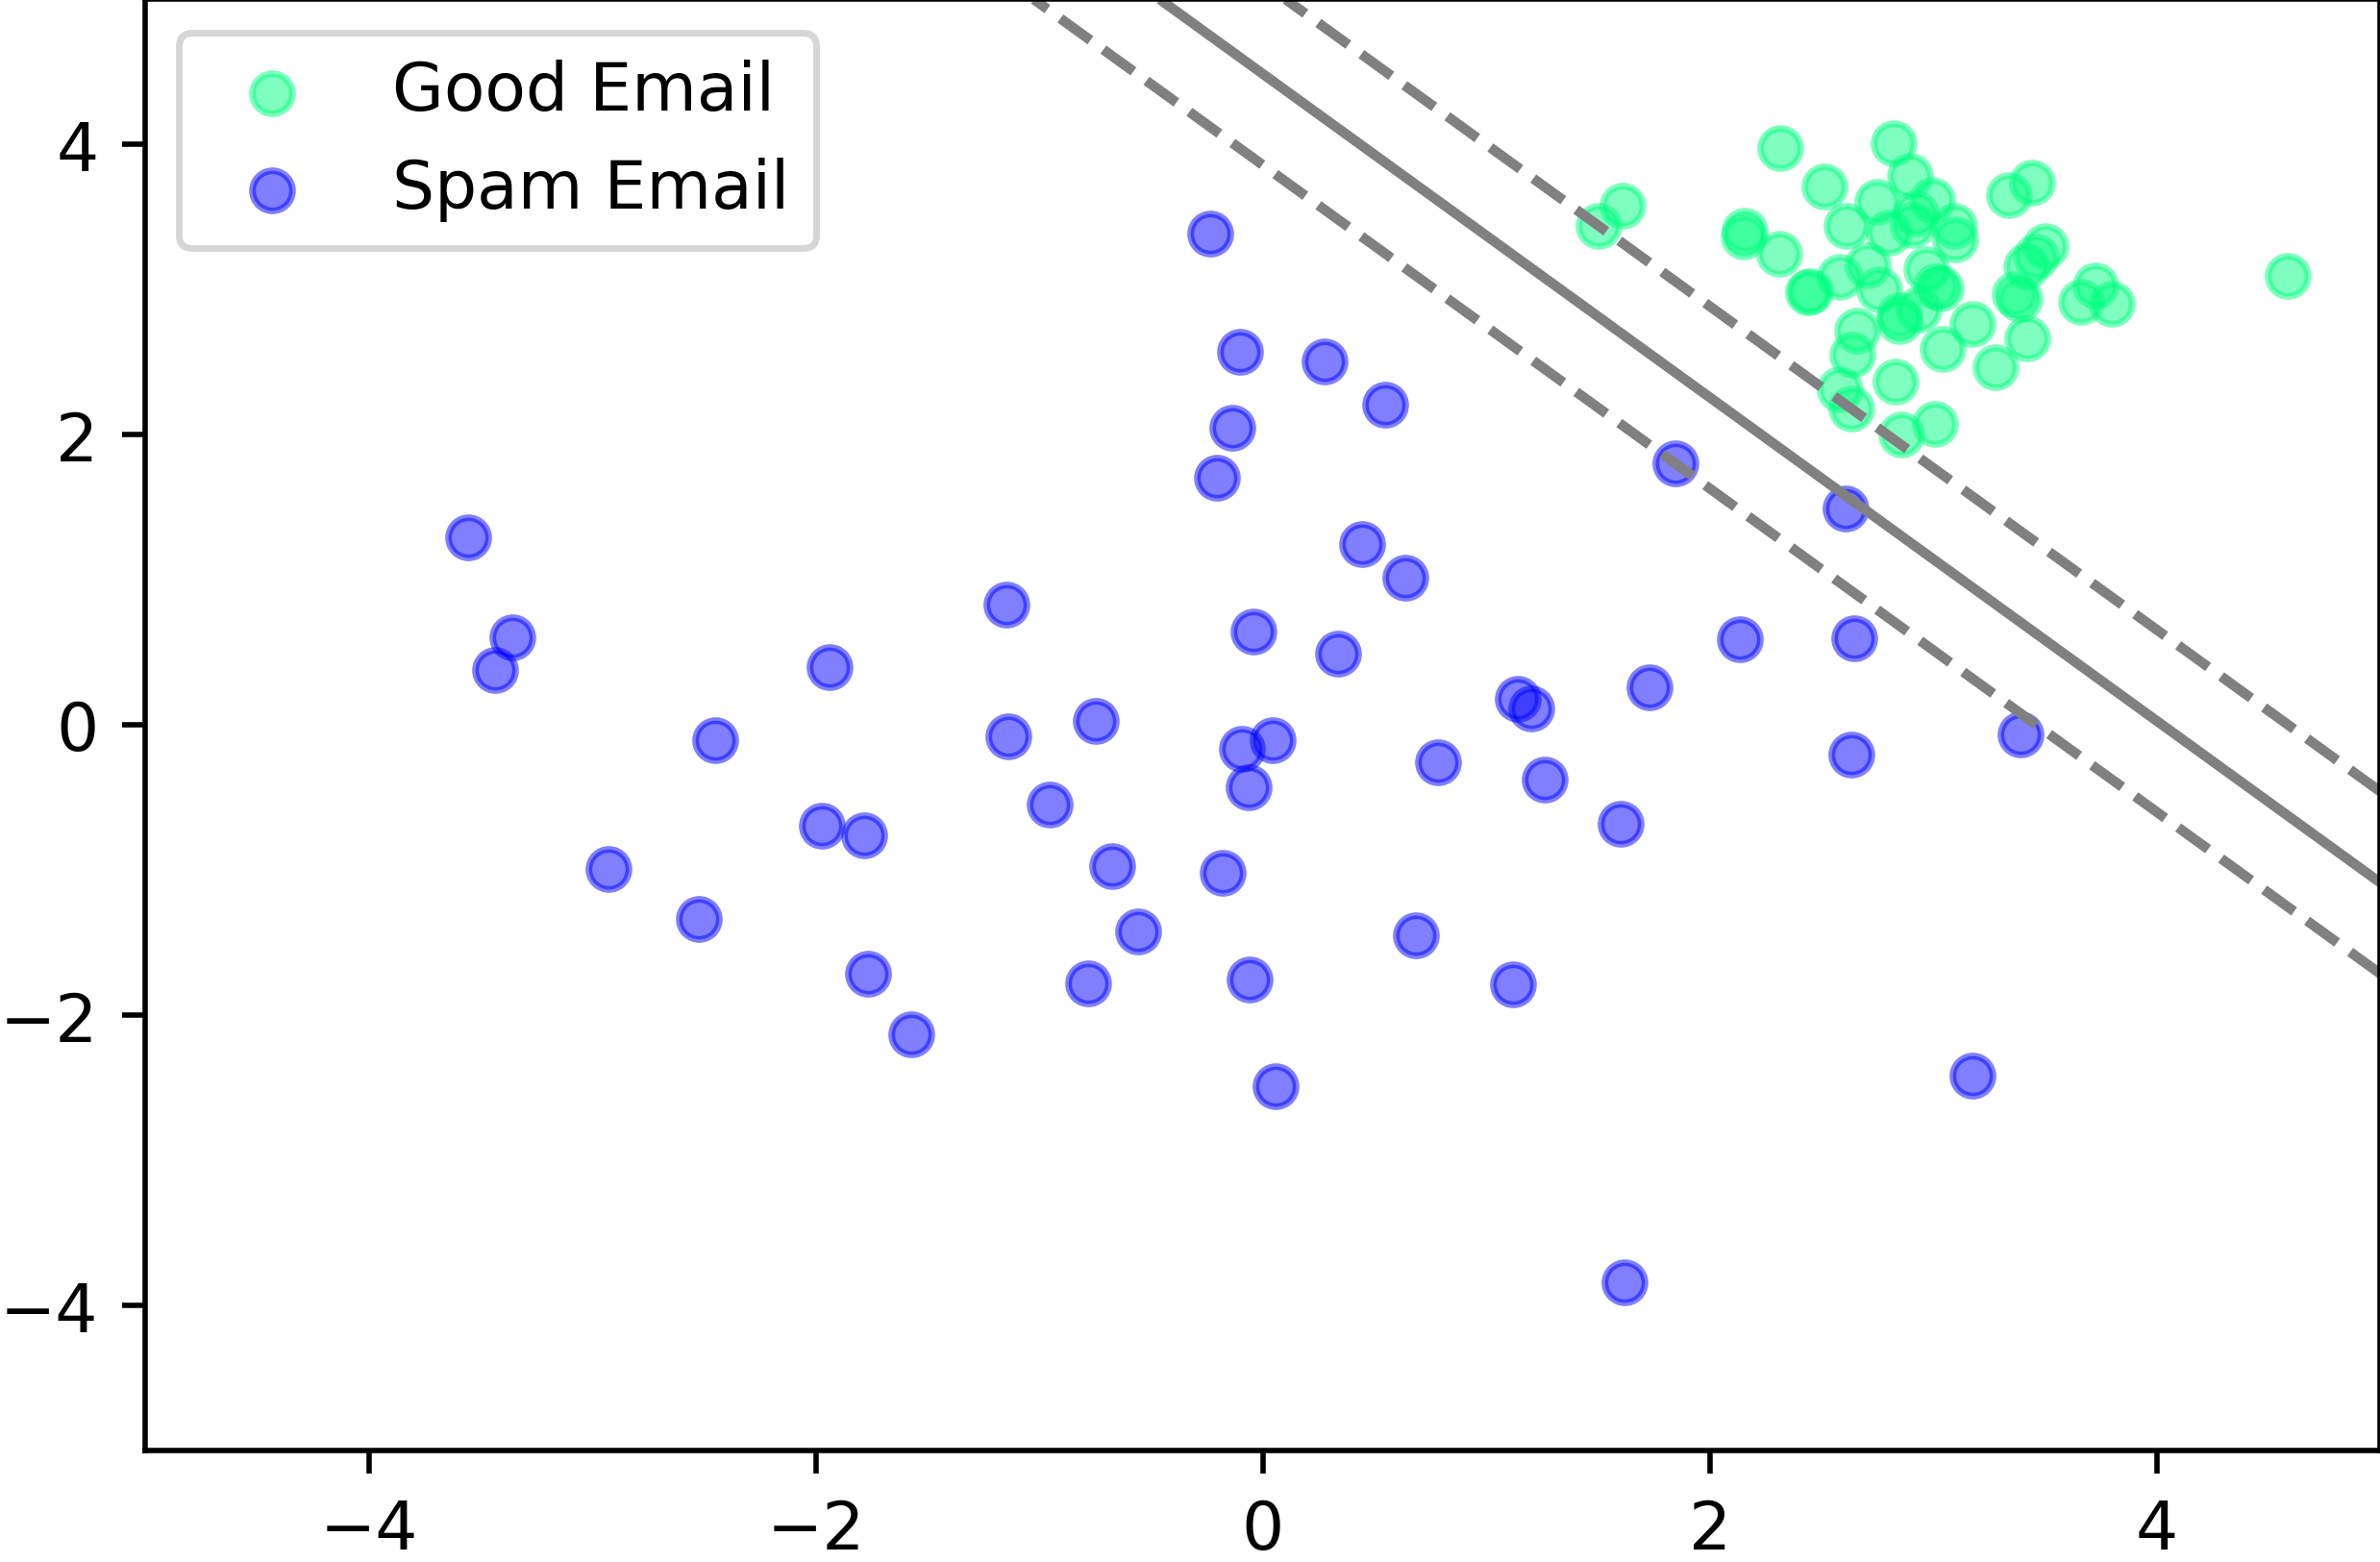
Classification
SVM Example

Slide 6
Supervised Learning
Classification
Input
“Training”
Programm (Model)
Output

Slide 7
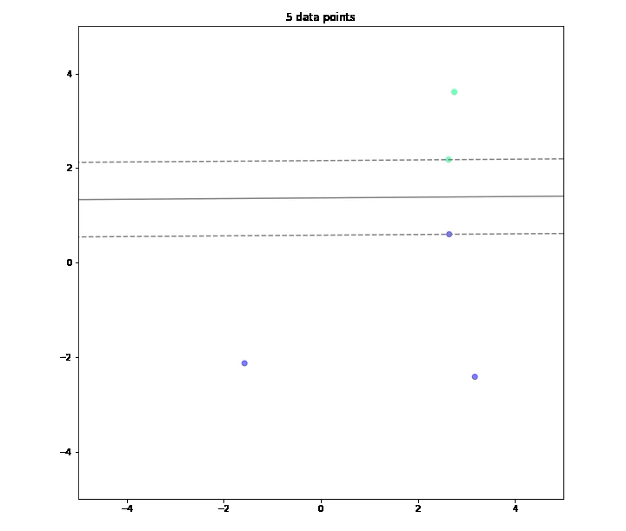
Classification
SVM Example

Slide 8
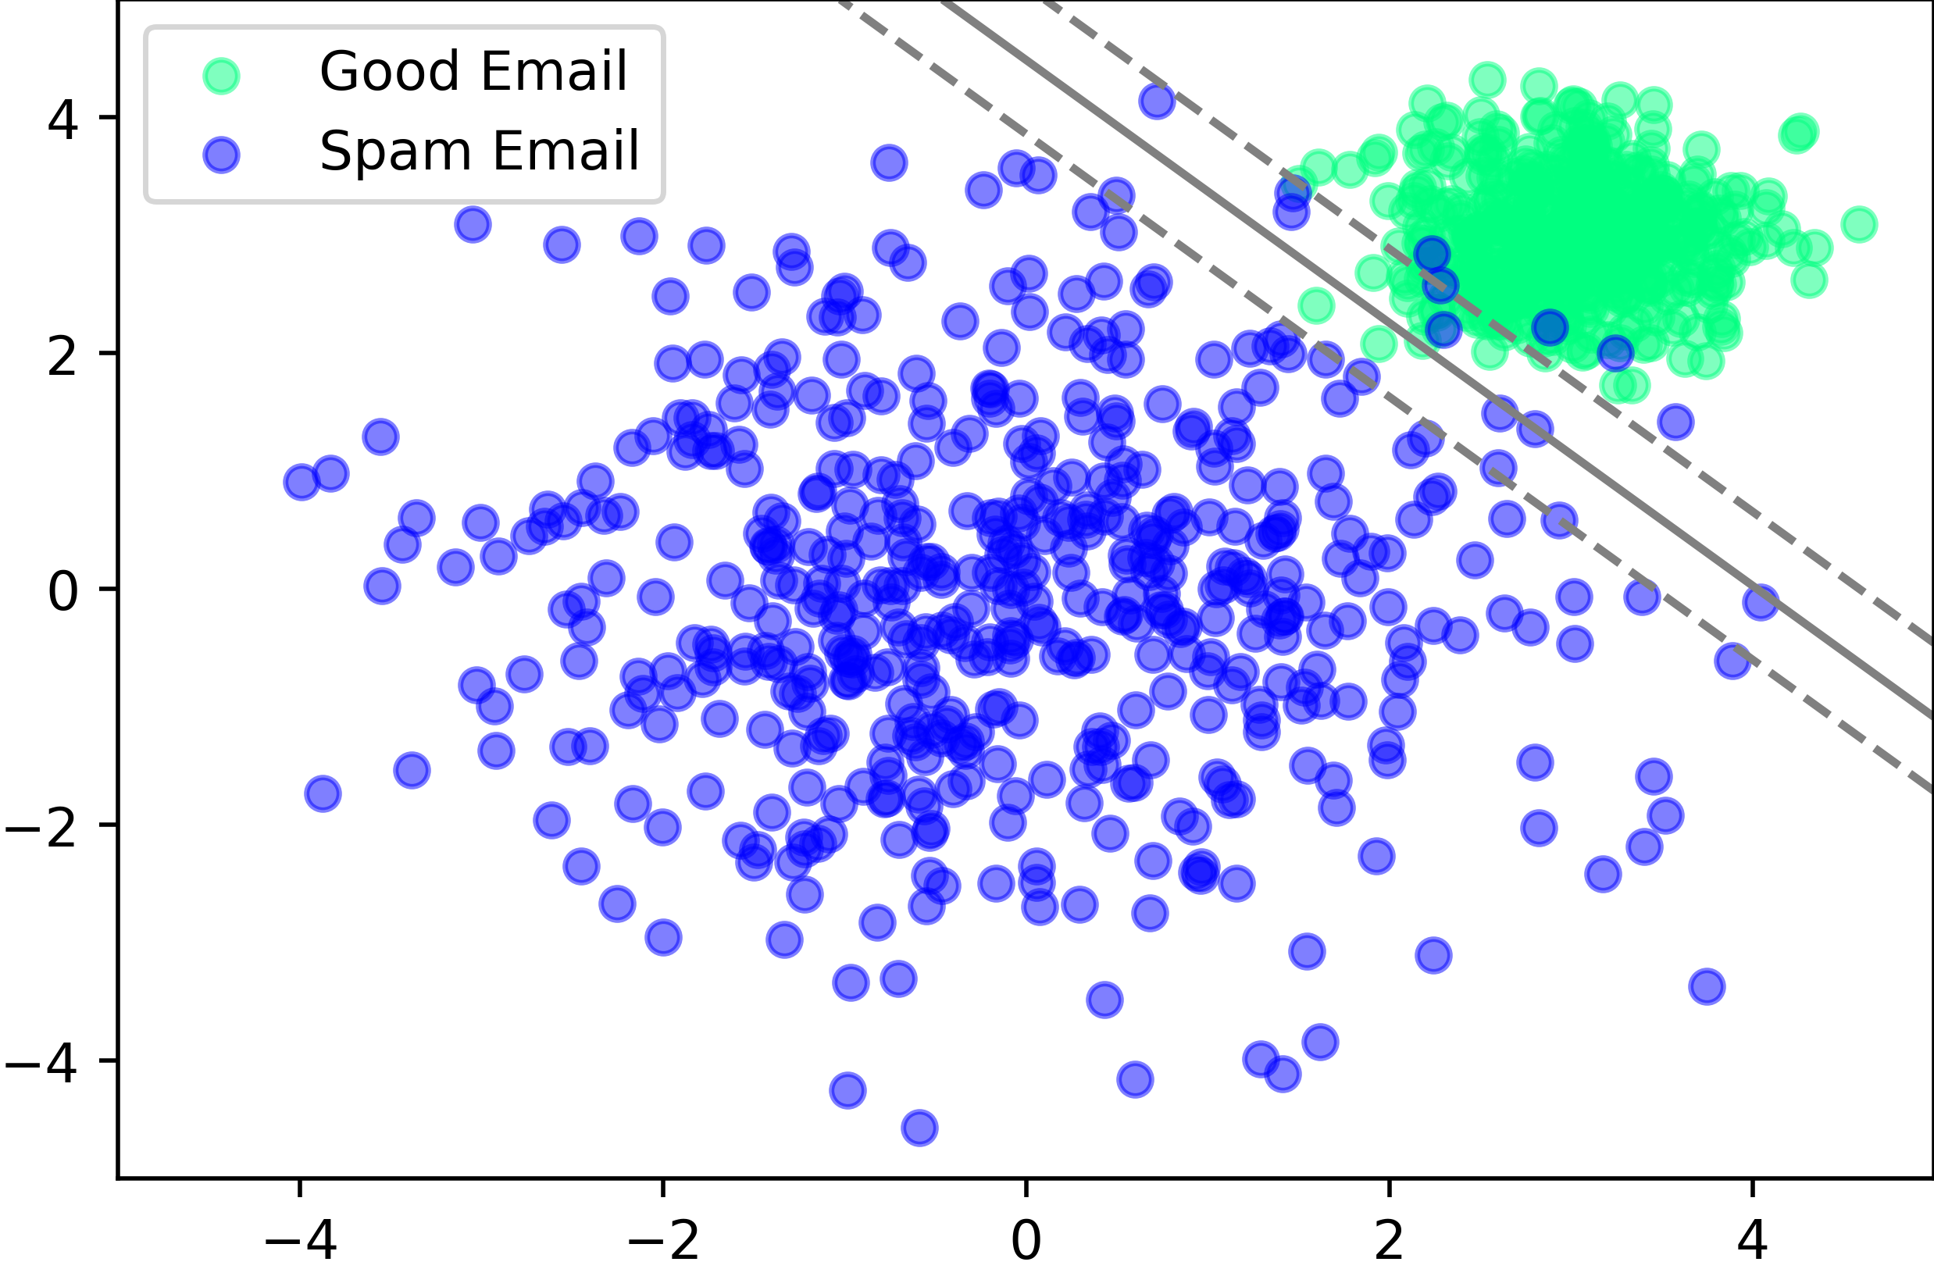
Classification
SVM Example

Slide 9
Regression
Supervised Learning

Slide 10
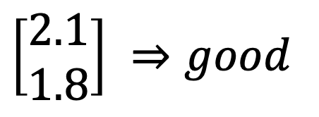
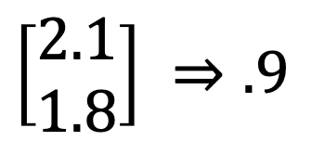
Regression
Classification
$\left[\begin{matrix}2.1 \\ 1.8\end{matrix}\right] ⇒good$
Regression
$\left[\begin{matrix}2.1 \\ 1.8\end{matrix}\right] ⇒.9$
With a likelihood of 90% is this email good.

Slide 11
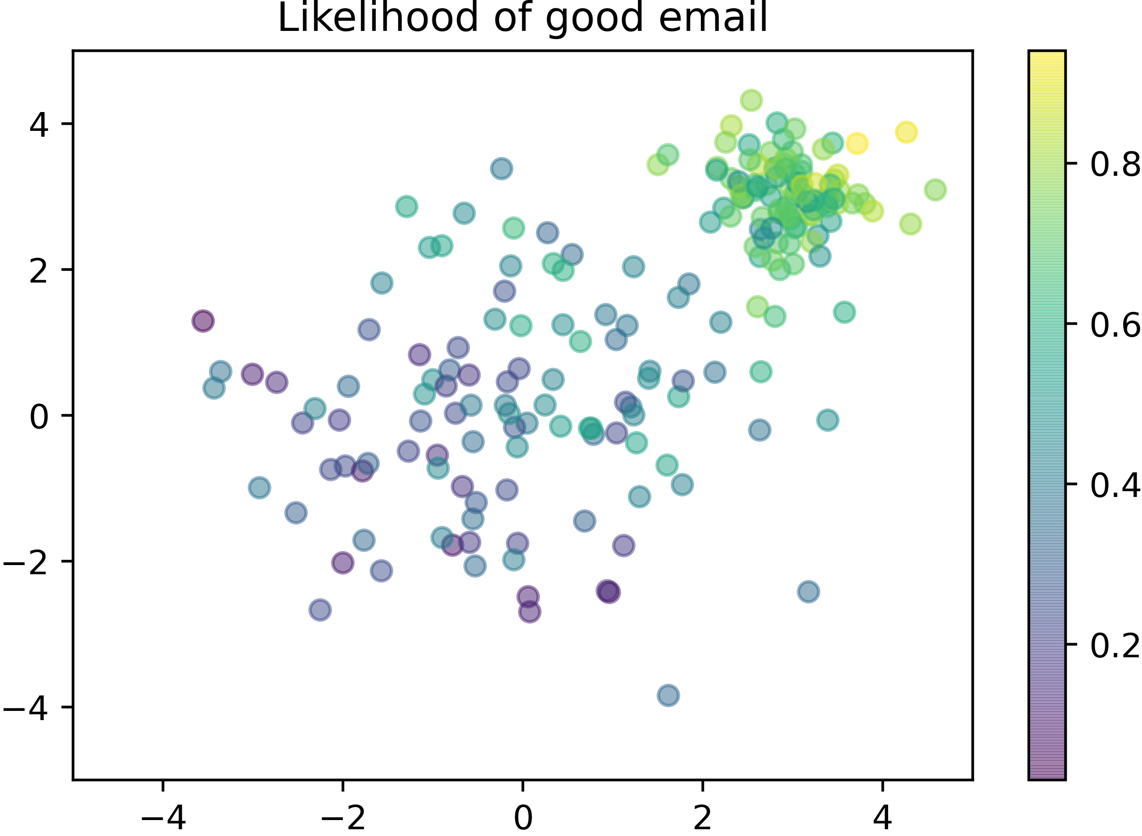
Regression

Slide 12
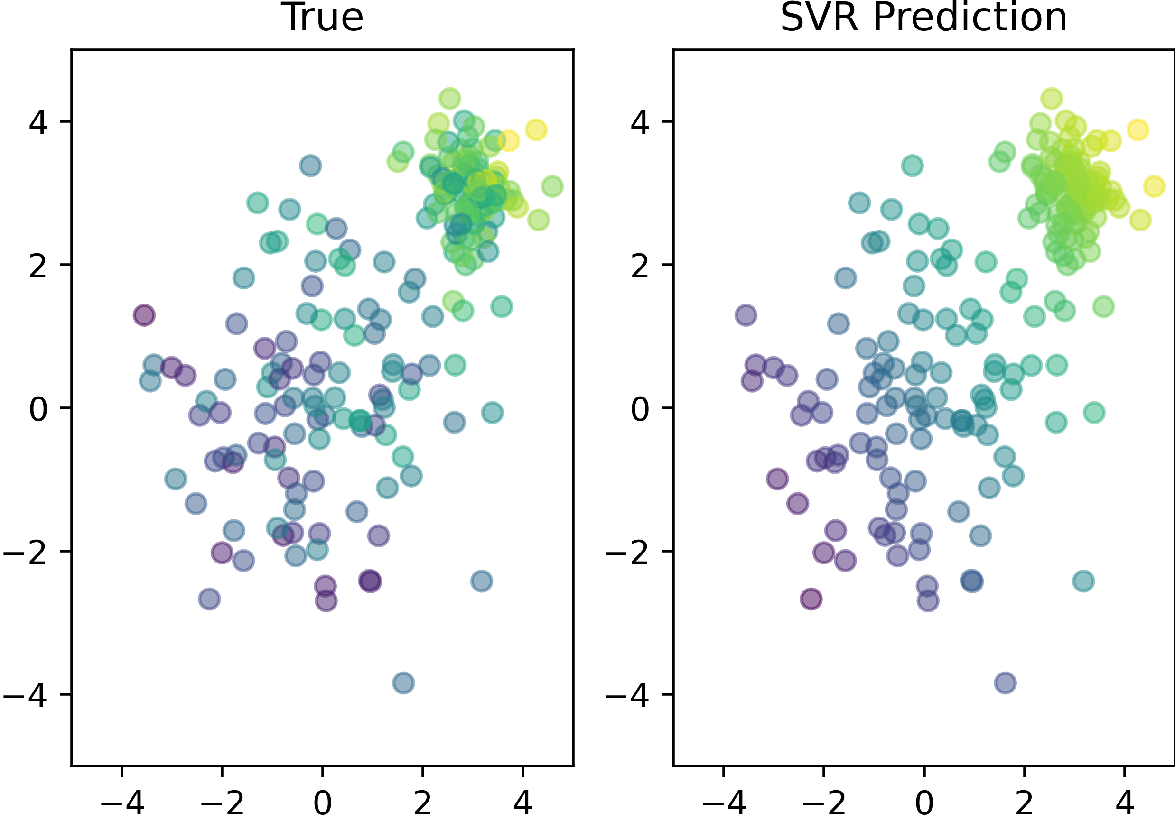
Regression
Linear Support Vector Regression (SVR)

Slide 13
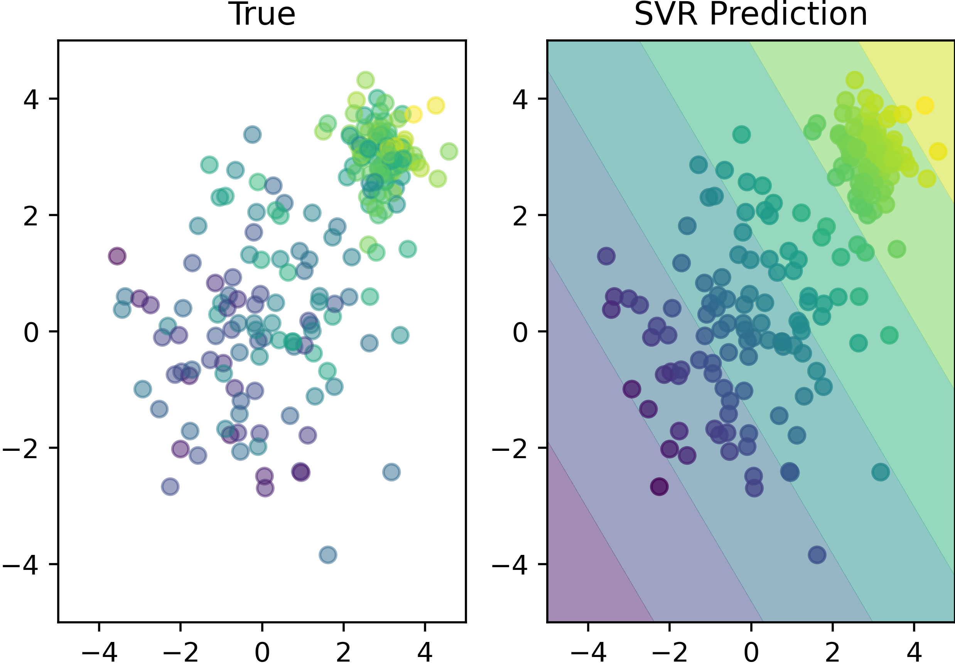
Regression
Linear Support Vector Regression (SVR)

Slide 14
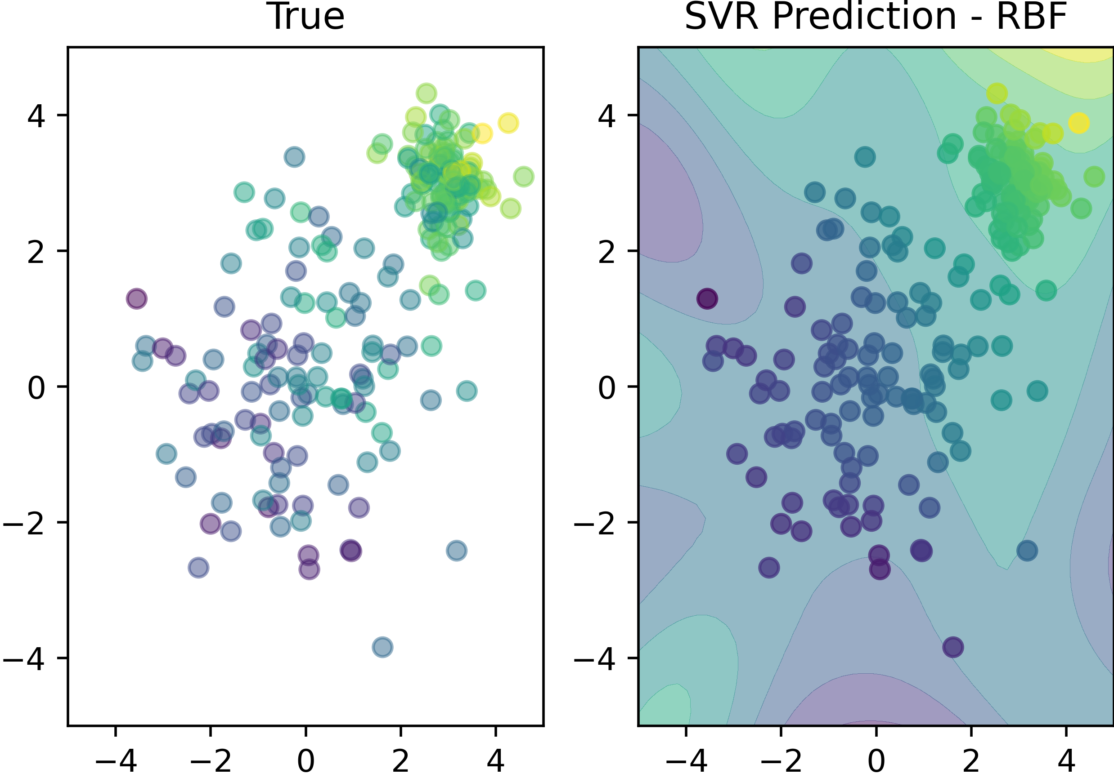
Regression
RBF Support Vector Regression (SVR)

Slide 15
Conclusion
Supervised Learning
Classification
Labeled data (paired input and label)
The label is of a class (e.g., dog, [grey, dog])
Regression
Labeled data (paired input and label)
Labels are on a continues scale (e.g., 3.4, [4.5, -17.1])

Slide 16

License
This file is licensed under the Creative Commons Attribution-Share Alike 4.0 (CC BY-SA) license:
https://creativecommons.org/licenses/by-sa/4.0
Attribution: Sven Mayer

