Slide 1


Practical Machine Learning
Neural Network Structure

Slide 2
Neuronal Network Structure
TensorFlow Syntax for a 2-Layer Model
model = tf.keras.Sequential()
x = tf.keras.layers.InputLayer((400,), name = "InputLayer")
model.add(x)
x = tf.keras.layers.Dense(14, name = "HiddenLayer1", activation = 'relu')
model.add(x)
model.add(tf.keras.layers.Dense(8, name = "HiddenLayer2", activation='relu'))
model.add(tf.keras.layers.Dense(2, name = "OutputLayer", activation = 'softmax'))

Slide 3
Layers to Pick from
tf.keras.layers.*
AbstractRNNCell
Activation
ActivityRegularization
Add
AdditiveAttention
AlphaDropout
Attention
Average
AveragePooling1D
AveragePooling2D
AveragePooling3D
AvgPool1D
AvgPool2D
AvgPool3D
BatchNormalization
Bidirectional
Concatenate
Conv1D
Conv1DTranspose
Conv2D
Conv2DTranspose
Conv3D
Conv3DTranspose
ConvLSTM2D
Convolution1D
Convolution1DTranspose
Convolution2D
Convolution2DTranspose
Convolution3D
Convolution3DTranspose
Cropping1D
Cropping2D
Cropping3D
Dense
DenseFeatures
DepthwiseConv2D
Dot
Dropout
ELU
Embedding
Flatten
GRU
GRUCell
GaussianDropout
GaussianNoise
GlobalAveragePooling1D
GlobalAveragePooling2D
GlobalAveragePooling3D
GlobalAvgPool1D
GlobalAvgPool2D
GlobalAvgPool3D
GlobalMaxPool1D
GlobalMaxPool2D
GlobalMaxPool3D
GlobalMaxPooling1D
GlobalMaxPooling2D
GlobalMaxPooling3D
InputLayer
InputSpec
LSTM
LSTMCell
Lambda
Layer
LayerNormalization
LeakyReLU
LocallyConnected1D
LocallyConnected2D
Masking
MaxPool1D
MaxPool2D
MaxPool3D
MaxPooling1D
MaxPooling2D
MaxPooling3D
Maximum
Minimum
MultiHeadAttention
Multiply
PReLU
Permute
RNN
ReLU
RepeatVector
Reshape
SeparableConv1D
SeparableConv2D
SeparableConvolution1D
SeparableConvolution2D
SimpleRNN
SimpleRNNCell
Softmax
SpatialDropout1D
SpatialDropout2D
SpatialDropout3D
StackedRNNCells
Subtract
ThresholdedReLU
TimeDistributed
UpSampling1D
UpSampling2D
UpSampling3D
Wrapper
ZeroPadding1D
ZeroPadding2D
ZeroPadding3D

Slide 4

Neuronal Network Structure
InputLayer
HiddenLayer1
HiddenLayer2
OutputLayer
InputLayer
Dense
Dense
Dense
$$⋮$$
2
8
400
14

Slide 5
Neuronal Network Structure
InputLayer
HiddenLayer1
HiddenLayer2
OutputLayer
InputLayer
Dense
Dense
Dense
Perceptron
$$⋮$$
2
8
400
14

Slide 6
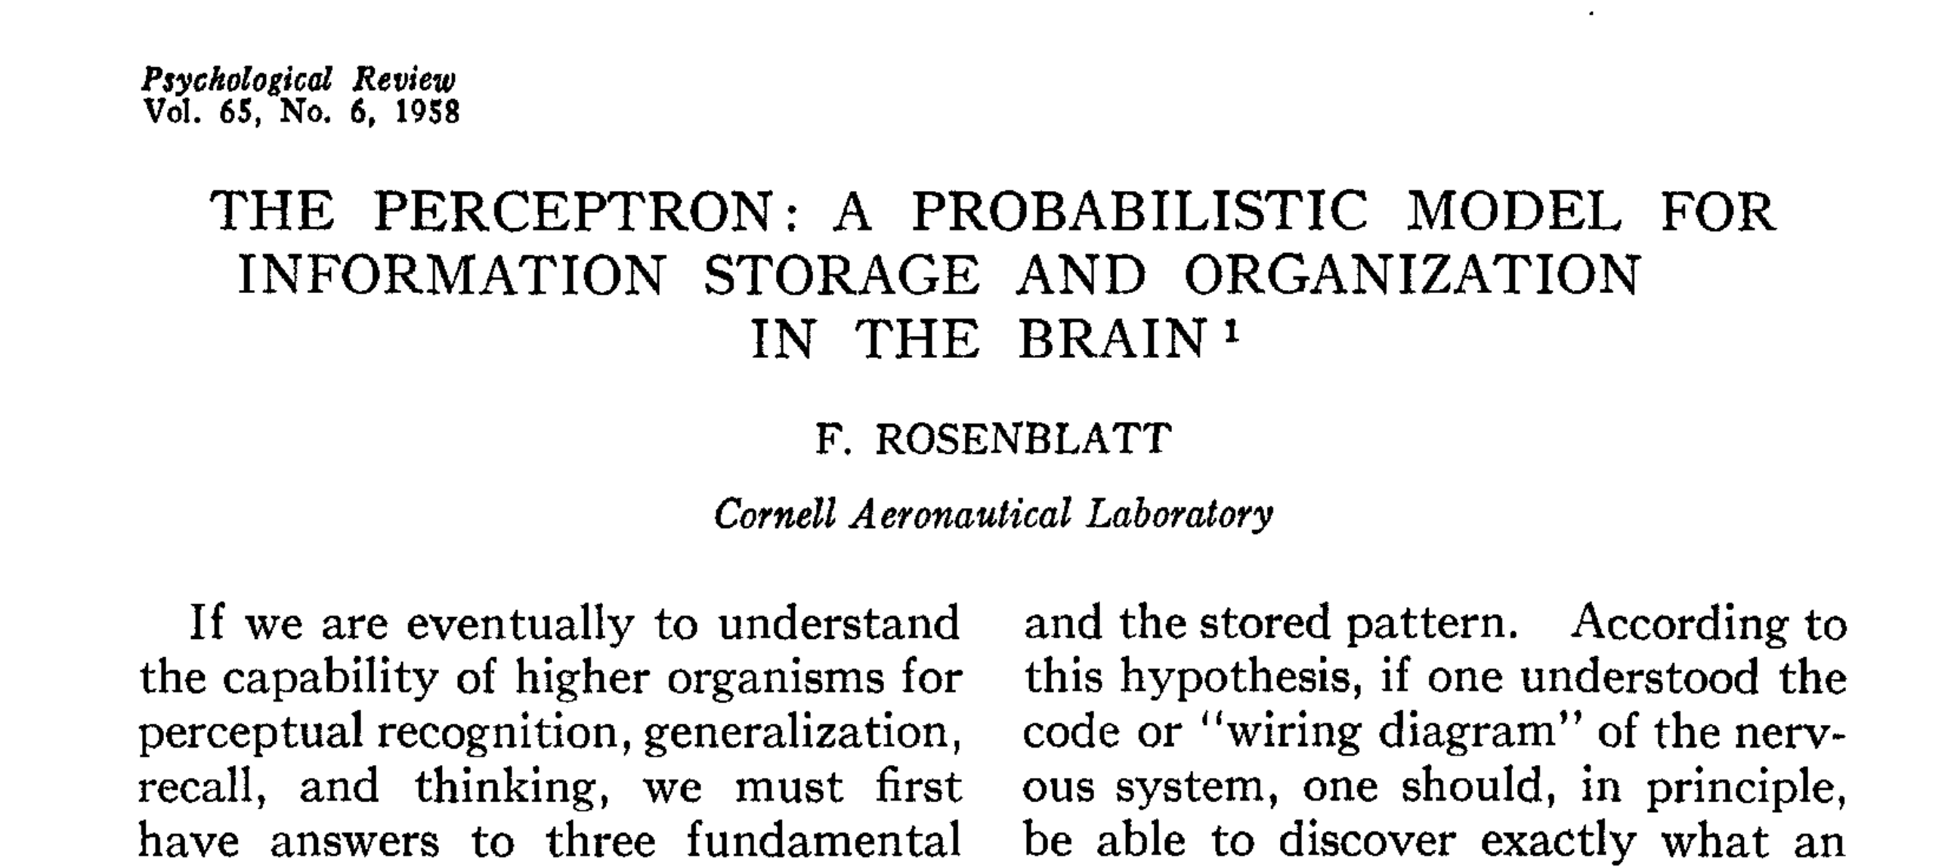
Neuronal Networks
What can be trained?
Frank Rosenblatt. "The perceptron: a probabilistic model for information storage and organization in the brain." Psychological review 65, no. 6 (1958): 386. DOI: https://psycnet.apa.org/doi/10.1037/h0042519

Slide 7










What is a Perceptron?
Single-Layer Perceptron
Bias
Input
Output
$$b$$
$$x_{0}$$
$$w_{0}$$
$$∑$$
$$a(z)$$
$$y$$
$$⋮$$
$$⋮$$
Activation function
$$x_{n}$$
$$w_{n}$$
Weights

Slide 8

What can be trained?
Single-Layer Perceptron
Input
Output
$$f\left(x\right)=y$$
Model
Notes:
. Dot Product != multiplication

Slide 9
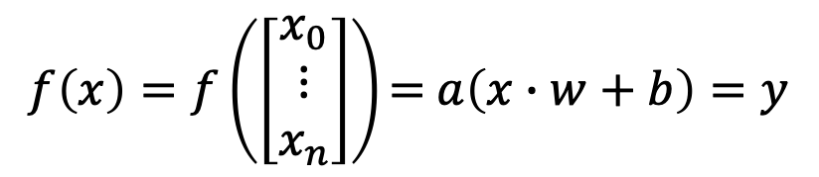
What can be trained?
Single-Layer Perceptron
Input
$$f\left(x\right)=f\left(\left[\begin{matrix}x_{0} \\ ⋮ \\ x_{n}\end{matrix}\right]\right)\text{= }a\left(x∙w+b\right)=y$$
Model
Output
Notes:
. Dot Product != multiplication

Slide 10
What can be trained?
Single-Layer Perceptron
Input
Weights
Bias
$$f\left(x\right)=f\left(\left[\begin{matrix}x_{0} \\ ⋮ \\ x_{n}\end{matrix}\right]\right)\text{= }a\left(x∙w+b\right)=y$$
Model
Activation function
Output
Notes:
. Dot Product != multiplication

Slide 11
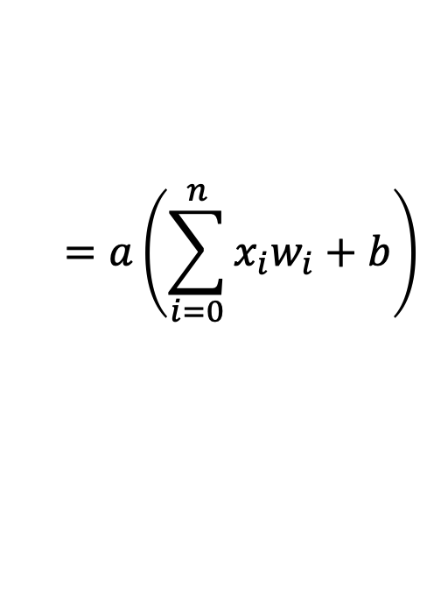
What can be trained?
Single-Layer Perceptron
Input
Weights
Bias
$$f\left(x\right)=f\left(\left[\begin{matrix}x_{0} \\ ⋮ \\ x_{n}\end{matrix}\right]\right)\text{= }a\left(x∙w+b\right)=y$$
Model
Activation function
Output
$$=a\left(\sum_{i=0}^{n}{x_{i}w_{i}}+b\right)$$
Notes:
. Dot Product != multiplication

Slide 12
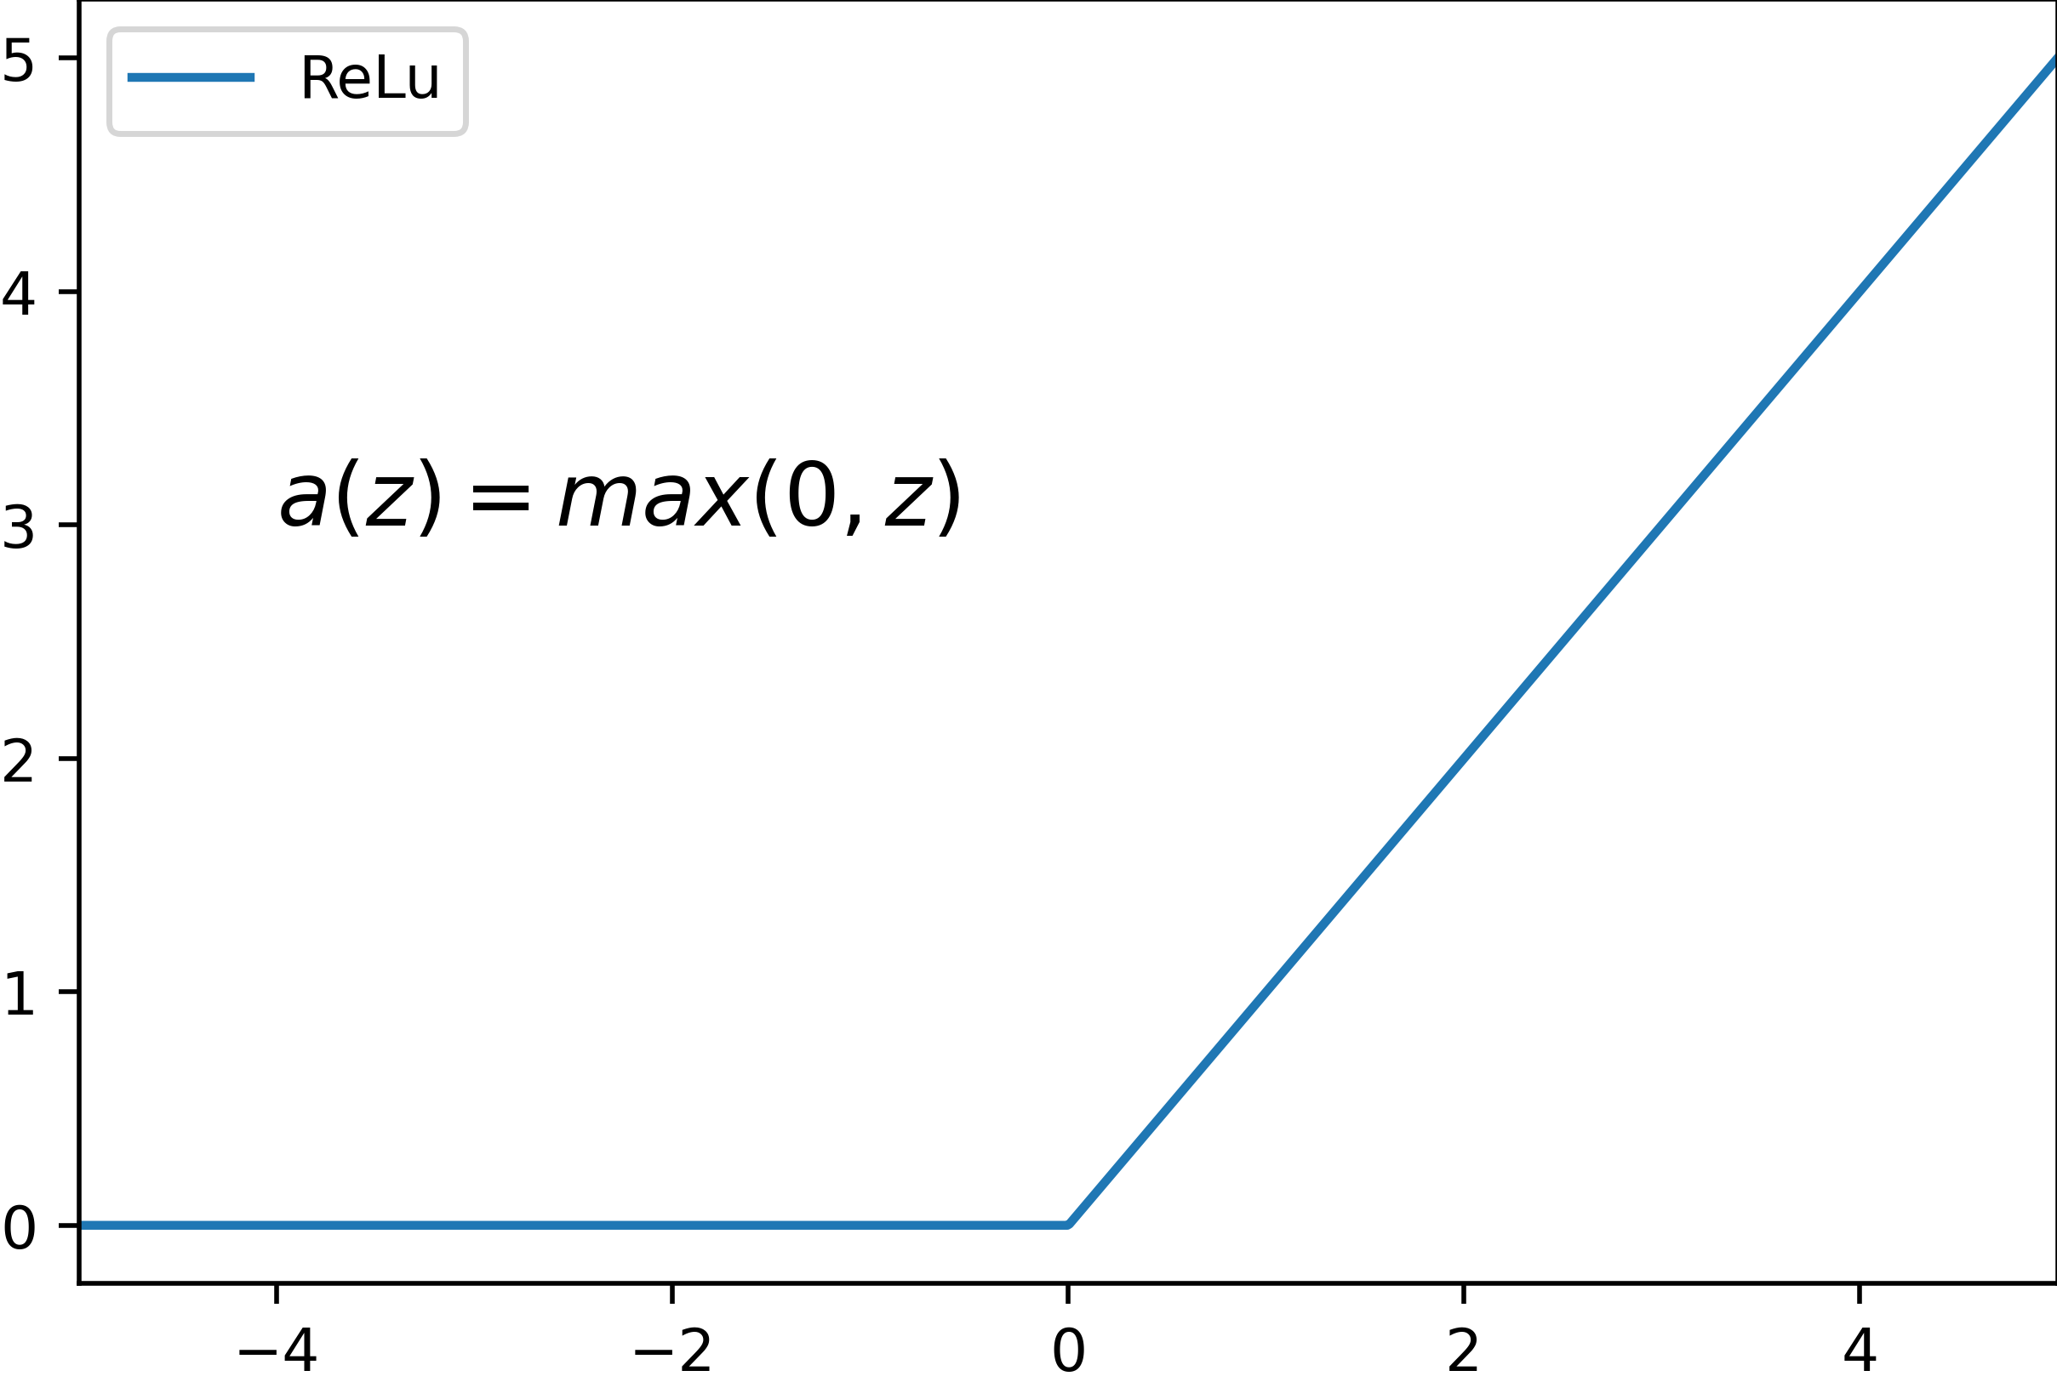
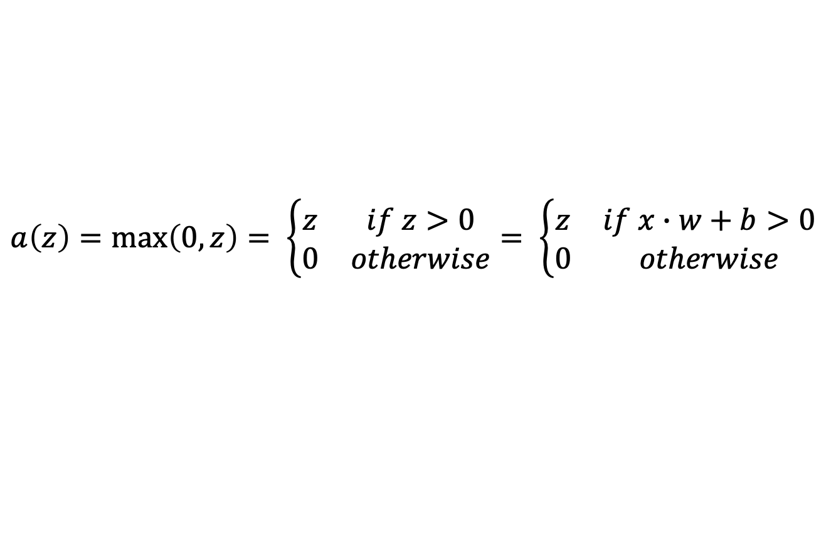
Activation Function
Rectified Linear Unit (ReLU)
$$a\left(z\right)=\max\left(0,z\right)= \left\{\begin{matrix}z & if z>0 \\ 0 & otherwise\end{matrix}\right.= \left\{\begin{matrix}z & if x∙w+b>0 \\ 0 & otherwise\end{matrix}\right.$$

Slide 13

Neuronal Network Structure
InputLayer
HiddenLayer1
HiddenLayer2
OutputLayer
$$a\left(\left[\begin{matrix}x_{0} \\ ⋮ \\ x_{n}\end{matrix}\right]∙\left[\begin{matrix}w_{0} \\ ⋮ \\ w_{n}\end{matrix}\right]+b\right)$$
Perceptron
$$⋮$$
2
8
400
14

Slide 14
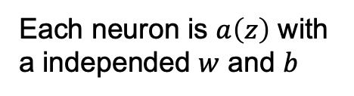
Neuronal Network Structure
InputLayer
HiddenLayer1
HiddenLayer2
OutputLayer
Each neuron is $a\left(z\right)$ with a independed $w$ and $b$
$$⋮$$
2
8
400
14

Slide 15

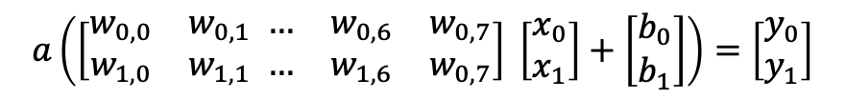
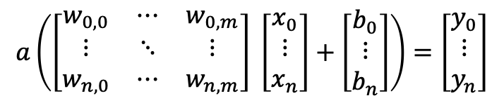

Combining Perceptions
Why is it all about fast matrix multiplication?
$$a\left(x∙w_{0}+b_{0}\right)=y_{0}$$
$$a\left(x∙w_{1}+b_{1}\right)=y_{1}$$
2
8
$$a\left(\left[\begin{matrix}w_{0,0} & w_{0,1} \\ w_{1,0} & w_{1,1}\end{matrix} \begin{matrix}… & w_{0,6} & w_{0,7} \\ … & w_{1,6} & w_{0,7}\end{matrix}\right] \left[\begin{matrix}x_{0} \\ x_{1}\end{matrix}\right]+\left[\begin{matrix}b_{0} \\ b_{1}\end{matrix}\right]\right)=\left[\begin{matrix}y_{0} \\ y_{1}\end{matrix}\right]$$
$$a\left(\left[\begin{matrix}w_{0,0} & ⋯ & w_{0,m} \\ ⋮ & ⋱ & ⋮ \\ w_{n,0} & ⋯ & w_{n,m}\end{matrix}\right] \left[\begin{matrix}x_{0} \\ ⋮ \\ x_{n}\end{matrix}\right]+\left[\begin{matrix}b_{0} \\ ⋮ \\ b_{n}\end{matrix}\right]\right)=\left[\begin{matrix}y_{0} \\ ⋮ \\ y_{n}\end{matrix}\right]$$

Slide 16

Parameter
$$⋮$$
2
Layers 400, 14, 8, and 2
  => weights: 400 * 14 + 14 * 8 + 8 * 2 = 5,728
  => biases: 14 + 8 + 2 = 24
  => trainable parameter: 5,728 + 24 = 5,752
Trainable parameters can raise fast
  Layers 400, 100, 40, 2 => Parameter: 44,222
  (one model from the walkthough)
8
400
14

Slide 17
Conclusion
Neural Network Structure
Perceptron
Weights
Biases
Combining multiple Perceptron
Trainable Parameter
Activation Function (e.g. ReLu)

Slide 18

License
This file is licensed under the Creative Commons Attribution-Share Alike 4.0 (CC BY-SA) license:
https://creativecommons.org/licenses/by-sa/4.0
Attribution: Sven Mayer

