Slide 1


Practical Machine Learning
Backpropagation

Slide 2

Parameter
$$⋮$$
2
Layers 400, 14, 8, and 2
  → weights: 400 * 14 + 14 * 8 + 8 * 2 = 5,728
  → biases: 14 + 8 + 2 = 24
  → trainable parameter: 5,728 + 24 = 5,752
Trainable parameters can raise fast
  Layers 400, 100, 40, 2 => Parameter: 44,222
  (one model from the walkthough)
8
400
14

Slide 3

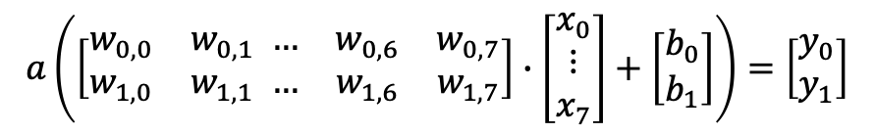
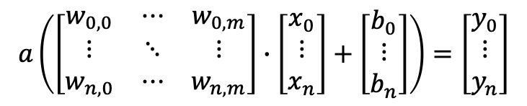

Combining Perceptions
Why is it all about fast matrix multiplication?
$$a\left(x∙w_{0}+b_{0}\right)=y_{0}$$
$$a\left(x∙w_{1}+b_{1}\right)=y_{1}$$
2
8
$$a\left(\left[\begin{matrix}w_{0,0} & w_{0,1} \\ w_{1,0} & w_{1,1}\end{matrix} \begin{matrix}… & w_{0,6} & w_{0,7} \\ … & w_{1,6} & w_{1,7}\end{matrix}\right]∙\left[\begin{matrix}x_{0} \\ ⋮ \\ x_{7}\end{matrix}\right]+\left[\begin{matrix}b_{0} \\ b_{1}\end{matrix}\right]\right)=\left[\begin{matrix}y_{0} \\ y_{1}\end{matrix}\right]$$
$$a\left(\left[\begin{matrix}w_{0,0} & ⋯ & w_{0,m} \\ ⋮ & ⋱ & ⋮ \\ w_{n,0} & ⋯ & w_{n,m}\end{matrix}\right]∙\left[\begin{matrix}x_{0} \\ ⋮ \\ x_{n}\end{matrix}\right]+\left[\begin{matrix}b_{0} \\ ⋮ \\ b_{n}\end{matrix}\right]\right)=\left[\begin{matrix}y_{0} \\ ⋮ \\ y_{n}\end{matrix}\right]$$

Slide 4
Training
Trainable Parameter
Weights
Biases
Trainable Parameter
Trainable Parameter
Input
Output
Given by the previous layer
Given by the label
$$a\left(\left[\begin{matrix}w_{0,0} & w_{0,1} \\ w_{1,0} & w_{1,1}\end{matrix} \begin{matrix}… & w_{0,6} & w_{0,7} \\ … & w_{1,6} & w_{1,7}\end{matrix}\right]∙\left[\begin{matrix}x_{0} \\ ⋮ \\ x_{7}\end{matrix}\right]+\left[\begin{matrix}b_{0} \\ b_{1}\end{matrix}\right]\right)=\left[\begin{matrix}y_{0} \\ y_{1}\end{matrix}\right]$$
$$a\left(\left[\begin{matrix}w_{0,0} & ⋯ & w_{0,m} \\ ⋮ & ⋱ & ⋮ \\ w_{n,0} & ⋯ & w_{n,m}\end{matrix}\right]∙\left[\begin{matrix}x_{0} \\ ⋮ \\ x_{n}\end{matrix}\right]+\left[\begin{matrix}b_{0} \\ ⋮ \\ b_{n}\end{matrix}\right]\right)=\left[\begin{matrix}y_{0} \\ ⋮ \\ y_{n}\end{matrix}\right]$$

Slide 5

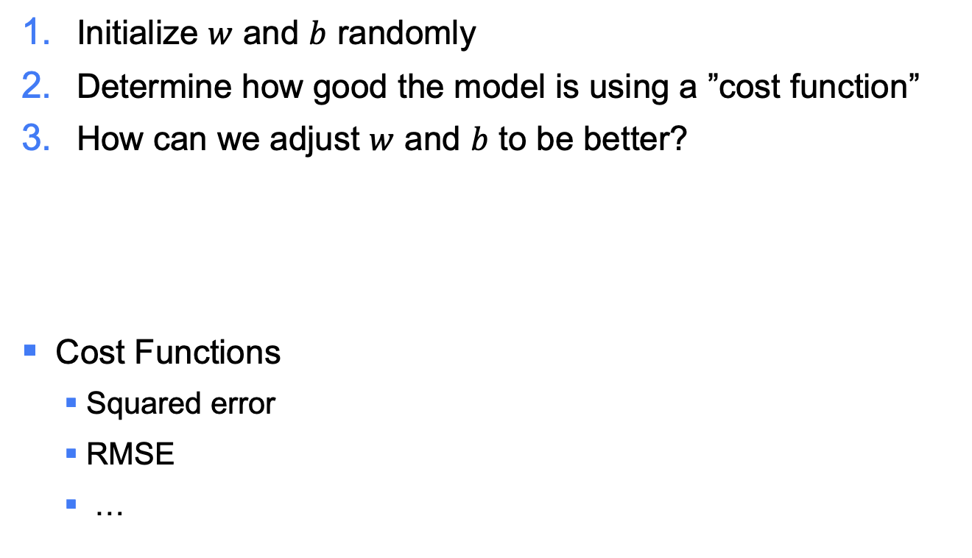
Training
Initialize $w$ and $b$ randomly
Determine how good the model is using a ”cost function”
How can we adjust $w$ and $b$ to be better?
Cost Functions
  Squared error
  RMSE
  …
$${\left(\left[\begin{matrix}y_{t,0} \\ ⋮ \\ y_{t,n}\end{matrix}\right]−\left[\begin{matrix}y_{p,0} \\ ⋮ \\ y_{p,n}\end{matrix}\right]\right)}^{2}$$

Slide 6
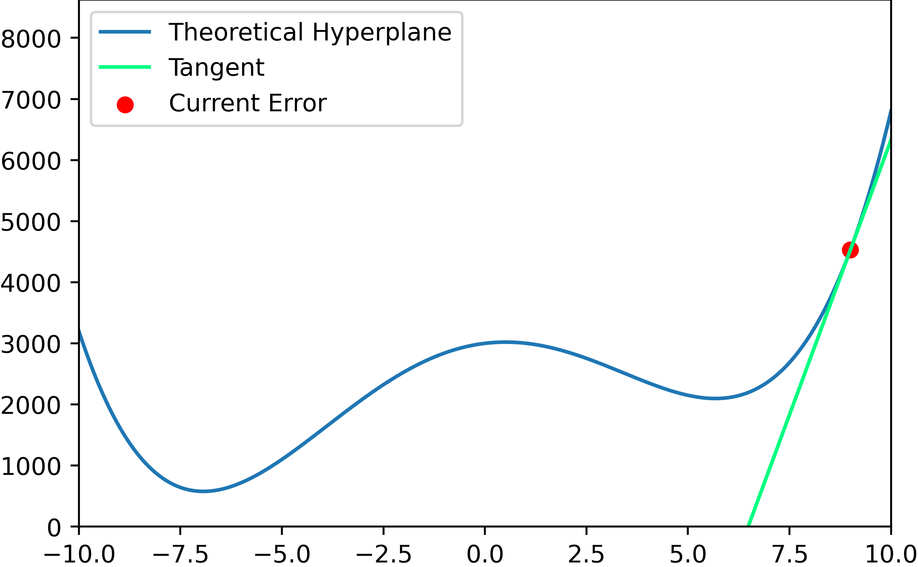
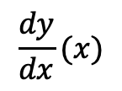
Optimization
“Stochastic Gradient Descent”
In which direction do we need to go to minimize our cost?
$$\frac{dy}{dx}(x)$$

Slide 7
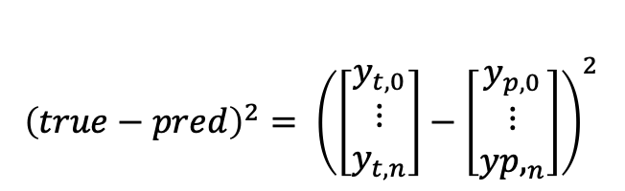


InputLayer
HiddenLayer1
HiddenLayer2
OutputLayer
Adjusting $w$ and $b$
$$⋮$$
2
Error
$${\left(true−pred\right)}^{2}= {\left(\left[\begin{matrix}y_{t,0} \\ ⋮ \\ y_{t,n}\end{matrix}\right]−\left[\begin{matrix}y_{p,0} \\ ⋮ \\ {yp,}_{n}\end{matrix}\right]\right)}^{2}$$
8
400
14

Slide 8


InputLayer
HiddenLayer1
HiddenLayer2
OutputLayer
Adjusting $w$ and $b$
Adjusting $w$ and $b$
Adjusting $w$ and $b$
$$⋮$$
2
Error
$${\left(true−pred\right)}^{2}= {\left(\left[\begin{matrix}y_{t,0} \\ ⋮ \\ y_{t,n}\end{matrix}\right]−\left[\begin{matrix}y_{p,0} \\ ⋮ \\ {yp,}_{n}\end{matrix}\right]\right)}^{2}$$
8
400
14

Slide 9
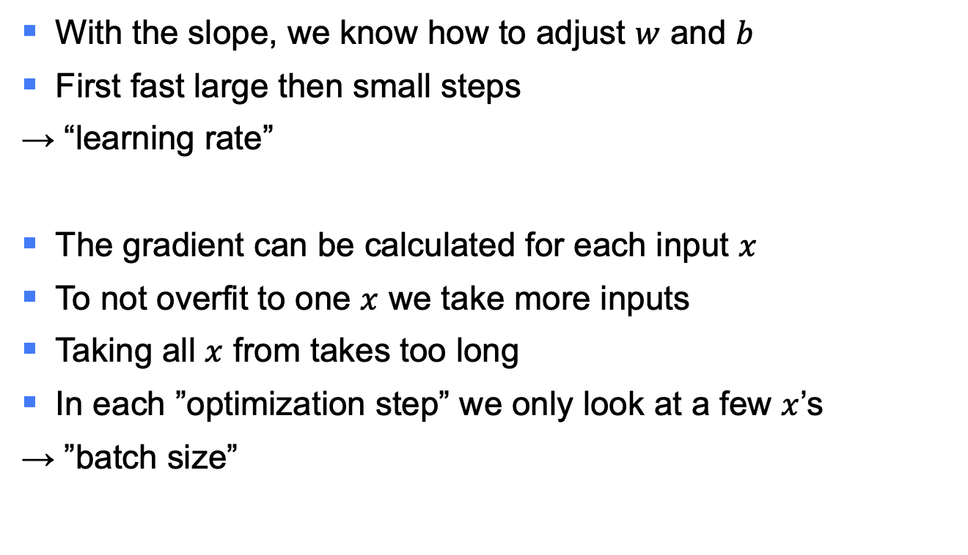

Adjusting $w$ and $b$
With the slope, we know how to adjust $w$ and $b$
First fast large then small steps
→ “learning rate”
The gradient can be calculated for each input $x$
To not overfit to one $x$ we take more inputs
Taking all $x$ from takes too long
In each ”optimization step” we only look at a few $x$’s
→ ”batch size”

Slide 10
Conclusion
Backpropagation
Backpropagation
Trainable Parameter: Weights and biases
Optimizing e.g. Stochastic Gradient Descent
Loss function e.g. MSE, MAE, RMSE
Learning rate
Batch size

Slide 11

License
This file is licensed under the Creative Commons Attribution-Share Alike 4.0 (CC BY-SA) license:
https://creativecommons.org/licenses/by-sa/4.0
Attribution: Sven Mayer

