Slide 1


Practical Machine Learning
Feature Engineering & Representation Learning

Slide 2
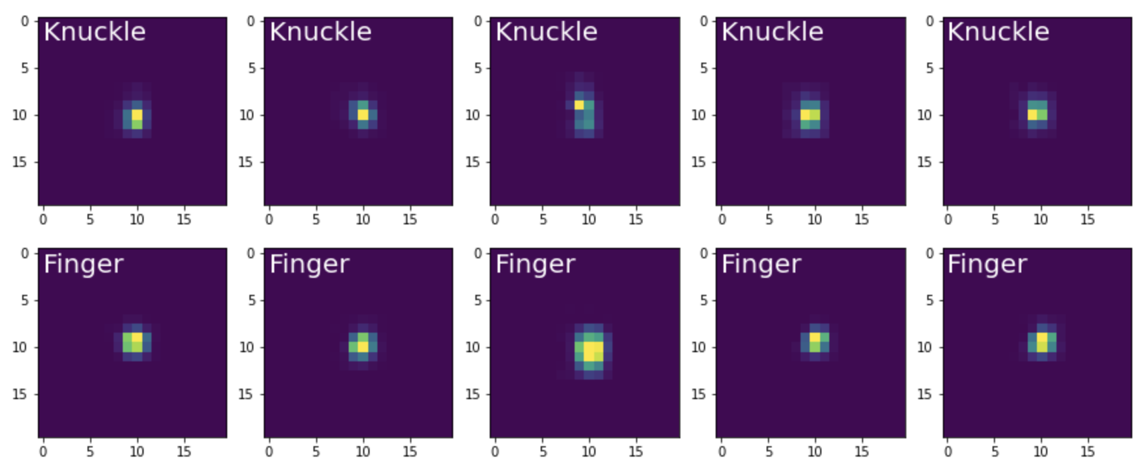
Feature Engineering
Feature Engineering is often used for non NN ML e.g. SVM
Requires domain knowledge and “thinking” before training

Slide 3
Feature Engineering
Sum of pixels
Min/Max value
Ellipse fitting
Radius 1 & 2
Theta
Area of the Convex hull
…
… And others we can think of depending on our problem

Slide 4
Representation Learning
The data gets presented into the model without additional preprocessing
No domain knowledge
No thinking
The hope is that the model is doing the “thinking” for you

Slide 5
Pros and Cons
Feature Engineering
Reduced the input data
→ models can be smaller
→ more suitable for “traditional” ML models
Representation Learning
Raw data as input
→ the models needs to do more “work”
→ the model has to be larger
→ Harder to train
→ more suitable for NN models

Slide 6
Conclusion
Feature Engineering & Representation Learning
Feature Engineering
Representation Learning

Slide 7

License
This file is licensed under the Creative Commons Attribution-Share Alike 4.0 (CC BY-SA) license:
https://creativecommons.org/licenses/by-sa/4.0
Attribution: Sven Mayer

