Slide 1


Practical Machine Learning
Additional Layers

Slide 2
Convolutional Neural Network (CNN)

Slide 3
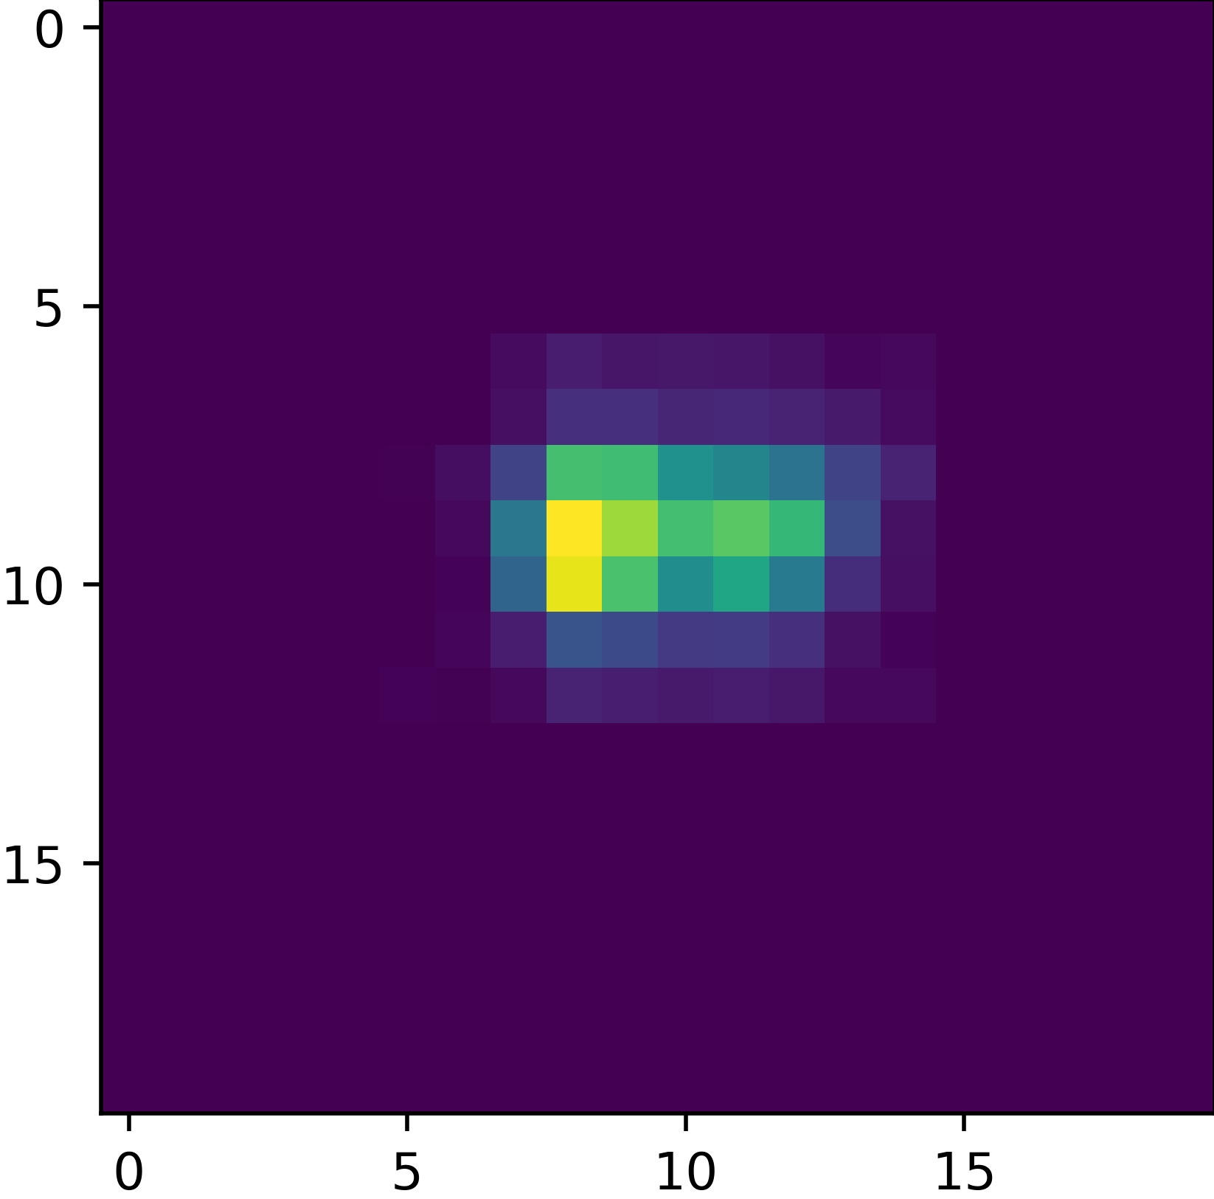


Convolutional Neural Network (CNN)
Filter
$$filter= \left[\begin{matrix}0.5 & 0.5 & 0.5 \\ 0.5 & 1 & 0.5 \\ 0.5 & 0.5 & 0.5\end{matrix}\right]$$

Slide 4

Convolutional Neural Network (CNN)
Process
$$filter= \left[\begin{matrix}0.5 & 0.5 & 0.5 \\ 0.5 & 1 & 0.5 \\ 0.5 & 0.5 & 0.5\end{matrix}\right]$$
0
$$A ∙filter$$

Slide 5
Convolutional Neural Network (CNN)
Process
$$filter= \left[\begin{matrix}0.5 & 0.5 & 0.5 \\ 0.5 & 1 & 0.5 \\ 0.5 & 0.5 & 0.5\end{matrix}\right]$$
0
0
$$A ∙filter$$

Slide 6
Convolutional Neural Network (CNN)
Process
$$filter= \left[\begin{matrix}0.5 & 0.5 & 0.5 \\ 0.5 & 1 & 0.5 \\ 0.5 & 0.5 & 0.5\end{matrix}\right]$$
0
0
$$A ∙filter$$

Slide 7
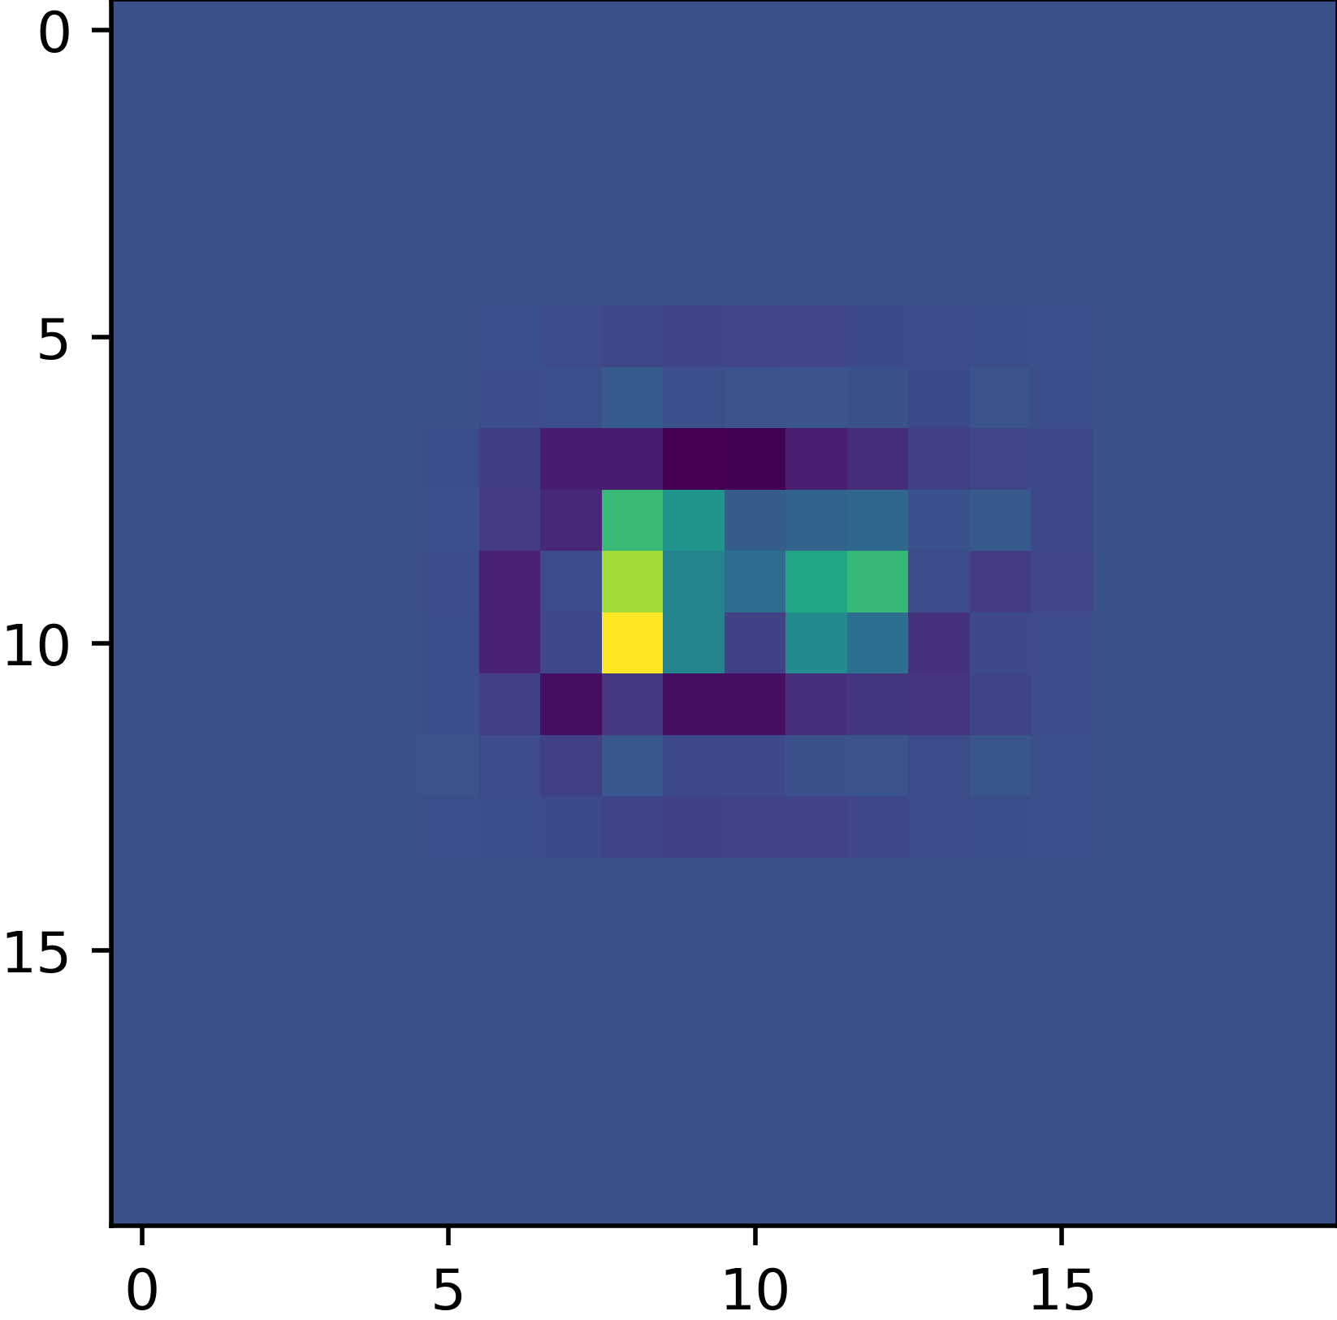
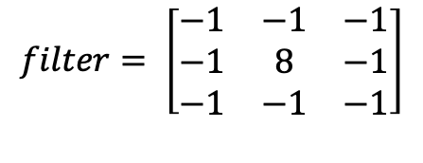
Convolutional Neural Network (CNN)
Filter – Edge Detection Example
$$filter= \left[\begin{matrix}−1 & −1 & −1 \\ −1 & 8 & −1 \\ −1 & −1 & −1\end{matrix}\right]$$

Slide 8

Convolutional Neural Network (CNN)
tf.keras.layers.Conv2D(filters, kernel_size, strides=(1, 1), padding='valid’, ….)
Filter count
Kernel size e.g. (3x3)
Step length (strides) e.g. (1,1)
Padding
$$filter= \left[\begin{matrix}w_{0,0} & ⋯ & w_{0,m} \\ ⋮ & ⋱ & ⋮ \\ w_{n,0} & ⋯ & w_{n,m}\end{matrix}\right]$$
During the learning the model learns the $w$’s of each filter.
Constraints:
Shaped Input
Shaped Output

Slide 9
Pooling Layer

Slide 10
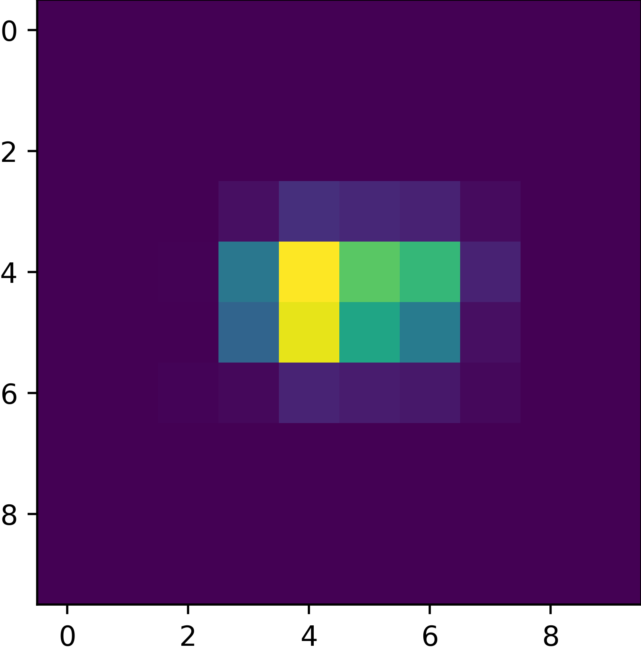
Max Pooling Layer
Kernel size e.g. (2x2)
Max value within the filter
0
0
9
0
9
(20x20)
(10x10)

Slide 11
Batch Normalization

Slide 12
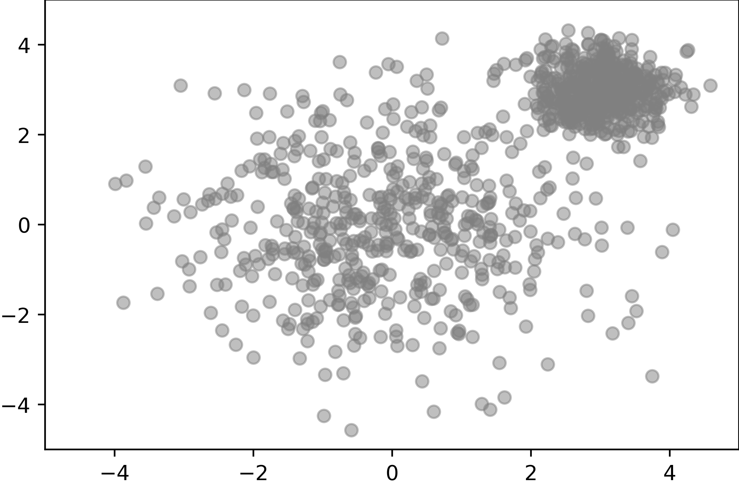
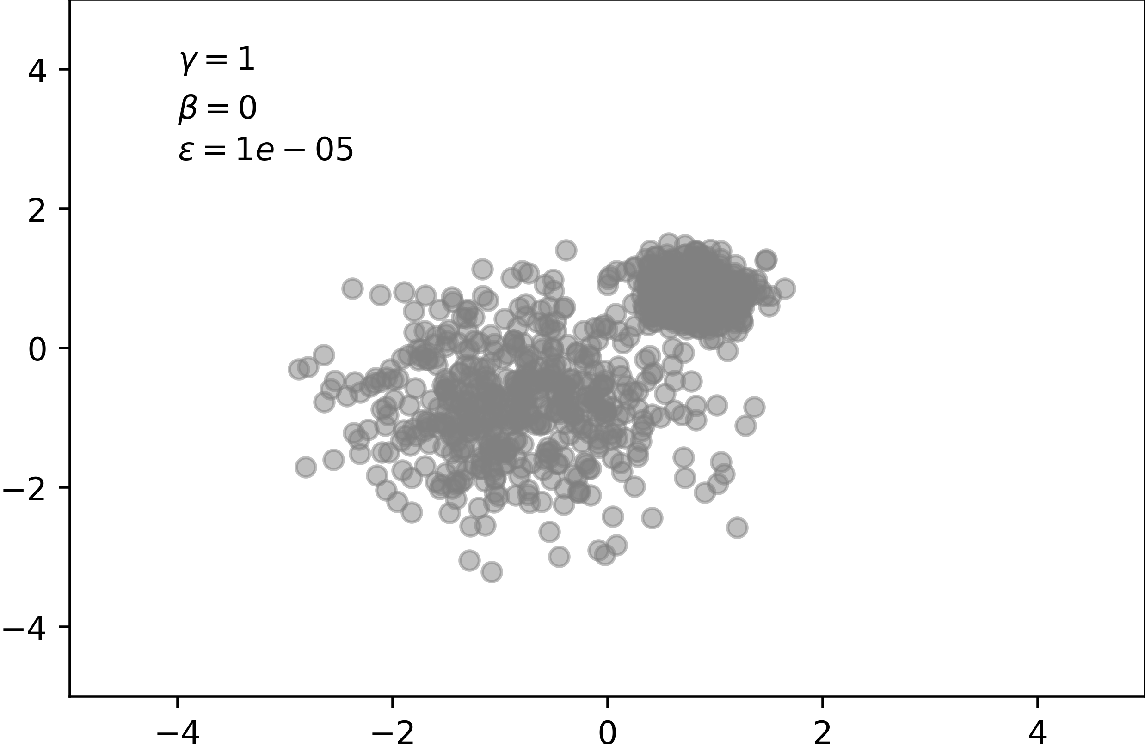
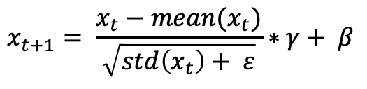
Batch Normalization
$$x_{t+1}= \frac{x_{t}−mean(x_{t})}{\sqrt{std\left(x_{t}\right)+ ε}}∗γ+ β$$
tf.keras.layers.BatchNormalization
Improves training
Often speeds up training
Ioffe and Szegedy 2015 https://arxiv.org/abs/1502.03167

Slide 13
Dropout

Slide 14
Dropout
Reduces overfitting
2
Dropout .25
8
Dropout layer reduces the likelihood to relay on one single “feature” as sometimes its not active.

Slide 15
What can we do now?

Slide 16
Example Model
model = Sequential()
model.add(InputLayer((28,28,1), name = "InputLayer"))
model.add(Conv2D(filters=128, kernel_size=(3,3), activation='relu', padding='same'))
model.add(MaxPool2D())
model.add(Dropout(rate=0.25))
model.add(Conv2D(64, kernel_size=(3,3), activation='relu', padding='same'))
model.add(MaxPool2D())
model.add(BatchNormalization())
model.add(Flatten())
model.add(Dense(128, name = "HiddenLayer1", activation='relu'))
model.add(Dense(64, name = "HiddenLayer2", activation='relu'))
model.add(Dense(2, name = "OutputLayer", activation=softmax'))
new layer Flatten needed after Conv2D to use a Dense next – similar to reshape

Slide 17
Conclusion
Layers
Convolutional Neural Network (CNN)
Max Pooling
Batch Normalization
Dropout

Slide 18

License
This file is licensed under the Creative Commons Attribution-Share Alike 4.0 (CC BY-SA) license:
https://creativecommons.org/licenses/by-sa/4.0
Attribution: Sven Mayer

