Slide 1


Practical Machine Learning
Optimizer and Hyperparameter

Slide 2
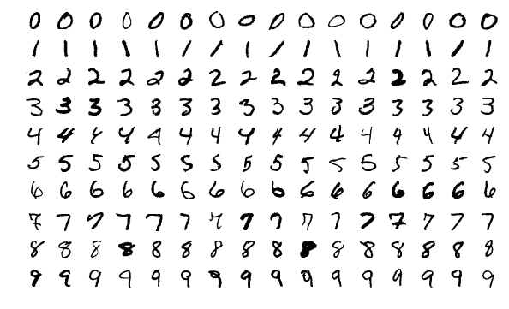
Impact of Hyperparameter on the Models
MNIST data as showcase

Slide 3
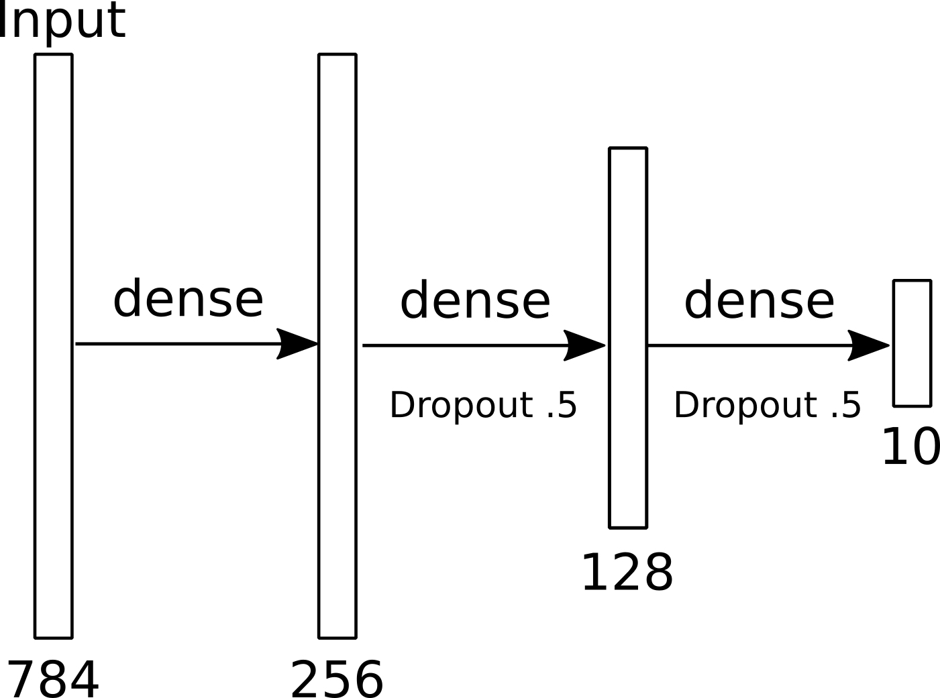
Test Model

Slide 4
Optimizer

Slide 5
Optimizer
The optimizer is an algorithm that decided on how to adjust the weights and biases during backpropagation. This is done by minimizing the cost described by the loss function.

Slide 6
Optimizer
Adadelta (2012 https://arxiv.org/abs/1212.5701)
Adagrad (2011 https://www.jmlr.org/papers/volume12/duchi11a/duchi11a.pdf )
Adam (v1: 2014 v9: 2017 https://arxiv.org/abs/1412.6980 )
Adamax (version of Adam https://arxiv.org/abs/1412.6980 )
FTRL (2013 https://research.google.com/pubs/archive/41159.pdf)
Nadam (2015 http://cs229.stanford.edu/proj2015/054_report.pdf)
Root Mean Square Propagation (RMSprop) (2012 http://www.cs.toronto.edu/~tijmen/csc321/slides/lecture_slides_lec6.pdf)
Stochastic gradient descent (SGD)

Slide 7
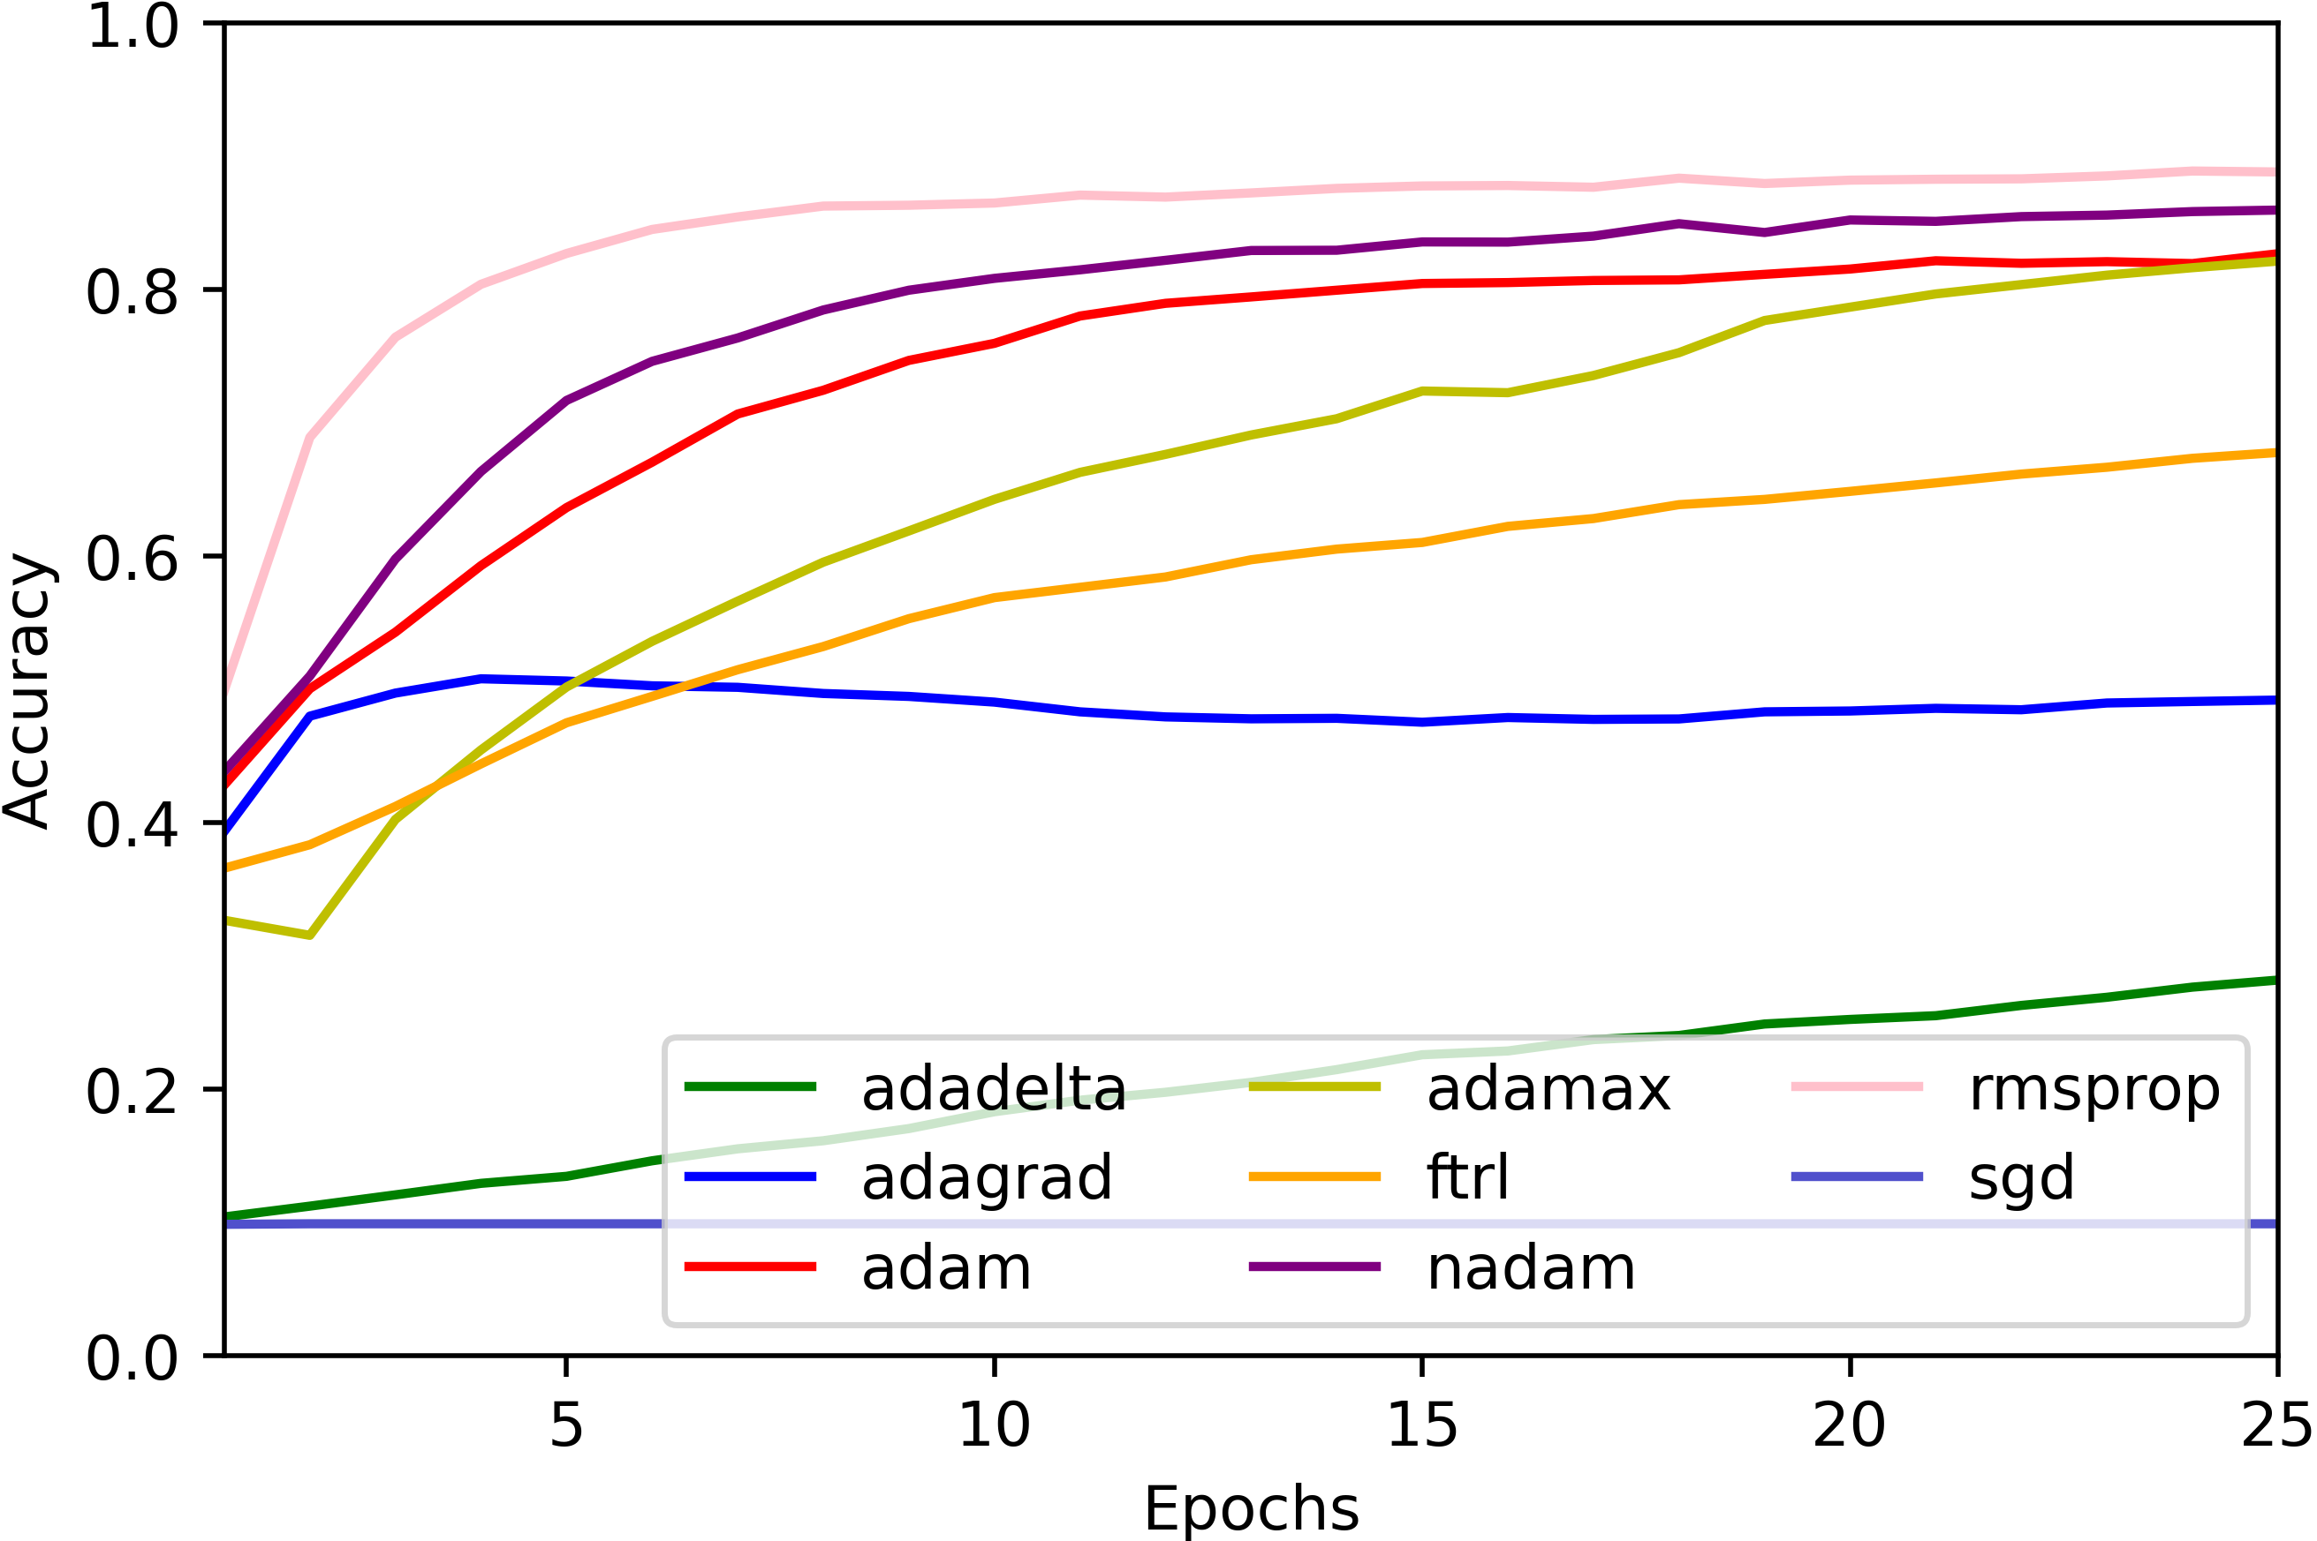
Optimizer Test
With default settings
2 dense layers with dropput tested on a subset of the MNIST dataset

Slide 8
Learning Rate

Slide 9
Learning Rate
The learning rate is the rate on how much the optimizer adjusts the weights and biases in each backpropagation step.

Slide 10
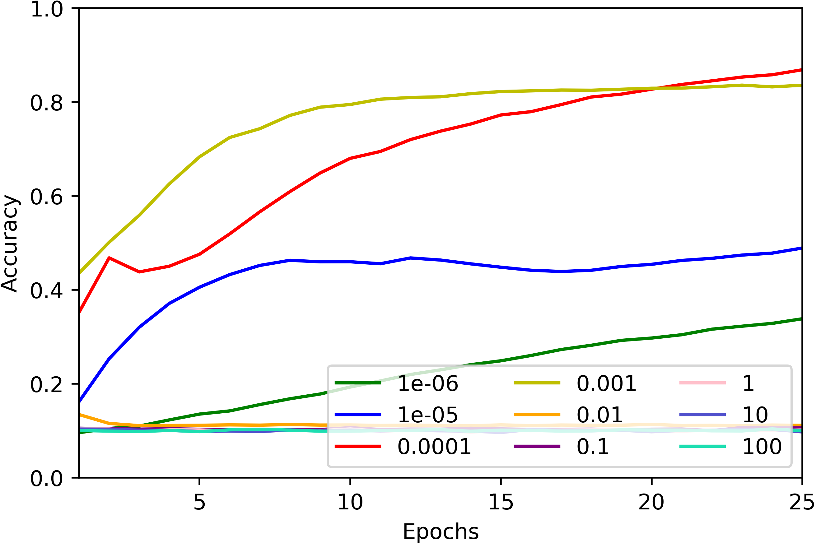
Learning Rate Test
Effect of the Initial Learning Rate Using Adam
2 dense layers with dropput tested on a subset of the MNIST dataset

Slide 11
Adaptive Learning Rate
Learning rate decay over time
Learning rate decay on no change (plateau)
Use of “momentum” to accelerate training

Slide 12
Loss Function

Slide 13
Loss Function
A loss function (cost function) is a function to determine how different the prediction is with respect to the ground truth. The optimizer's goal is to minimize the loss.

Slide 14
Loss Functions
Discrete Data
  Binary Cross Entropy
  Categorical Cross Entropy
  Hinge loss
Continues Data
  Mean Absolute Error (MAE) (also know as L1 Loss)
  Mean Squared Error (MSE) (also know as L2 Loss)
  Mean Squared Logarithmic Error

Slide 15
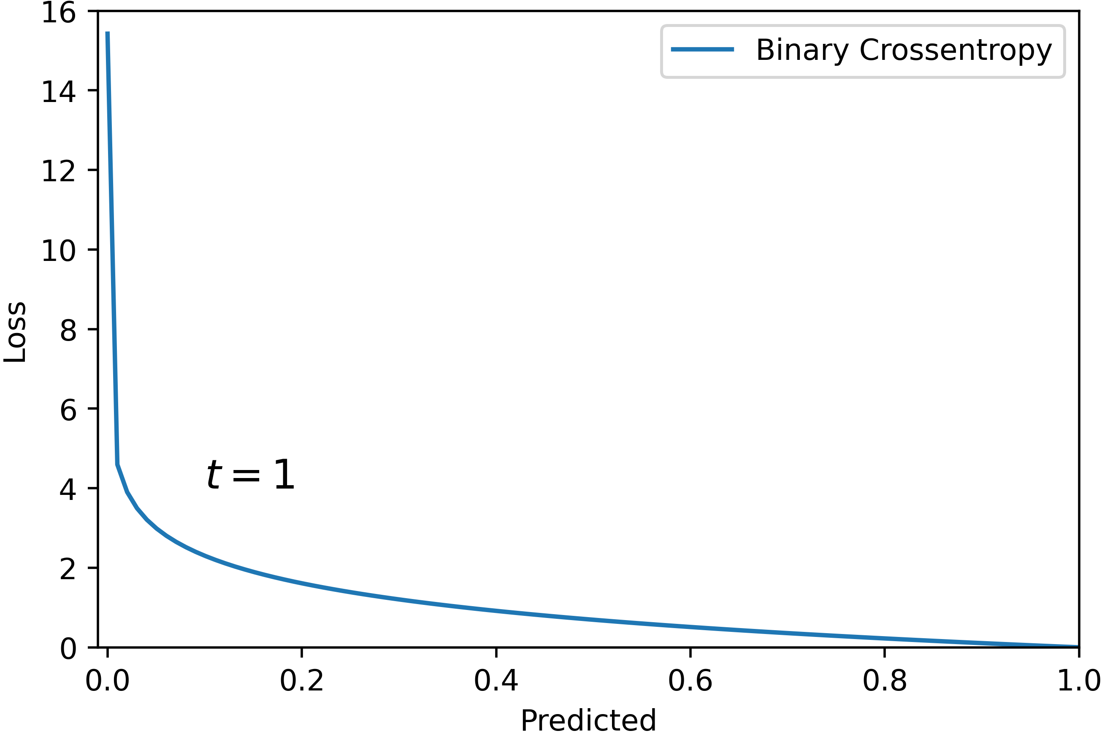
Loss Functions
Classificaion

Slide 16
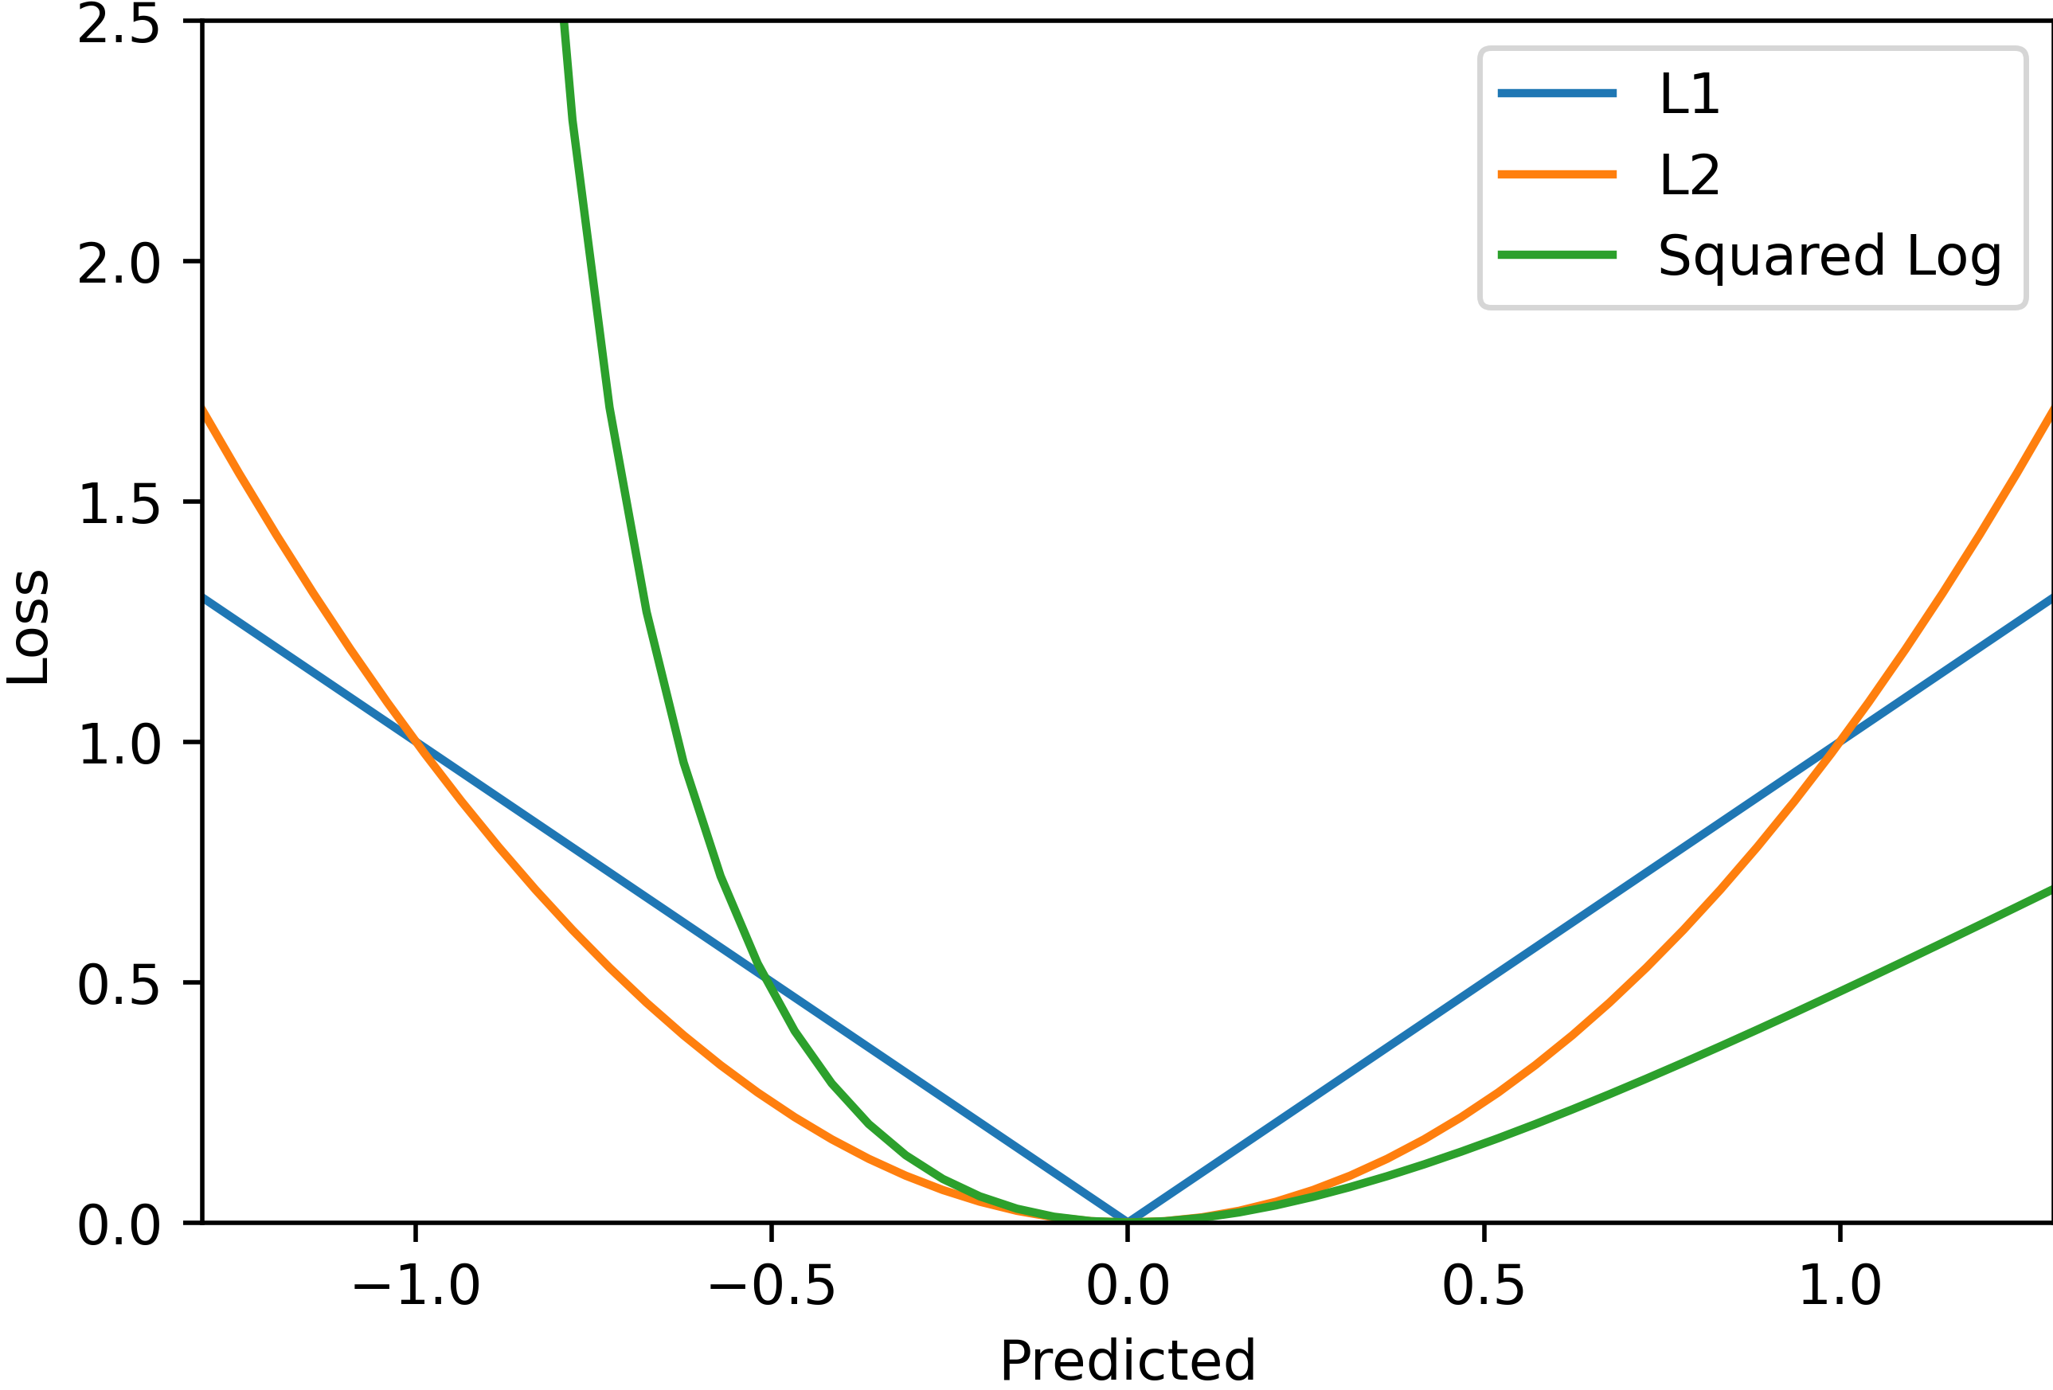
Loss Functions
Regression

Slide 17

Loss Functions
Advanced Loss
Pixel-wise loss
Feature matching (FM), e.g. [1]
$$loss=λ_{1}∗MSE+ λ_{2}∗FM$$
In the image domain, such approaches are used to
counteract blurry images.
[1] Florian Schroff, Dmitry Kalenichenko, James Philbin; Proceedings of the IEEE Conference on Computer Vision and Pattern Recognition (CVPR), 2015, pp. 815-823

Slide 18
Conclusion
Layers
Optimizer
Learning Rate
Adaptive Learning Rate
Loss Function

Slide 19

License
This file is licensed under the Creative Commons Attribution-Share Alike 4.0 (CC BY-SA) license:
https://creativecommons.org/licenses/by-sa/4.0
Attribution: Sven Mayer

