Slide 1


Practical Machine Learning
Recurrent Neural Network and Long Short-Term Memory

Slide 2
Model Layers
Dense Layer
  No specific relationship between inputs
CNN Layer
  Budling an understanding by looking at neighboring inputs in an n-dimensional input

Slide 3
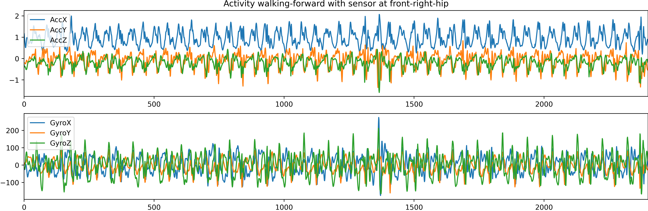
Sequence Data
Time Series Data
Natural Language
Data Source: https://dl.acm.org/doi/10.1145/2370216.2370438

Slide 4
Recurrent Neural Network (RNN)

Slide 5



Recap Perceptron
Perceptron
$$x$$
$$a(x)$$
$$y$$

Slide 6



Recurrent Neural Network (RNN)
Perceptron
$$x$$
$$a(x)$$
$$y$$
RNN Unit
$$x$$
$$a(x)$$
$$y$$
Hidden State

Slide 7
















Recurrent Neural Network
Unrolled Recurrent Neural Network
$$x_{0}$$
$$a(x)$$
$$y_{0}$$
$$x$$
$$a(x)$$
$$y$$
$$x_{1}$$
$$a(x)$$
$$y_{1}$$
$$x_{2}$$
$$a(x)$$
$$y_{2}$$
$$⋮$$
$$⋮$$
$$⋮$$
$$x_{n}$$
$$a(x)$$
$$y_{n}$$

Slide 8





Recurrent Neural Network
$$y_{t}$$
$$h_{t−1}$$
$$h_{t}$$
$$tanh$$
$$x_{t}$$

Slide 9
Recurrent Neural Network
Each state gets the “recent” information
Long-term dependencies gets lost
$$x_{0}$$
$$a(x)$$
$$y_{0}$$
$$x_{1}$$
$$a(x)$$
$$y_{1}$$
$$x_{2}$$
$$a(x)$$
$$y_{2}$$
$$⋮$$
$$⋮$$
$$⋮$$
$$x_{n}$$
$$a(x)$$
$$y_{n}$$

Slide 10
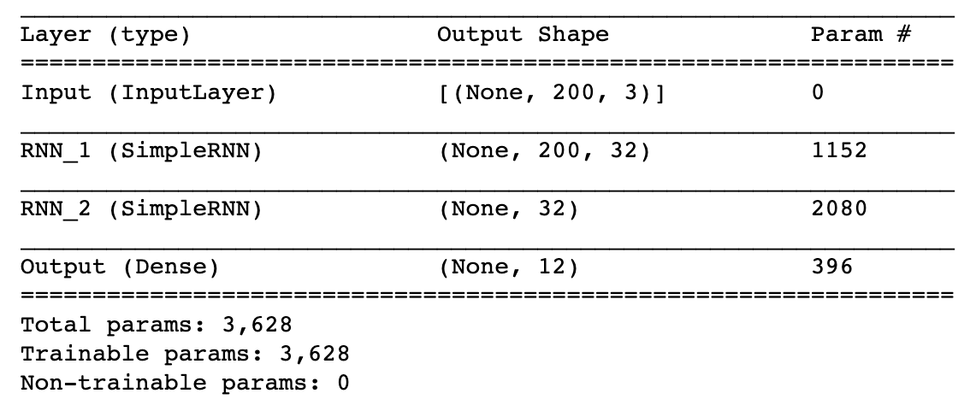
RNN in TensorFlow
Two RNN layer using a fixed window length
inputs = Input(shape=(WINDOW_LENGTH, 3), name="Input")
x = SimpleRNN(32, name="RNN_1", return_sequences=True)(inputs)
x = SimpleRNN(32, name="RNN_2")(x)
prediction = Dense(len(classes), activation="softmax", name="Output")(x)
model_functional = tf.keras.Model(inputs = inputs, outputs = prediction)
model_functional.summary()

Slide 11
Long Short-Term Memory (LSTM)

Slide 12
Long Short-Term Memory (LSTM)
$$x_{0}$$
$$a(x)$$
$$y_{0}$$
$$x_{1}$$
$$a(x)$$
$$y_{1}$$
$$x_{2}$$
$$a(x)$$
$$y_{2}$$
$$⋮$$
$$x_{n}$$
$$a(x)$$
$$y_{n}$$
Sepp Hochreiter, and Schmidhuber Jürgen. "Long short-term memory.” Neural computation (1997).

Slide 13













Long Short-Term Memory (LSTM)
$$y_{t}$$
$$C_{t−1}$$
$$C_{t}$$
$$×$$
$$+$$
$$×$$
$$tanh$$
$$σ$$
$$σ$$
$$tanh$$
$$h_{t−1}$$
$$h_{t}$$
$$σ$$
$$×$$
$$x_{t}$$
Credit: http://colah.github.io/posts/2015-08-Understanding-LSTMs/

Slide 14
Long Short-Term Memory (LSTM)
$$y_{t}$$
$$C_{t−1}$$
$$C_{t}$$
$$×$$
$$+$$
$$×$$
$$tanh$$
“Forget Gate”
$$σ$$
$$σ$$
$$tanh$$
$$h_{t−1}$$
$$h_{t}$$
$$σ$$
$$×$$
$$x_{t}$$
“Input Gate”

Slide 15
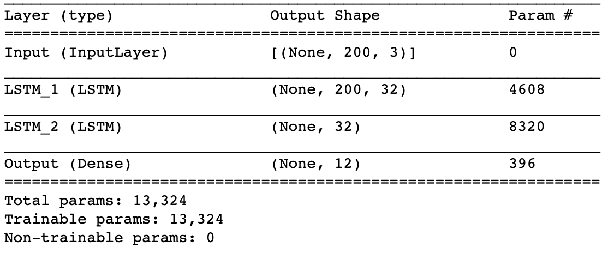
LSTM in TensorFlow
Two RNN layer using a fixed window length
inputs = Input(shape=(WINDOW_LENGTH, 3), name="Input")
x = LSTM(32, name="LSTM_1", return_sequences=True)(inputs)
x = LSTM(32, name="LSTM_2")(x)
prediction = Dense(len(classes), activation="softmax", name="Output")(x)
model_functional = tf.keras.Model(inputs = inputs, outputs = prediction)
model_functional.summary()

Slide 16
Conclusion
Recurrent Neural Network and Long Short-Term Memory
Processing sequence data using neuronal networks
Recurrent Neural Network (RNN)
Long Short-Term Memory (LSTM)
Variations
  Gated Recurrent Unit (GRU) [1]
[1] Cho, Kyunghyun, et al. "Learning phrase representations using RNN encoder-decoder for statistical machine translation." arXiv preprint arXiv:1406.1078 (2014).

Slide 17

License
This file is licensed under the Creative Commons Attribution-Share Alike 4.0 (CC BY-SA) license:
https://creativecommons.org/licenses/by-sa/4.0
Attribution: Sven Mayer

