Slide 1
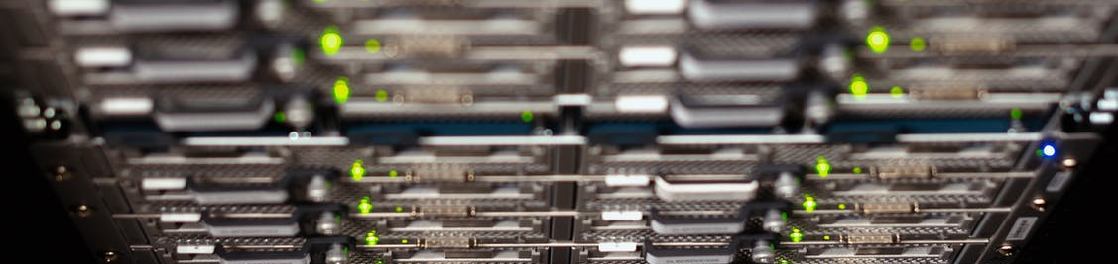

Practical Machine Learning
Generative Adversarial Network

Slide 2
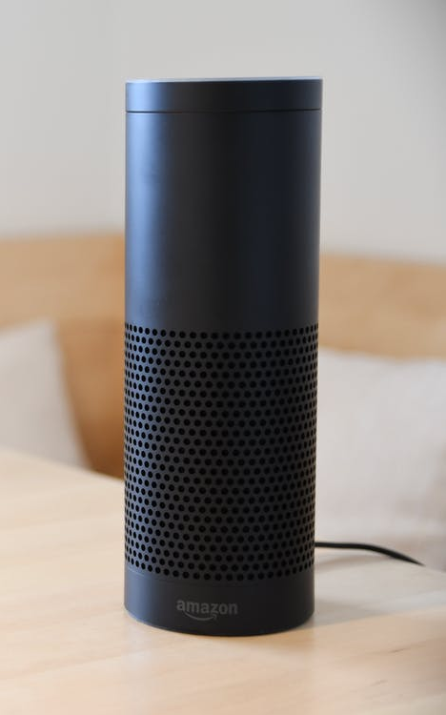
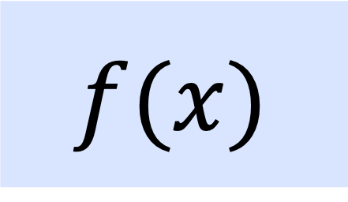
Generative Adversarial Network (GAN)
$$f(x)$$
speaker
GAN

Slide 3
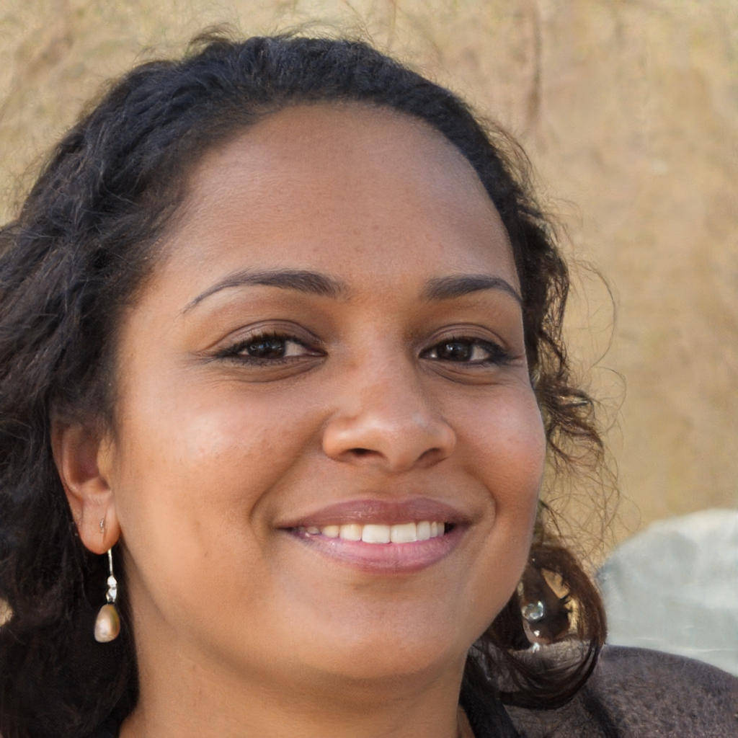
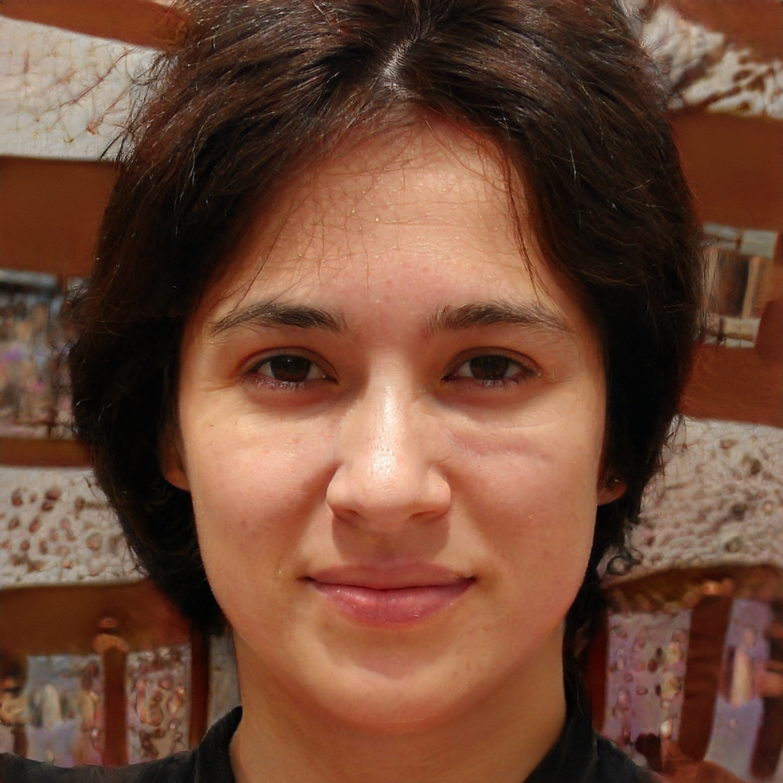

Face Generation
Source: https://thispersondoesnotexist.com/
Karras, Tero, et al. "Analyzing and improving the image quality of stylegan." Proceedings of the IEEE/CVF Conference on Computer Vision and Pattern Recognition. 2020. DOI: https://arxiv.org/abs/1912.04958

Slide 4
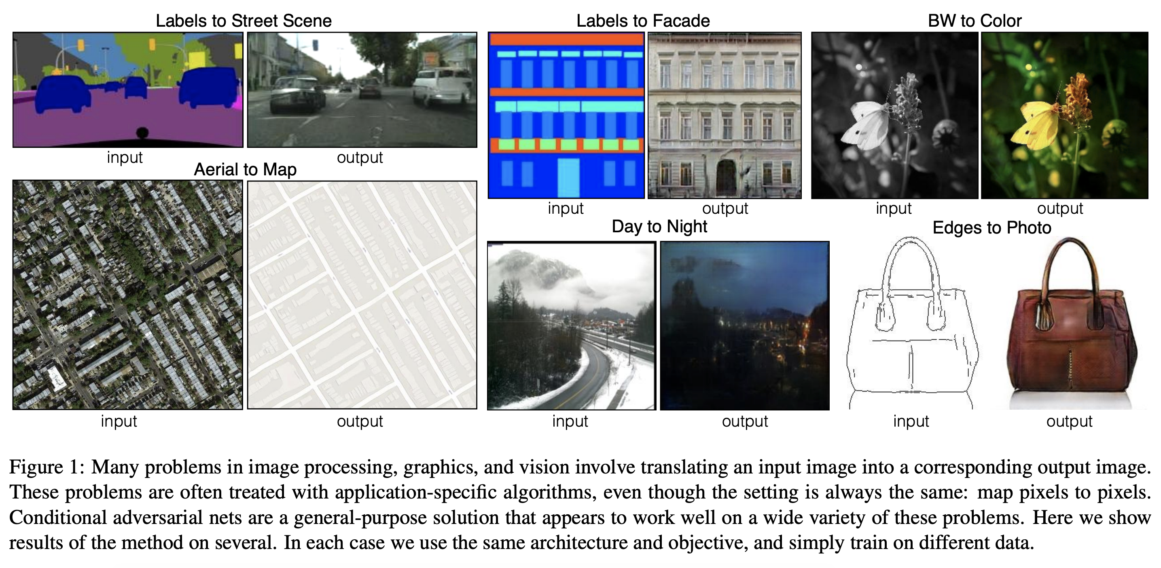
Style Transfer
Isola, Phillip, et al. "Image-to-image translation with conditional adversarial networks." Proceedings of the IEEE conference on computer vision and pattern recognition. 2017. DOI: https://arxiv.org/abs/1611.07004

Slide 5
Generative Adversarial Network
Create Data
Style Transfer
Increase Image Resolution (super-resolution)
…

Slide 6




Generative Adversarial Network
Generator
Generator Loss
$$r$$
$$y′$$
random vector $(r$)
Discriminator
Discriminator Loss
$$y$$

Slide 7
Generative Adversarial Network
Generates a new sample
Generator
Generator Loss
$$r$$
$$y′$$
random vector $(r$)
Discriminator
Discriminator Loss
$$y$$
Is the sample real or fake?

Slide 8
Generator Training
Backpropagation Generator
Generator
Generator Loss
$$r$$
$$y′$$
random vector $(r$)
Discriminator
Discriminator Loss
$$y$$
*
* Frozen model

Slide 9
Discriminator Training
Generator
Generator Loss
$$r$$
*
$$y′$$
random vector $(r$)
Discriminator
Discriminator Loss
$$y$$
Backpropagation Discriminator
* Frozen model

Slide 10
Training
During the training process the generator and the discriminator improve each other by both getting better each trying to outperform the other model.

Slide 11
What is a good Generator?
In the end the generator is should be so good to fool the discriminator. Thus, the discriminator needs to guess fake or real (accuracy is ~.5).

Slide 12
Conclusion
Generative Adversarial Network
Generator
Discriminator
Generator tries to outperform the Discriminator to detect is if it is a real or fake image

Slide 13

License
This file is licensed under the Creative Commons Attribution-Share Alike 4.0 (CC BY-SA) license:
https://creativecommons.org/licenses/by-sa/4.0
Attribution: Sven Mayer

