Slide 1
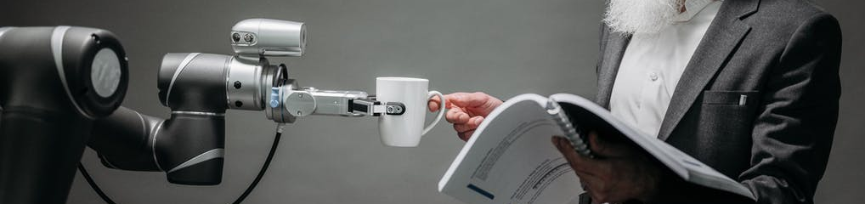

Practical Machine Learning
Reinforcement Learning

Slide 2
Supervised Learning
VGG16 Model
1000 Classes
e.g. milk, traffic light, printer
Input Image
224 x 244 x 3
Labeled Data Needed
The model can not be better then the labels

Slide 3
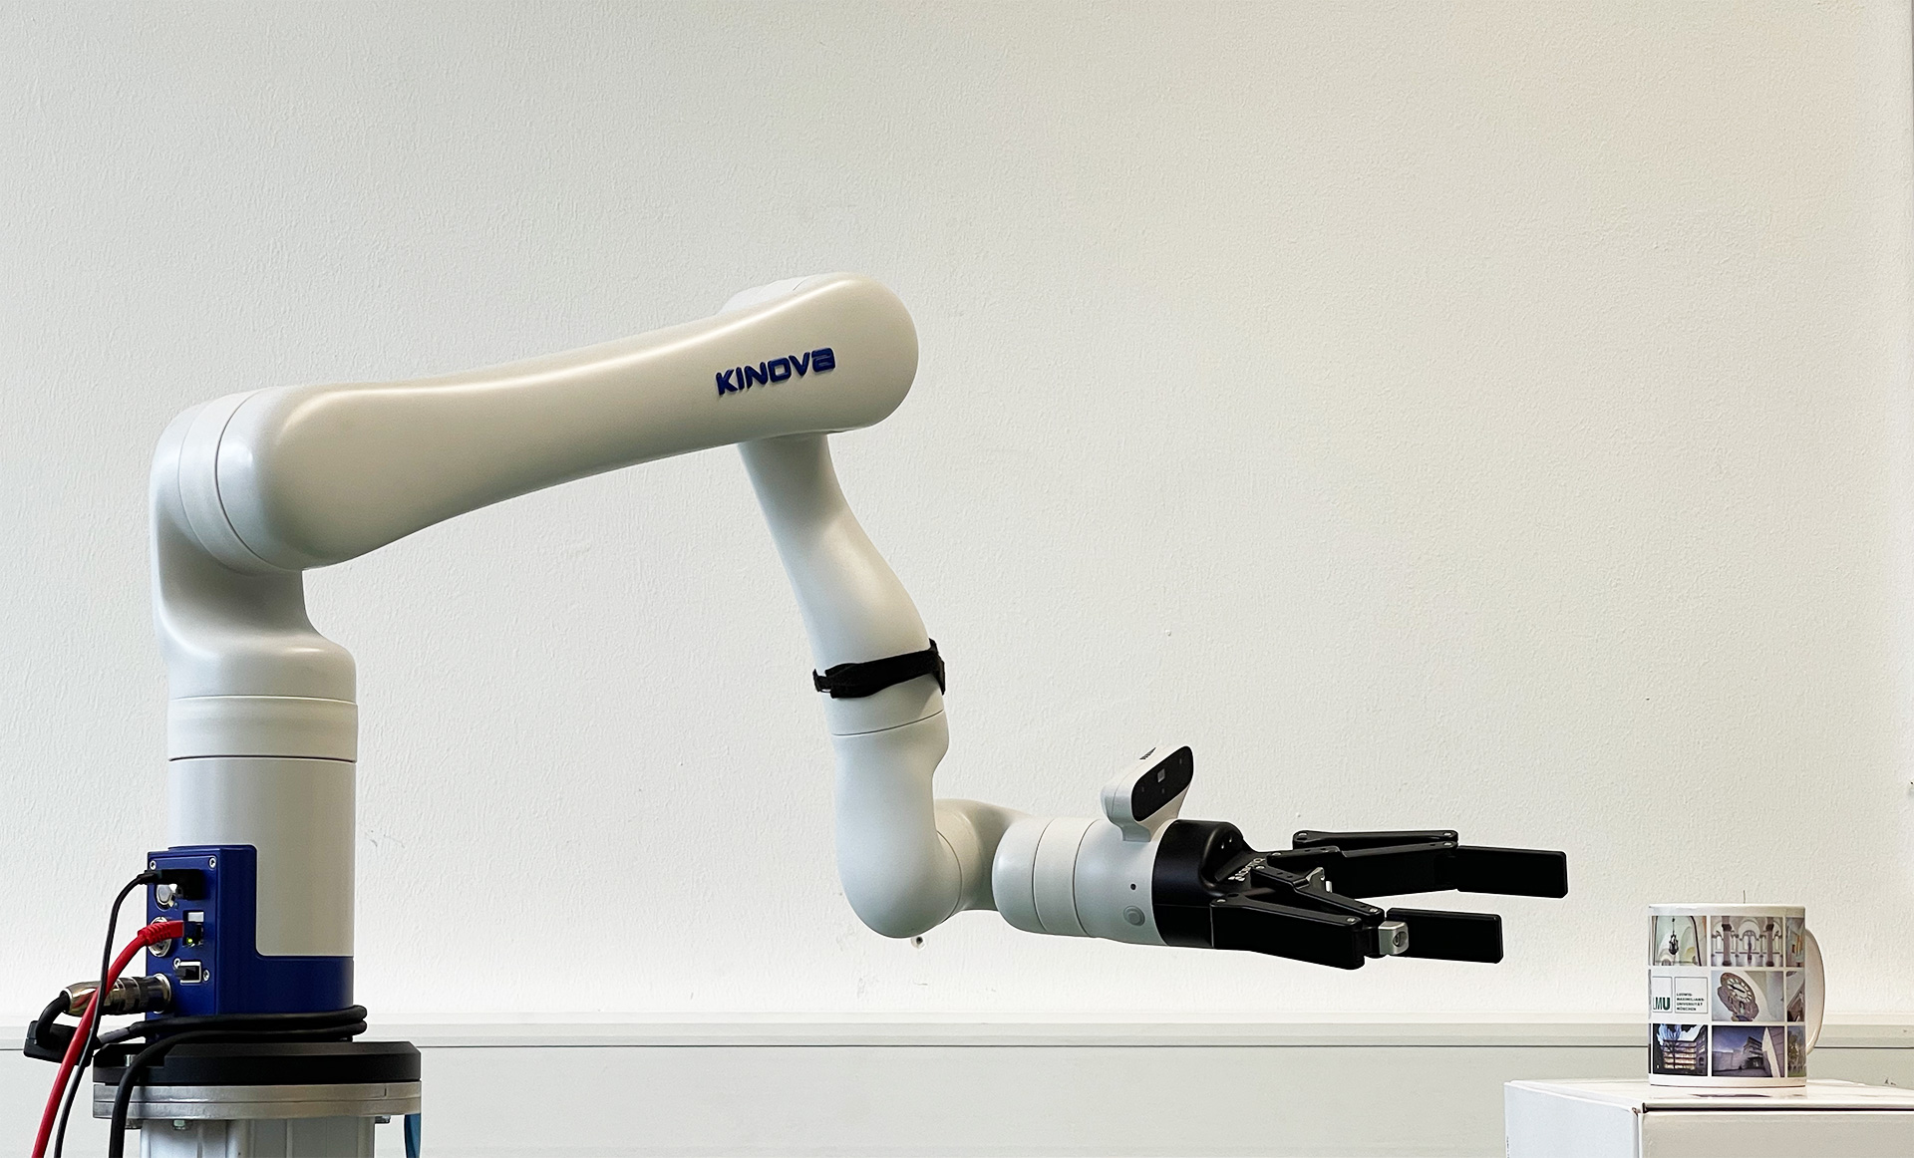
Pick Up the Cup

Slide 4
Learning Strategies
Supervised Learning
Unsupervised Learning
Reinforcement learning

Slide 5
Learning Strategies
Supervised Learning
Unsupervised Learning
Reinforcement learning

Slide 6
Reinforcement Learning
Learning from the environment what works
by getting positive feedback/reward

Slide 7
Reinforcement Learning
Agent

Slide 8
Reinforcement Learning
Agent
Environment

Slide 9

Reinforcement Learning
Agent
Environment
Action ($a$)

Slide 10

Reinforcement Learning
Agent
Environment
Action ($a$)
State ($s$)

Slide 11

Reinforcement Learning
Reward ($r$)
Agent
Environment
Action ($a$)
State ($s$)

Slide 12

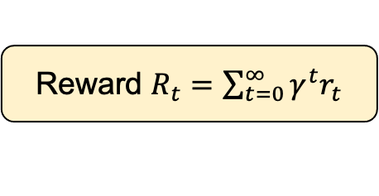

Reinforcement Learning
Reward ($r$)
Policy $π\left(s, a\right)$
Agent
Environment
Action ($a$)
State ($s$)
Reward $R_{t}=\sum_{t=0}^{∞}{γ^{t}r_{t}}$
$γ$ = Discount factor

Slide 13
Credit Assignment Problem
Which of the action contributed to getting the reward?
Minsky, M. (1961). Steps toward artificial intelligence. Proceedings of the IRE, 49(1), 8-30.

Slide 14

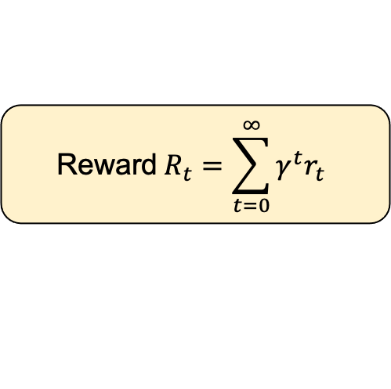
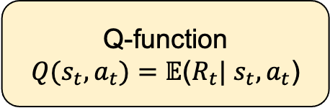
Q – Learning
Reward ($r$)
Policy $π\left(s, a\right)$
Agent
Environment
Action ($a$)
State ($s$)
$$\text{Reward} R_{t}=\sum_{t=0}^{∞}{γ^{t}r_{t}}$$
Q-function
$Q(s_{t}, a_{t})=𝔼$($R_{t}| s_{t}, a_{t}$)
$γ$ = Discount factor

Slide 15
Deep Q Networks (DQN)
State (𝑠)
Deep
NN
Q(s, a)
Action
The goal is to approximate the Q-function

Slide 16

Deep Q Networks
State (𝑠)
Deep
NN
Q(s, a)
Action
Q(s, a₀)
Q(s, a₁)
State (𝑠)
Deep
NN
$$⋮$$
Q(s, a_{n})

Slide 17

Credit: https://www.youtube.com/watch?v=TmPfTpjtdgg
Mnih, Volodymyr, Koray Kavukcuoglu, David Silver, Andrei A. Rusu, Joel Veness, Marc G. Bellemare, Alex Graves et al. "Human-level control through deep reinforcement learning." nature 518, no. 7540 (2015): 529-533.

Slide 18
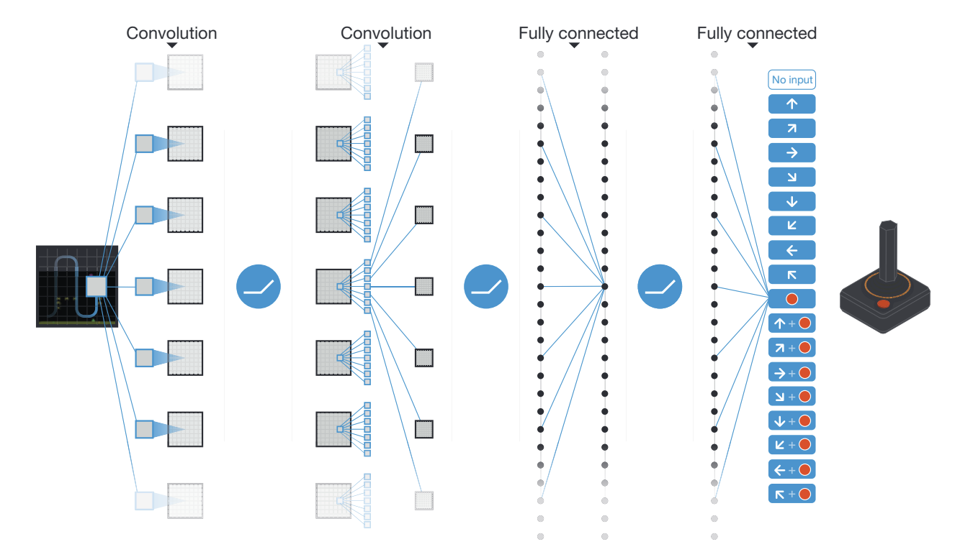
Deep Reinforcement Learning
Mnih, Volodymyr, Koray Kavukcuoglu, David Silver, Andrei A. Rusu, Joel Veness, Marc G. Bellemare, Alex Graves et al. "Human-level control through deep reinforcement learning." nature 518, no. 7540 (2015): 529-533.

Slide 19
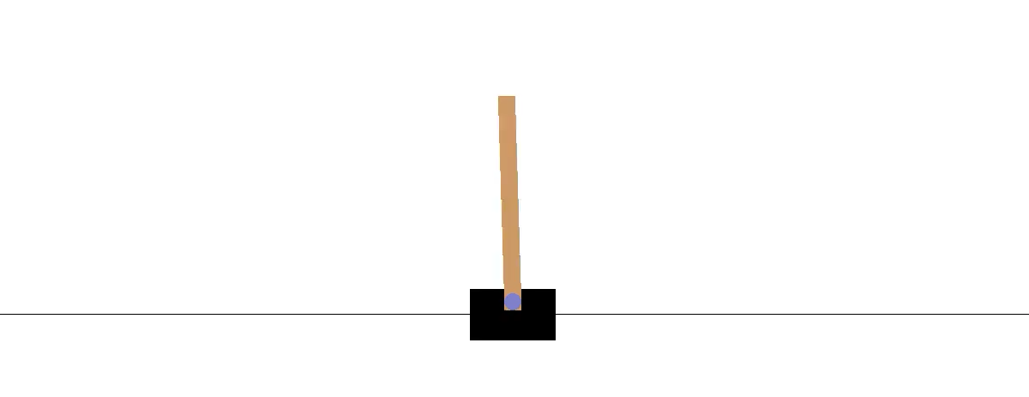
Exercise
https://github.com/tensorflow/agents/blob/master/docs/tutorials/1_dqn_tutorial.ipynb

Slide 20
Conclusion
Reinforcement Learning
What is Reinforcement Learning?
Agent in environments
Policy for next action
Learning from reward
Using Deep Neuronal Networks in RL
Deep Q Learning
Next steps: Policy Gradient
… and many more approaches

Slide 21

License
This file is licensed under the Creative Commons Attribution-Share Alike 4.0 (CC BY-SA) license:
https://creativecommons.org/licenses/by-sa/4.0
Attribution: Sven Mayer

