Slide 1
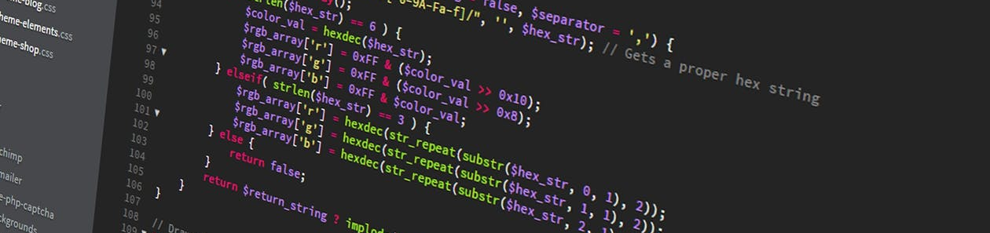
Tutorial Practical Machine Learning
Session 1: Organization & Getting Started

Slide 2
Organization

Slide 3


Who Are We?
Jesse Grootjen
PhD Student
Maximiliane Windl
PhD Student
Tutorial Practical Machine Learning

Slide 4
Organization Tutorials
Time: Fridays, 10 – 12 c.t.
Format: → Live coding sessions
→ Project ideation/pitches
→ Please participate (ask questions, write in chat, …)
Zoom-Link: uni2work
Material: https://uni2work.ifi.lmu.de/course/S21/IfI/PML
Website: http://sven-mayer.com/pml/
Tutorial Practical Machine Learning

Slide 5
Exam
The exam will consist of two parts:
Your practical projects in teams of 3 to 5 students (1/2 of final grade)
An online oral exam of 10 minutes (1/2 of final grade)
Tutorial Practical Machine Learning

Slide 6
Final Projects
You will practically apply what you have learned in the course
You will develop the project in groups of 3 to 5 students
You will need to hand in a contribution statement explaining for which parts of the project you were responsible
Be creative and rather do not try to improve already existing systems
Building large data sets from scratch is hard! Try using existing ones
You will present your projects iteratively in project pitches
You can ask questions/ask for help in the tutorials or send an email
Project ideation: 11.06. (Tutorial)
Final presentations: 15.07. (Lecture) and 16.07. (Tutorial, only if necessary)
Tutorial Practical Machine Learning

Slide 7
Overview Tutorial
23.04.2021 Organization & Getting Started
30.04.2021 Live Coding Session: Getting Started with Traditional ML
07.05.2021 Live Coding Session: Getting Started with Neuronal Networks
14.05.2021 canceled
21.05.2021 Live Coding Session: Deploying Models to Mobile Devices (Android)
28.05.2021 Live Coding Session: Continue
04.06.2021 canceled
11.06.2021 Project Ideation
18.06.2021 Individual Help for Projects
25.06.2021 Project Pitches: Show Current Project Status
02.07.2021 Individual Help for Projects
09.07.2021 How to give a great project presentation; Q&A: Exam preparation
16.07.2021 Final Presentation - only if necessary
Tutorial Practical Machine Learning

Slide 8
Get to Know Your Classmates
What is your name?
What is your study program?
Where are you?
Why did you enroll for this course?
What is your experience with Machine Learning?
What is the last song you listened to?
Breakout rooms (5 min)
Tutorial Practical Machine Learning

Slide 9
Getting Started

Slide 10
Python
Windows
Open a browser window and navigate to https://www.python.org/downloads/windows/
Under the “Python Releases for Windows” heading, download Python 3.8.0
Run the installer
MacOS
Open a browser window and navigate to https://www.python.org/downloads/mac-osx/
Under the “Python Releases for Mac OS X” heading, download Python 3.8.0
Run the installer
Or use Homebrew: brew install python3
Detailed installation instructions: https://realpython.com/installing-python/
Tutorial Practical Machine Learning

Slide 11
Installing The Machine Learning Environment
Install Anaconda/Virtual Environment (optional) https://www.anaconda.com/products/individual
Tensorflow: pip install --upgrade tensorflow
Keras: pip install keras
Detailed Instructions:
Windows: https://towardsdatascience.com/installing-keras-tensorflow-using-anaconda-for-machine-learning-44ab28ff39cb (you don‘t have to downgrade Python to 3.6 anymore!)
MacOS: https://margaretmz.medium.com/anaconda-jupyter-notebook-tensorflow-and-keras-b91f381405f8
Tutorial Practical Machine Learning

Slide 12
Jupyter Notebooks
Open source web application to create and share documents that contain live code, equations, visualizations, and text
Uses the kernel that you chose when you started your Notebook
We start it with Python 3 as the kernel, so that means you can write Python code in your code cells
You can run the Notebook locally (comes pre-installed if you use anaconda) or simply use Google Colab
Detailed instructions: https://realpython.com/jupyter-notebook-introduction/
Tutorial Practical Machine Learning

Slide 13
Google Colab
Jupyter notebook based runtime environment which allows you to run code entirely in the cloud
All you need is a Google account and a web browser
Most general packages needed for machine learning come pre-installed
→ http://colab.research.google.com/
Tutorial Practical Machine Learning

Slide 14
Android Environment
Install latest version of Android Studio
→ https://developer.android.com/studio
Or install Jetbrains Toolbox to have all Jetbrains environments in one (they offer free student licenses)
→ https://www.jetbrains.com/community/education/#students
Tutorial Practical Machine Learning

Slide 15
Questions?

Slide 16

License
This file is licensed under the Creative Commons Attribution-Share Alike 4.0 (CC BY-SA) license:
https://creativecommons.org/licenses/by-sa/4.0
Attribution: Jesse Grootjen & Maximiliane Windl

